Slide 1
Presented by: Farahnaaz Khakoo-Mausel Ph.D
Progress Update Report
F

Slide 2
AGENDA
About The WGISTA
The WGISTA Objectives
The WGISTA Progress Updates, October 2024

Slide 3
A. About The WGISTA
26 Members
11 observers
Inaugural
Meeting
Annual
Meetings
2019
Established
at INCOSAI 2019
SAI UAE is Chair
and
U.S. GAO is Vice-Chair
New Incoming Chair in November 2024 SAI Egypt
26 members including Chair & Vice Chair, and 11 observers
Well represented from across INTOSAI regions
Professional bodies like AICPA, IIA as observers
Virtual Inaugural meeting held in 16th September, 2020
The 2nd annual meeting (virtual) was held in October 2021.
The 3rd annual meeting and 1st seminar were held in December 2022 in Abu Dhabi, UAE.

Slide 4
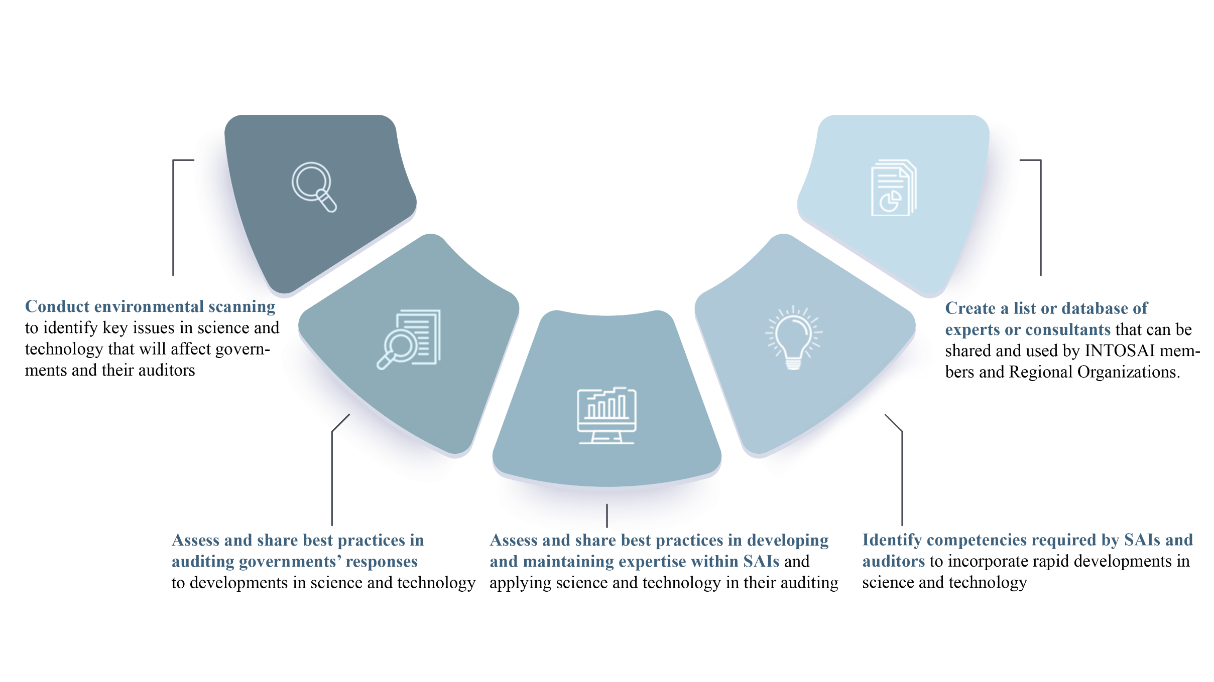
B. The 2019-2023 WGISTA Objectives

Slide 5
C. WGISTA Progress Updates, as of October 2024
Published two WGISTA reports in November 2023 available at https://wgista.uaeaa.gov.ae/en/Pages/Documents.aspx
Ongoing leadership transition from SAI UAE to SAI Egypt as Chair June 2024 to November 2024
WGISTA is working on a draft work plan for 2025-2026 August through December of 2024
Planning the 5th Annual meeting Spring of 2025

Slide 6
Thank You

