Slide 1
Update on KSC Activities

Slide 2
1. Launch of INTOSAI Community Portal
www.intosaicommunity.net

Slide 3
2. Update on Goal Chair Allocation - KSC portion

Slide 4
KSC FINANCIALS
KSC Goal Chair Allocation
KSC (Goal 3) Balance (December 2023): Euro 93,474.68
Proposed to approve fund allotment for
1. INTOSAI Community Portal
2. Working Groups
KSC (Goal 3) Receipts (2024): Euro 27,702.30

Slide 5
Goal Chair Allocation WG balances (Euros)
Working Group | 2023 | 2024
 | Balance | Allocation | Balance
WGITA | 6500 | 500 | 7000
WGBD | 1000 | 500 | 1500
WGFACML | 500 | 500 | 1000
WGEA | 6500 | 500 | 7000
WGEPPP | 1100 | 500 | 1600
WGVBS | 6500 | 500 | 7000
WGPD | 6500 | 500 | 7000
WGSDG & KSDI | 6500 | 500 | 7000
WGEI | 2500 | 500 | 3000
WGISTA | 6500 | 500 | 7000
WGFES | 6500 | 500 | 7000
WGPPA | 6500 | 500 | 7000

Slide 6
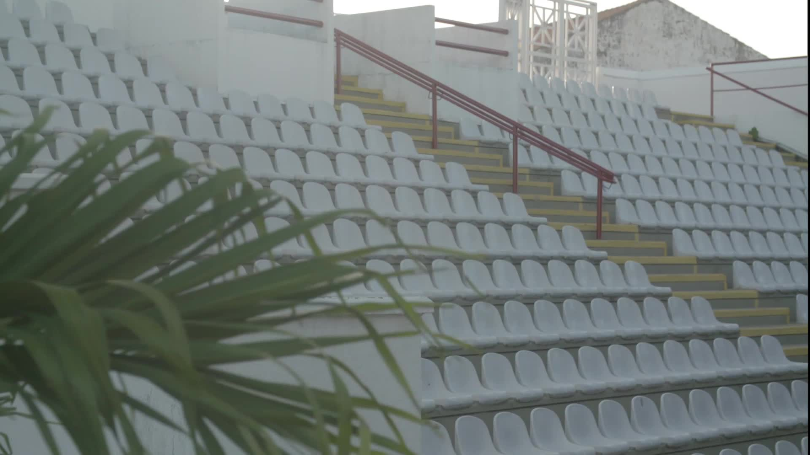
Venue of the 17th KSC SC meeting Venue: Hyderabad, India Date: 12 September 2025
Request participation of all KSC SC members and observers in the event

Slide 7
THANK YOU

