Slide 1
Agenda Item 8: Collaboration with INTOSAI Development Initiative (IDI)
16 KSC SC Meeting, Nairobi
Independent, credible and sustainable SAIs for better societies and improved lives

Slide 2
Overview of IDI’s support in 2023
Independent SAIs
Proactive and reactive advocacy
SIRAM in Montenegro, Poland.
Follow up in Sierra Leone, Ghana
Strengthened partnerships
Raising profile of independent SAIs
Well Governed SAIs
Pilot-SAI Governance Academy
Revision of SAI PMF Framework initiated
Third round of SPMR launched
Pilots finalised: TOGETHER (HR, ethics and inclusion), pICTure (ICT governance) and CRISP (risk and crisis management)
MASTERY outreach to Heads of SAIs on
PFM, SAI Independence and Inclusive
Leadership
Bilateral Support
Somalia: New audit law and new cooperation agreement 2023-2024
South Sudan: Audits conducted and reported
Madagascar: COVID 19 Audit reports
published
The Gambia: Commenced compliance audits
DRC: Developed Code of Ethics and SAI Performance Report
PAP-APP: Support to 9 SAIs continues
GSAI: Support to 8 SAIs established
Professional SAIs
IDI Centre for SAI Audit Professionals
PESA in 100 countries
3rd cohort of SYL graduate
Holistic support for sustainable PA practices
Pilot:System of Audit Quality Management
IDI-ACCA-IFAC ‘Preparing for sustainability reporting & assurance’
Relevant SAIs
48 EFA Changemakers in English & Spanish
48 SAIs participating in Global cooperative
audit of Climate Change Adaptation Actions ( English & Spanish)
62 LOTA Pioneers being developed.
More than 200 SAI Learning Professionals join the Circle.
Global Foundations
Global Survey 2023 launched and progressed during the year
INTOSAI-Donor Cooperation supported
BUSS rolled out in OLACEFS
IDI communication and advocacy
Collaboration with stakeholders like IMF and Inter-Parliamentary Union
INTOSAI DEVELOPMENT INITIATIVE

Slide 3
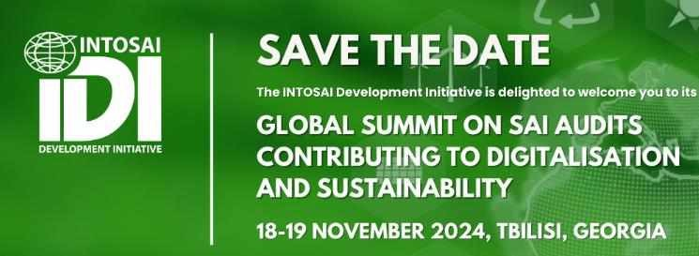
Working together for SAI relevance
IDI- WGEA partnership for auditing climate change adaptation actions
Partnership with WGITA, WGISTA and
WGPD for auditing
technology, data
analytics and AI.
Partnership WGPD for auditing public debt
INTOSAI DEVELOPMENT INITIATIVE

Slide 4
Cooperating for SAI Independence
Global Foundations
Consultations with
Working Group on Extractive Industries
Working Group on the Fight Against Corruption and Money Laundering
Cooperation between INTOSAI- Donor Cooperation WG on Climate Change with Working Group on Environmental Audit
INTOSAI DEVELOPMENT INITIATIVE

Slide 5
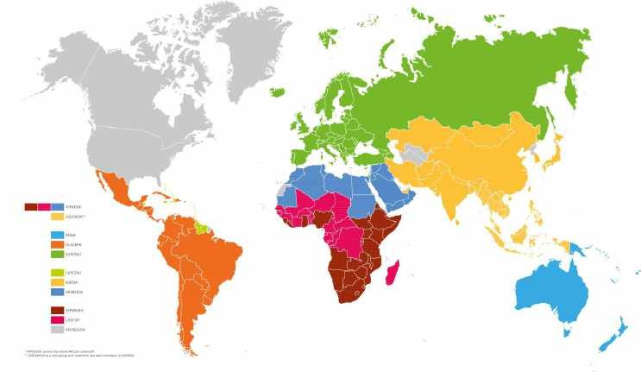
INTOSAI Global Stocktaking Report 2023
166 SAI respondents (80% response rate)
Data collection period from July to November
Analysis based on Global Survey 2023, SAI PMF, PEFA
and v-dem data

Slide 6
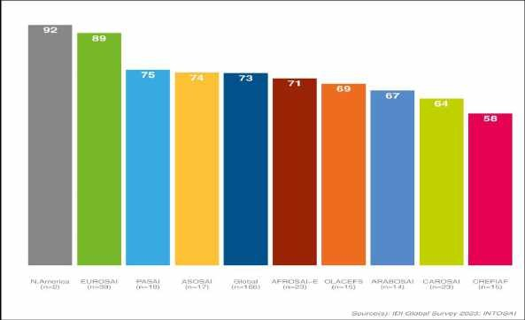
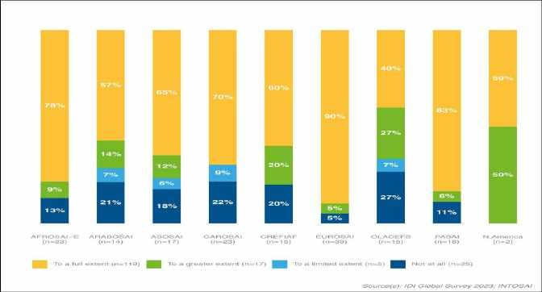
SAI Independence continues to regress
Overall decline in SAI Independence Index, based on
the Mexico Declaration
Access to information remains an issues – Principle 4
Declines also in financial autonomy – Principle 8
Inadequate legal frameworks remain an issue –
Principle 1
More SAI have become limited in selection of audit programmes
10% reported Heads of SAI had experienced interference in conducting their mandates

Slide 7
Other institutional challenges continues
A group of SAIs is limited in reporting
Around 15% of SAIs continue to not publish any audit reports
A decline in reporting average
SAI resourcing remain an issue
39% of SAIs find the staff resources adequate in numbers and competencies
53% of SAIs report to have sufficient financial resources
45% of SAIs find it difficult to obtain external support when they plan to manage the intervention on their own

Slide 8
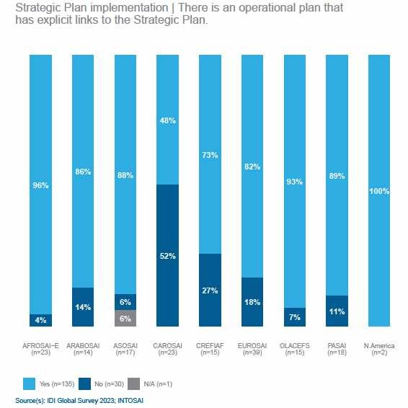
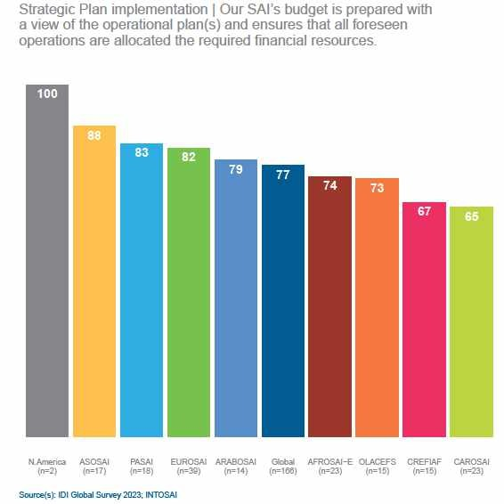
Strategic Management practices sustained over time

Slide 9
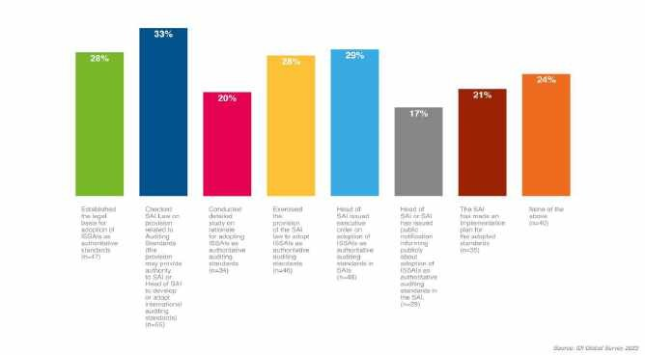
ISSAI adoption needs a more systematic guidance
Adoption of ISSAs standards are almost universal across audit types
Yet there is not a uniform way for the process
There’s a small increase towards SAI audit engagement with only financial, compliance or performance audit objectives and away from combined audit, which still is the main approach.

Slide 10
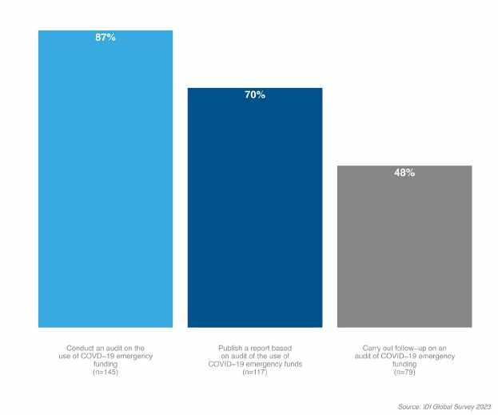
SAIs are responsive to emerging issues
SDG audits
49% have audited preparedness of SDG implementation
43% have done performance audits on SDG implementation
22% audit for the purpose of country reporting
49% carry out other audits of specific SDGs

Slide 11
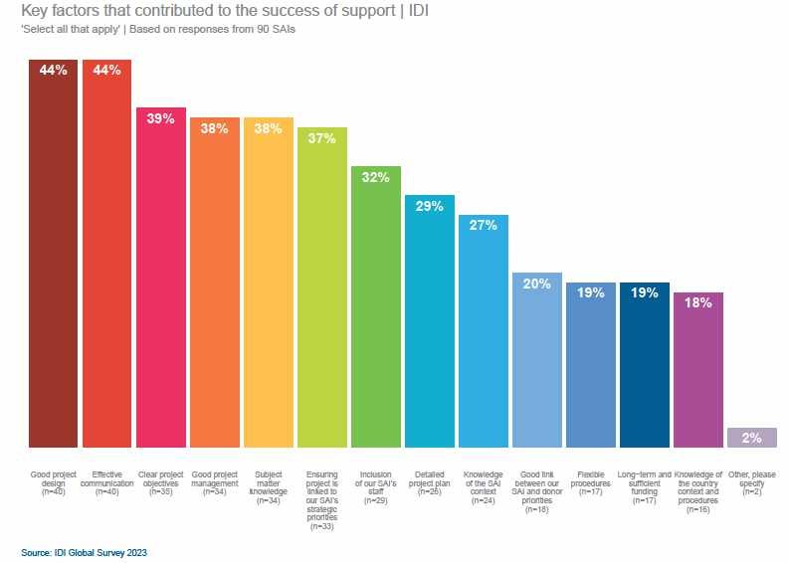
The reduction in peer support continues
A decline from 87 reported peer
providers in GSR2017 to 42 in GSR2023
COVID-19 likely a reason to this, as most SAIs rely on their own staff and in-country visits
However, funding remains an issue as only 21% have dedicated or available funding to provide peer support
The preference for support from peers have apparently shifted towards international development partners
Yet, needs communicated by SAIs are strongly focused on audit expertise and skills

Slide 12
INTOSAI Development Initiative (IDI) Stenersgata 2, 0184 Oslo, Norway www.idi.no

