Slide 1
Chair’s Report
Chairperson Gamaliel A. Cordoba
Commission on Audit
Republic of the Philippines

Slide 2
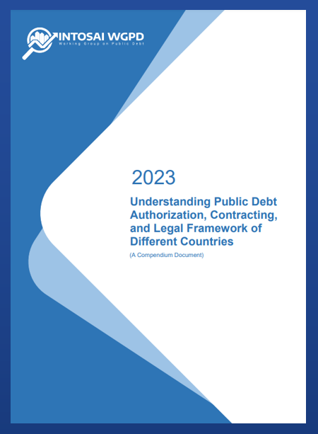
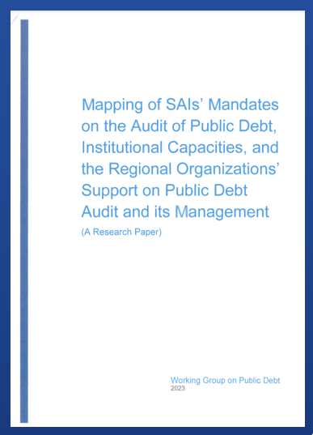
SG1
SO1
DEVELOP, MAINTAIN, KEEP UP-TO-DATE GUIDANCE RELATED TO THE AUDIT OF PUBLIC DEBT
Development of Non-IFPP Products/Guidance Materials
Mapping of SAI’s mandates on the audit of PD, institutional capacities and the Regional Organizations’ support on PD Audit and its Management (A Research Paper)
(QA Level 2)
COMPLETED
Understanding Public Debt Authorization, Contracting, and Legal Framework of Different Countries (QA Level 2)
Approved by the INTOSAI Governing Board
Officially pronounced during the 77th INTOSAI Governing Board Meeting in Vienna, Austria, on November 20-21, 2023

Slide 3
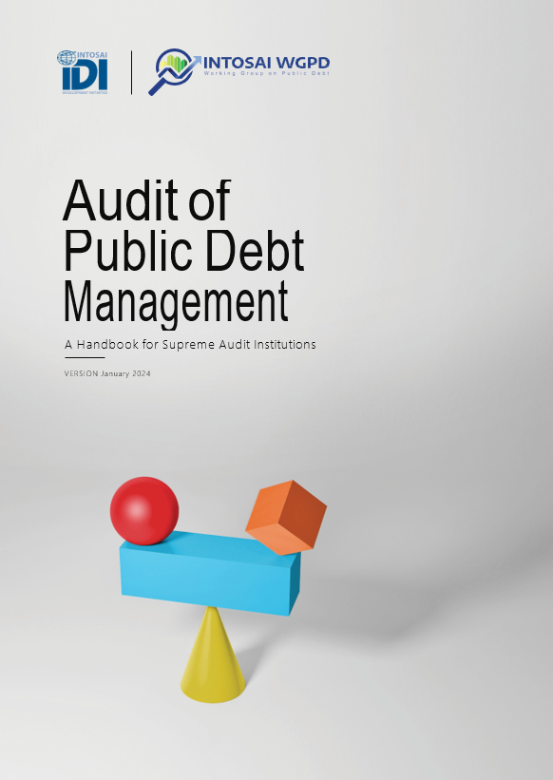
SG1
SO1
DEVELOP, MAINTAIN, KEEP UP-TO-DATE GUIDANCE RELATED TO THE AUDIT OF PUBLIC DEBT
Updating of IDI-WGPD Audit of Public Debt Management: A Handbook for SAIs
Project Proposal
(Oct 2023)
Updating of IDI-WGPD Handbook
(Oct 2023 – Feb 2024)
Circulation of updated draft to WGPD Steering Committee
(Feb 2024 – March 2024)
Submission to IDI of the updated IDI-WGPD Handbook
(March 2024)

Slide 4
SG1
SO1
DEVELOP, MAINTAIN, KEEP UP-TO-DATE GUIDANCE RELATED TO THE AUDIT OF PUBLIC DEBT
Development of Non-IFPP Products/Guidance Materials
COMPLETED ENDORSEMENT VERSION
(PENDING PRONOUNCEMENTS)
An Audit Reference on Fiscal Exposures
(QA Level 1)
Compendium of Case Studies: Impact of Recent Health and Other Crises to Public Debt and Public Debt Management
(QA Level 3)
QA Certificate issued by the KSC Chair on March 19, 2024
For KSC’s motion to the INTOSAI Governing Board in October 2024
QA Certificate issued by the KSC Chair on July 30, 2024
For KSC’s motion to the INTOSAI Governing Board in October 2024

Slide 5
SG1
SO1
DEVELOP, MAINTAIN, KEEP UP-TO-DATE GUIDANCE RELATED TO THE AUDIT OF PUBLIC DEBT
Development of Non-IFPP Products/Guidance Materials
ENDORSEMENT VERSION
Guidelines in the Audit of Government Guarantees
(QA Level 2)
Ongoing development of Endorsement Version based on the comments received during the exposure period
Endorsement version was circulated to the WGPD Steering Committee on August 8, 2024 for review and approval

Slide 6
SG1
SO1
DEVELOP, MAINTAIN, KEEP UP-TO-DATE GUIDANCE RELATED TO THE AUDIT OF PUBLIC DEBT
Development of Non-IFPP Products/Guidance Materials
General Guidance on the Definition, Structure, and Disclosure of PD
(QA Level 2)
Compendium of Audit Objectives and Procedures in the Audit of Internal Control
(QA Level 2)
Public Debt Glossary and Bibliographies
(QA Level 3)
EXPOSURE DRAFT

Slide 7
SG1
SO1
DEVELOP, MAINTAIN, KEEP UP-TO-DATE GUIDANCE RELATED TO THE AUDIT OF PUBLIC DEBT
Development of Non-IFPP Products/Guidance Materials
PROJECT PROPOSAL
Role of SAIs on Debt Sustainability
(A Research Paper)
[QA Level 2]

Slide 8
SG2
SO1
IMPROVED RECOGNITION OF THE WORKING GROUP
AND ITS PRODUCTS
Members
Experts
Partner Stakeholders
41 Members
1 Observer
89 Subject Matter Experts
IBP
IDI
IMF
UNCTAD
UNDESA
World Bank

Slide 9
SG2
SO1
IMPROVED RECOGNITION OF THE WORKING GROUP
AND ITS PRODUCTS
Role of SAIs in Debt Sustainability
Public debt transparency and legal frameworks
An End to Debt Déjà Vu: Building Domestic Accountability

Slide 10
SG2
SO1
IMPROVED RECOGNITION OF THE WORKING GROUP
AND ITS PRODUCTS
2024 WGPD Annual Meeting
June 5-7, 2024
28 member SAIs in-person
2nd WGPD Steering Committee Meeting
June 6, 2024
Baku, Azerbaijan
Baku, Azerbaijan
9 SC member SAIs
Hybrid format
In-person

Slide 11
Thank
You
secretariat.wgpd@coa.gov.ph
https://wgpd.intosaicommunity.net/
INTOSAI Working Group on Public Debt

