Slide 1



Knowledge Sharing
UPDATE AND WAY FORWARD
04 October 2023

Slide 2


01.
RESEARCH PROJECT ON AUDIT COMMUNICATION AND
REPORTING OF AUDIT RESULTS
Project Progress
02.
UPDATE ON GOAL CHAIR ALLOCATION
KSC Portion
03.
ENHANCING OUTREACH OF KSC PRODUCTS
Discussion on Way Forward
04.
VENUE FOR KSC SC MEETING 2024 AND 2025
TABLE OF
CONTENTS
Invitation of Interest

Slide 3


RESEARCH PROJECT ON AUDIT COMMUNICATION AND REPORTING OF AUDIT RESULTS
SAI India (Project Lead) | SAI Afghanistan | SAI Costa Rica
SAI Bangladesh | SAI Uganda | SAI UAE
SAI Turkey | SAI Suriname | SAI Mexico
SAI Kuwait | SAI Indonesia
SAI Hungary | SAI Italy
PROJECT TEAM

Slide 4



PROJECT OVERVIEW
  PROJECT AIM
To provide an insight into the existing systems of audit communication and reporting of audit results in SAIs
  PROJECT OBJECTIVES
•To review current approaches of audit communication and reporting of audit results;
•To assess available methods and procedures for measuring the impact of approaches of audit communication and reporting of audit results; and
To identify best practices and good techniques for enhancing the quality of audit communication and reporting of audit results
QUALITY ASSURANCE LEVEL
Non-IFPP QA Level 2

Slide 5

PROJECT PROGRESS
  5. Circulation of Exposure Draft
  1. Approval of PID
  3. Receipt of Responses to Survey
October 2023
August 2021
2021 (Round 1)
2022 (Round 2)
  6. Endorsement Version
January 2024
  2. Circulation of Survey Matrix
  4. Drafting Exposure Draft
2022-23
2021 (Round 1)
2022 (Round 2)

Slide 6
BUDGET
1.
2.
3.
ALLOCATION
BALANCE
ALLOTMENT SCHEME
Allotment: 25% of INTOSAI’s revenue.
DECEMBER 2022: Euro 85,488
RECEIPTS 2023: Euro 24,470
Allotment for revamping of INTOSAI Community Portal and other crosscutting priorities;
4.
5.
ALLOTMENT SCHEME
UNUTILISED SHARE
Remaining funds to be divided equally among all WGs for approved KSC Workplan related activities
Unutilized share for a year to be carried forwarded to next year;

Slide 7





ALLOTMENT OF GOAL CHAIR ALLOCATION
  12 KSC SC
  15 KSC SC
Balance: Euro 48,000
Each WG Earmarked: Euro 4,000
Remittance (2020)
WGEI (Euros 4,000)
WGFACML (Euros 4,000)
Receipt: 24,470 Euros (2023)
Each WG Earmarked:
Euro 6,500
  14 KSC SC
  13 KSC SC
Receipt: 22,487 Euros (2022)
Each WG Earmarked: Euro 6,000 Euros
Remittance (2021-22):
WGEPPP (Euros 5,400),
WGBD (Euros 5,500)
WGFACML (Euros 2,000),
Receipt: 27,900 Euros (2021)
Each WG Earmarked:
Euro 5,500

Slide 8
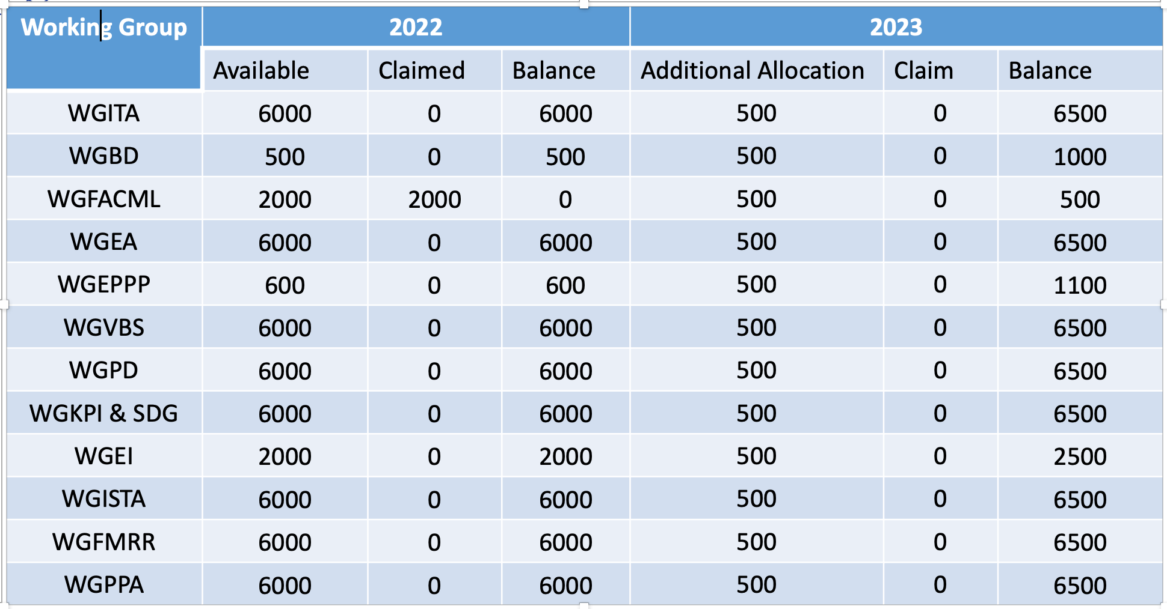

GOAL CHAIR ALLOCATION: WG BALANCES

Slide 9





ENHANCING OUTREACH OF KSC PRODUCTS
  Webinars, Workshops and Training (Physical or Virtual)
  Sector-Specific Guidance
guidance tailored to different sectors, to address unique audit challenges within each domain
To reach a larger audience, enabling participants to join from anywhere in the world
  Online Collaboration, User-Friendly Platforms
  Customizable Resources
Creation of documents to be made, keeping possibilities for customisation open
Intuitive online platforms for knowledge sharing

Slide 10






VENUE FOR 16TH AND 17TH KSC SC MEETING

