Slide 1
15TH. ANNUAL MEETING OF STEERING COMMITTEE OF INTOSAI KNOWLEDGE SHARING AND KNOWLEDGE SERVICES COMMITTEE (ABU DHABI, UAE)
DISCUSSION ON KEY QUESTION ON CREATION OF WORKING GROUP ON FOLLOW UP AUDITS
NATIONAL AUDIT DEPARTMENT OF MALAYSIA
(NADM)
OCTOBER 2023

Slide 2
CONTENTS
1
Introduction
2
The importance & Rationale of Establishing INTOSAI Working Group on Follow-up Audit
3
Recommendation, Why SAI Malaysia? &
Current Practice Vs Proposed Practice
4
Robust SAI Malaysia Follow-up Audit Progress over the years
5
Proposed Activities & Timeline
6
Conclusion

Slide 3
INTRODUCTION
1
14th. September 2022 : 1st Proposal Date during 14th. INTOSAI KSC SC Meeting, Cairo Egypt
2
20 October 2022 : Submission of Concept Note and ToR
3
31st. August 2023 : Communication with INTOSAI KSC on the key question & submission slides to INTOSAI KSC
4
4th. October 2023: 15th. KSC Annual Meeting (Agenda 22)

Slide 4
THE IMPORTANCE OF WGFA
NEW PATH
COLLABORATION
COMMUNICATION & SHARING
Securing new path to implement and drive for the future WGFA activities.
Diverse perspective collaboration, the form of WGFA, and other relevant factors among SAIs member in conducting cooperative activities on the follow-up progress
Promote effective communication and sharing among the member countries

Slide 5
RATIONALE FOR THE ESTABLISHMENT OF WGFA
Performance Audit Handbook V1/2021 by INTOSAI Development Initiatives
Best practices guide by EUROSAI Project Group
INTOSAI Development Initiatives (IDI) Global Stoctaking 2020
“…lack of follow-up and limited focus on stakeholder management and communication with public suggest that this is an area of improvement ( Increase the value & impact of audit). It could be better integrated in the audit process, and that a more holistic approach the audit approach could help improve audit work….”
“…..implementing the recommendations will bring considerable benefits to the audited entities, public institutions and the citizens….”
“…follow-up mechanism in a timely manner can influence the impact of audit…”

Slide 6
RECOMMENDATION
SEEKING FOR ENDORSEMENT
THE CHAIR OF WGFA?
SAI Malaysia proposes to the INTOSAI KSC Steering Committee to endorsed a creation new Working Group on Follow-Up Audit (WGFA)
SAI Malaysia is determined to become Chair of the INTOSAI KSC Working Group WGFA

Slide 7
WHY SAI MALAYSIA?
INTOSAI
ASOSAI
ASEANSAI
Capacity Building Committee (CBC)
* Role: Member
Knowledge Sharing Committee (KSC)
* Role: Steering Committee (Observer)
Governing Board Members (2021-2024)
Chair of the Special Committee on Establishing ASOSAI Working Group on State Owned Enterprises (WGSOE)
* Determined to be Chair of ASOSAI WGSOE
Knowledge Sharing Committee (KSC)
*Role: Chair since 2012
195 member countries
48 member countries
10 member countries

Slide 8
CURRENT PRACTICE vs PROPOSED PRACTICE
Follow-up Audit Progress over the years among the members countries
In Silo
Executed Internally
Robust Development Internally, yet Unknown (Database/Committee)
Lack of Sharing on Best Practices & Progress
Legal Mandate/ISSAI
The proposed Best Practice Among the members countries
Knowledge Sharing on Follow-up Audit Progress: Cooperation & Collaboration
Benchmarks on follow-up audit
Best Practice review/studies for continuous improvement
Capacitate the auditor’s skill and professionalism
Creation of Lesson Learnt Culture
In line with INTOSAI IDI Initiatives of Facilitating Audit Impact (FAI)
VS

Slide 9
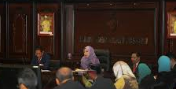
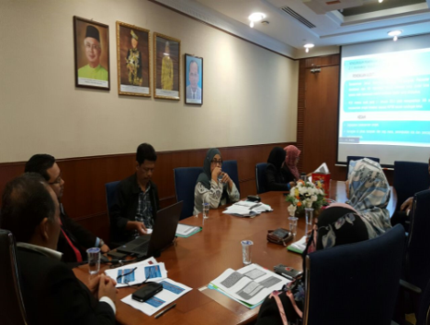
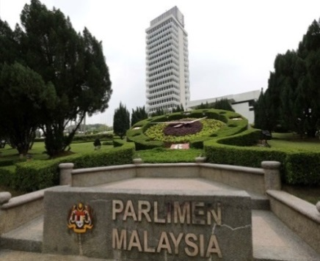
ISSAI & SAI MALAYSIA FOLLOW-UP PROCESS
SAI MALAYSIA FOLLOW-UP AUDIT PROCESS
ISSAI 3000
The auditor shall follow up, as appropriate, on previous audit findings and recommendations and the SAI shall report to the legislature, if possible, on the conclusion and impacts of all relevant corrective actions. (ISSAI 3000/136)
The auditor shall focus the follow-up on whether the audited entity has adequately addressed the problems and remedied the underlying situation after a reasonable period. (ISSAI 3000/139)
EXIT CONFERENCE
PRESENTATION AND FINALIZATION OF AG’S DRAFT REPORT
TABLING OF AG’S REPORT IN PARLIAMENT/ PAC BREIFING SESSION
FINAL AG’S REPORT
CORRECTIVE
AG’S DASHBOARD
PUTRAJAYA INQUISITION
FOLLOW-UP AUDIT OBJECTIVES –
SAI MALAYSIA PERSPECTIVE
Increasing effectiveness of audit reports
Assisting the government and legislature
Evaluation of SAI’s performance
Creating incentives for learning and development
ISSUES IN AG’S REPORT
RED FLAG/ PUNITIVE
ACTION COMMITTEE (JSLKAN)
9

Slide 10
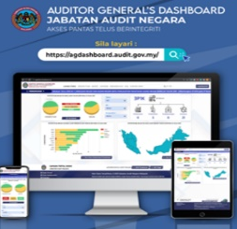
FOLLOW-UP THROUGH AGD
Statutes of Action: AG’s Report Issues
Filtering Process of Audit issue – (Corrective Action/Punitive Action – CAPA)
NO ACTION
FLLOW-UP THROUGH TRAFFIC LIGHT SYSTEM
IN ACTION/PARTIAL ACTION
O
ACTION TAKEN - COMPLETED
Feedback – Corrective and preventive action taken by auditee and updated in the AG’s Dashboard.
Updates by relevant enforcement/central agencies (if any) on statutes of investigation or action.
10

Slide 11
DIRECTION FOR
FURTHER INVESTIGATION OR ACTION
RED FLAG/PUNITIVE ISSUES
JSLKAN
NEGLIGENCE OF PUBLIC SERVANT
CRIMINAL/CORRUPTION CHARGES/BLACKLIST
CENTRAL AGENCY
PUBLIC SERVICE DEPARTMENT
ENFORCEMENT AGENCIES
(POLICE, ANTI CORRUPTION AGENCY, COMPANIES COMMISSION, AGC)
CENTRAL AGENCY: MoF
(Blacklist of Contractor)
SPECIAL INVESTIGATION COMMITTEE
AT FEDERAL MINISTRY/DEPARTMENT LEVEL
INTERNAL INVESTIGATION
STATE, STATUTORY BODIES, LOCAL COUNCIL/AUTHORITIES & GLC’S

Slide 12
WGFA PROPOSED ACTIVITIES
Knowledge Sharing
Annual Meeting
Research
Reporting
As a platform for the Working Group to brainstorm ideas and discuss internally
Publication
Objectives
To organize knowledge-sharing programmes i.e. webinar / conference
To summarize activities being carried out by the WGFA and report progress to the KSC Steering Committee Meeting
To identify the problems and challenges related with Follow-Up Audit worldwide
To prepare and publish manual/ guideline/best practice/ journal/ article or other references.

Slide 13
TIMELINE
DIS
2023
MAC 2024
MAY 2024
JULY 2024
OCT 2024
DIS 2024
MAC 2025
2025 ONWARD- CONTINUES
1ST. CHAIR MEETING
PUBLICATION
ANNUAL MEETING
HANDS ONN TRAINING
Appointment of Members
Sharing Updates on Follow-up
Brainstorming Session
Discussion on the Preparation of Article/Jurnal
Presentation of Achievement and Proposed Future Activities
Understanding and Learning the Available Database on Follow-up Audit.
KNOWLEDGE SHARING
ONGOING ACTIVITIES
REPORTING
RESEARCH
Progress Report Analysis on Summarized Activiies on Follow-up Audit of every member countries
1st. Webinar on Best Practice Progress
Discussion of Accross the board Research
Regular meeting on updates for potensil cooperation & collaboration

Slide 14
CONCLUSION
SAI Malaysia are willing and with full determination seek to head the CHAIR OF FOLLOW-UP AUDIT WORKING GROUP. SAI Malaysia as the future potential Chair of this Working Group believes in achieving the 2 main goals:
1
To promote and enhance the role of SAIs in assisting their governments in improving Follow-up audit value and impact which focuses on action and resolution of audit issues
2
To empower better understanding, accountability, transparency, and sustainability in the execution and governance of the Follow-up activities.
Asking For Your Approval

Slide 15
NAD

