Slide 1
Presented by: Mazen AlAkkad – 2nd October, 2023
Progress Update Report

Slide 2
AGENDA
About The WGISTA
The WGISTA Objectives
The WGISTA 2022-2023 Work Plan
The WGISTA Progress Updates

Slide 3
A. The Evolution of WGISTA
Discussion at 2018 INTOSAI Governing Board meeting
Needs for WGISTA
How to audit governments’ implementations of these emerging technologies
How to benefit from these technologies in conducting our own work as public sector auditors
a Task force was created to draft ToRs of WGISTA

Slide 4
A. The Evolution of WGISTA
The Task force was co-led by SAI UAE and SAI USA and its other participants included:
American Institute of Certified Public Accountants
Audit Board of the Republic of Indonesia
China National Audit Office
Institute of Internal Auditors
INTOSAI Development Initiative
Office of the Comptroller and Auditor General of India
Organization for Economic Cooperation and Development
Pacific Association of Supreme Audit Institutions
United Nations Department of Economic and Social Affairs
World Bank

Slide 5
A. About The WGISTA
26 Members
11 observers
Inaugural
Meeting
Annual
Meetings
2019
Established
at INCOSAI 2019
SAI UAE is Chair
and
U.S. GAO is Vice-Chair
26 members including Chair & Vice Chair, and 11 observers
Well represented from across INTOSAI regions
Professional bodies like AICPA, IIA as observers
Virtual Inaugural meeting held in 16th September, 2020
The 2nd annual meeting (virtual) was held in October 2021.
The 3rd annual meeting and 1st seminar were held in December 2022 in Abu Dhabi, UAE.

Slide 6
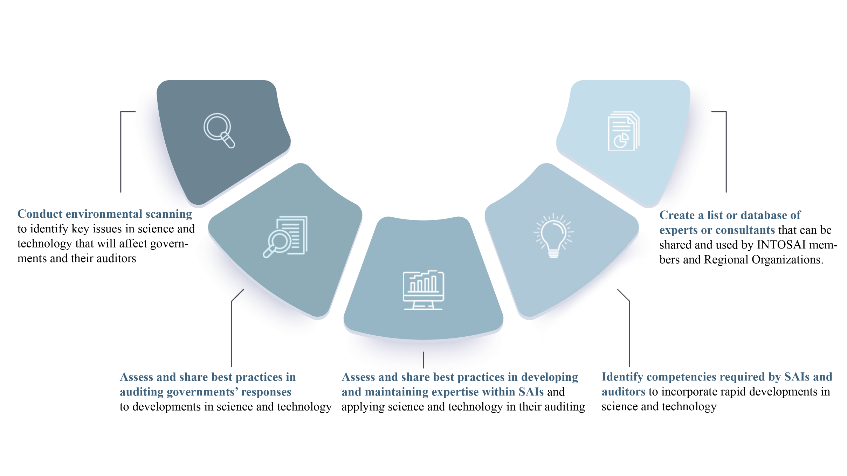
B. The WGISTA Objectives

Slide 7
C. The WGISTA 2022-23 Work Plan
Webinars
a Seminar
3rd Annual Meeting
The WGISTA products
4th Annual Meeting

Slide 8
D. The WGISTA Progress Updates
2022 Webinar
WGISTA’s first webinar was held in June 2022
Title of Webinar: “Adopting Digital Mindset for Audit and Fighting Corruption”
Organized and hosted by SAIUAE
Topics discussed:
“Innovating Digital Capabilities to Strengthen Oversight Capacities”
“Preparing for the Age of Post 4th Industrial Revolution”
“Impact of technology on Developing and Implementing anti-corruption policies and measures”
Webinar recording is available on WGISTA website

Slide 9
D. The WGISTA Progress Updates
3rd Annual Meeting and 1st Seminar
WGISTA’s third annual meeting and 1st seminar were held in December 2022
Title of Seminar: “AI, Innovation, Governance and Auditing : Challenges and Opportunities”
Organized by SAI UAE
Topics discussed in the Seminar:
“ SAI UAE’s Strategic Alignment with Advanced Technology Driven Auditing”
“ Supporting the U.S. Congress on Emerging Science and Tech Issues”
“ UAE Government Digital Procurement Policy and Procurement Platform”
“ Opportunities and Challenges of Big Data Application in China’s Financial System Audit”
“ UAE Central Bank Digital Currency- Cyber Security”
“UAE’s Blockchain Ecosystem”
Meeting and Seminar recording is available on WGISTA website

Slide 10
D. The WGISTA Progress Updates
2023 Webinar
WGISTA’s Second webinar was held in July 2023
Title of Webinar: “The Future of Auditing: Unveiling Emerging Tech Tools”
Organized by U.S. GAO and SAI UAE
Topics discussed:
“ Brain-Computer Interfaces, Digital Twins, Generative AI”
“ Implications of Blockchain in the Field of Audit ”
“ Global Perspectives: S&T Policy Organizations around the World ”
“ Leveraging of Technological Advancements ”
Webinar recording is available on WGISTA website

Slide 11
D. WGISTA Progress Updates
Product 1: Environment Scan report on SAI capabilities in emerging technologies and auditability in the public sector.
Project lead and team:
SAI UAE and U.S. GAO
Aims to understand the landscape of emerging technologies from a public sector auditor’s perspective, to have insight into how SAIs are faring with respect to these technologies and to get expert views on best approaches to mainstream these technologies in public sector auditing.
Research Methods:
Literature Review
Environment Scanning Survey of Supreme Audit Institutions
Experts Interviews

Slide 12
D. WGISTA Progress Updates
Product 2: Emerging technologies applications in developing and maintaining expertise within supreme audit institutions in the use of science and technology in Auditing.
Project Team:
SAI Chile (Lead)
SAI India
SAI Philippines
SAI Thailand
SAI Pakistan
SAI Vietnam
Aims to provide SAIs with insights into the potential applications and benefits of the emerging technologies in the field of audit
Research Methods:
Bibliographic research, online research, experts interviews

Slide 13
D. WGISTA Progress Updates
Project 3: Create a list or database of experts/consultants (on Advanced and Emerging Technologies) that can be shared and used by INTOSAI members and Regional Organizations.
Project Team:
SAI UAE (Lead)
SAI Estonia
SAI China
SAI Kenya
SAI Hungary
Aims to provide a platform of experts and knowledgeable resources in emerging and advanced technologies from SAIs to those SAIs in need of expert discussion and advice.

Slide 14
D. WGISTA Progress Updates
WGISTA Upcoming Event
4th Annual Meeting,
Scheduled on 6 - 7 November 2023, in Abu Dhabi, UAE

Slide 15
Thank You

