Slide 2
Report by Working Group on Audit of Extractive Industries (WGEI)
By Mr. Stephen Kateregga: Assistant Auditor General
on behalf of A.G. John F.S. Muwanga Chair INTOSAI WGEI
15th KSC Steering Committee Meeting
Abu Dhabi, United Arab Emirates

Slide 3
Background information
1
Strategic Objective 1
2
3
Strategic Objective 2
4
Strategic Objective 3

Slide 4
Background
Information
WGEI Membership: 46 SAIs
Observers: IDI & AFROSAI-E
WGEI Steering Committee comprises:
SAIs: Norway , USA, South Africa, Iraq, India, Fiji, Zambia, Ghana, Ecuador, Indonesia, Brazil & Uganda

Slide 5
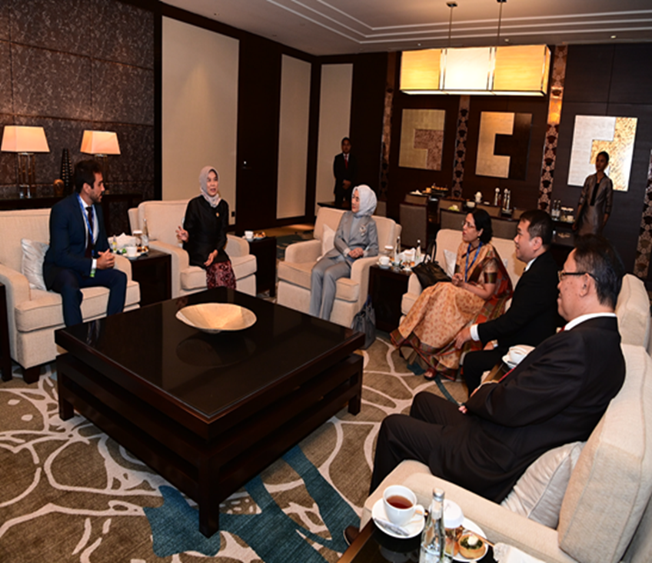
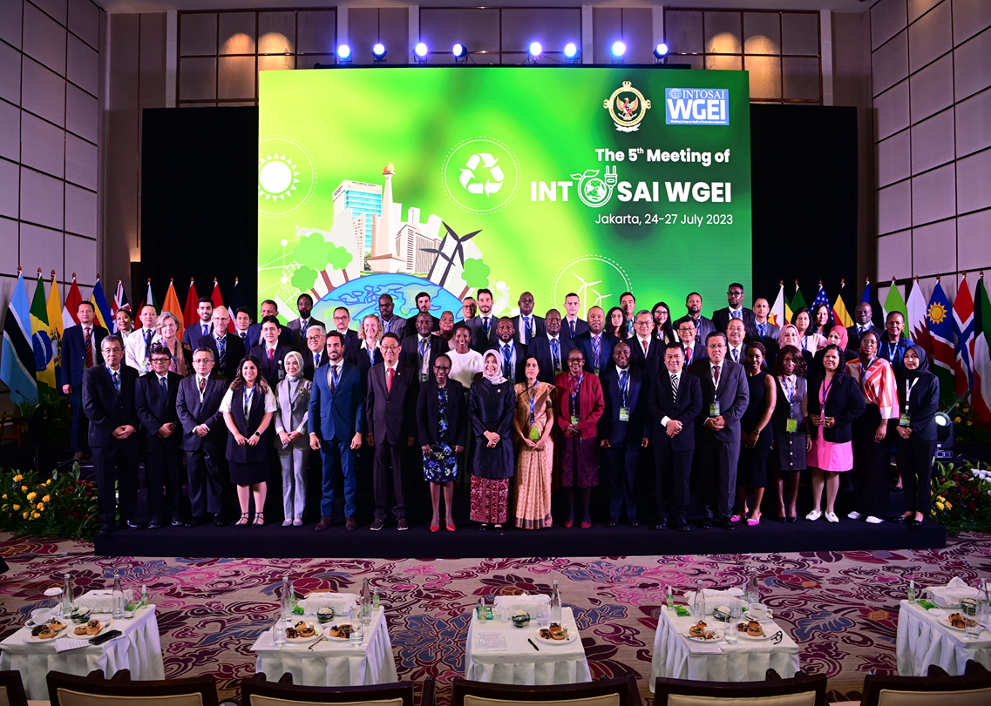
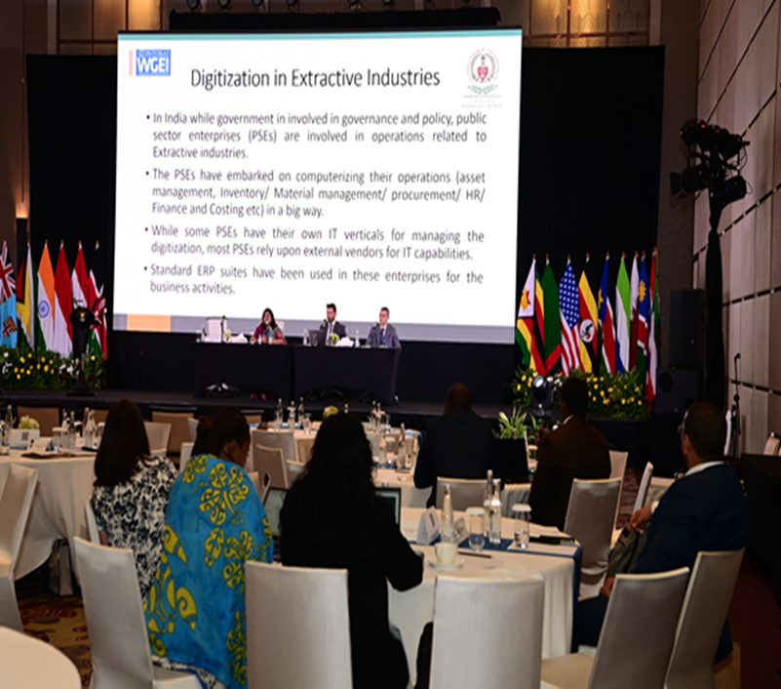
Background Information cont…..
WGEI celebrated 10 years of existence at its 5th Members’ meeting, which was hosted by the Audit Board of the Republic of Indonesia in Jakarta, 24th – 27th July 2023.

Slide 6
WGEI is implementing its Workplan (2023 -2025)
The activities reflect the KSC Operational Plan (2023 – 2025)
The are four activities:
1.Administration of WGEI secretariat
2.Learning undertakings
3.Knowledge and Experience Sharing
4.Networking with Key Stakeholders
This report presents the WGEI activities contributing to the KSC Strategic Objectives as per the KSC Operational Plan (2023 – 2025)
Background
Information cont...

Slide 7
WGEI Contribution to KSC Strategic Objective 1: Develop and maintain expertise in areas of public-sector auditing
WGEI is reviewing the Briefing Note on the role of SAIs in the Audit of Extractive Industries. – The initiative is led by SAI Norway
The WGEI Learning Task Force is finalising the e-learning course ‘on exploration and data management.’ The Learning Task Force is comprised of SAIs Ecuador, Ghana, India, Iraq, Norway, Uganda, Vietnam, Zambia, Zimbabwe and AFROSAI-E
The Course is based on module 3 of WGEI Training Framework
The course is being developed using funding of Euro 4000 received from the KSC.
The course content was developed by experts from SAIs of Egypt, Kenya, Tanzania and Zambia
The content was reviewed by experts from SAIs of India, Ghana, Uganda, Norway, Indonesia, Philippines and AFROSAI-E
WGEI has engaged AFROSAI-E to identify service providers to transform course content into online course

Slide 8
WGEI Contribution to KSC Strategic Objective 2: Facilitate wide exchange of knowledge and experience
WGEI webpage on the INTOSAI Community portal is actively maintained. It has over 112 Extractive Industries audit reports from member SAIs, materials from 4 training initiatives and 65 useful links
23 Extractive Industries documents and reports translated from their original languages to other INTOSAI languages – translation is led by SAIs Iraq, United States, Ecuador, Chile and the ARABOSAI Secretariat
WGEI Collaborates with other INTOSAI working bodies including IDI and the Regional Organisations (AFROSAI-E, ARABOSAI, ASOSAI, OLACEFS and PASAI)
WGEI Steering Committee comprised of SAIs from all INTOSAI Regions who serve as the working group’s ambassadors in their regions
The working group actively networks with external stakeholders in EI eg Extractive Industry Transparency Initiative (EITI), Open Ownership, etc – The initiative is led by the SAIs of Norway, Brazil and Fiji

Slide 9
WGEI Contribution to KSC Strategic Objective 3: Facilitate continuous improvement of SAIs through knowledge sharing activities
WGEI is in partnership with iCED of SAI India to provide training based on the WGEI Training Framework
WGEI and iCED organised a hybrid International Training Programme on Audit of Extractive Industries in March 2023. It attracted 14 participants from 8 SAIs who attended in person and 9 participants who attended virtually
WGEI collaborated with the Canadian Audit and Accountability Foundation (CAAF) to deliver EI training to SAI Guyana in April 2023. The training was facilitated by experts from SAIs Kenya, Uganda and Alberta (Canada)
The Working group has embraced the virtual environment for example Quarterly Steering Committee meetings are hosted on the INTOSAI Community Portal, and some WGEI training is held on virtual platforms

Slide 10
Audit House
Plot 2C Apollo Kaggwa Road
Kampala, Uganda
info[a]oag.go.ug
+256 0417 336 000
http://www.oag.go.ug//

