Slide 2
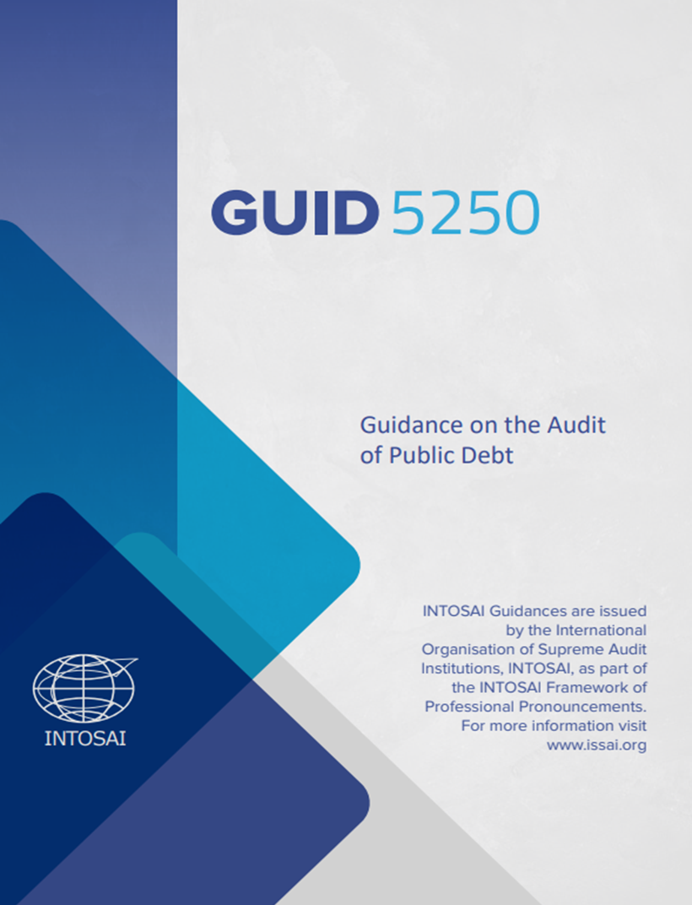
SO
3.1
DEVELOP & MAINTAIN EXPERTISE IN PUBLID DEBT AUDITS & WORK WITH OTHER INTOSAI ENTITIES TO DEVELOP & SHARE CONTENT FOR THE IFPP & OTHER INTOSAI PRODUCTS
Consolidation and alignment of Public Debt ISSAIs
with ISSAI 100 (GUID 5250)
Development of the Guidance on the Audit of Public Debt (GUID 5250)
Withdrawn Seven ISSAIs on Public Debt
Public Debt ISSAIs (ISSAIs 5410, 5411, 5420, 5421, 5422, 5430, and 5440) published at the IFPP website as withdrawn pronouncements
No longer considered as part of the IFPP
Officially pronounced at the INCOSAI XXIV on November 8, 2022
Available in five INTOSAI languages
Accessible at the IFPP website and the WGPD page at the KSC Community Portal (www.issai.org and www.intosaicommunity.net/wgpd)
////////////////////////////////////////////////////////////////////////////

Slide 3
SO
3.1
DEVELOP & MAINTAIN EXPERTISE IN PUBLID DEBT AUDITS & WORK WITH OTHER INTOSAI ENTITIES TO DEVELOP & SHARE CONTENT FOR THE IFPP & OTHER INTOSAI PRODUCTS
Development of Non-IFPP Products/Guidance Materials
1
Ongoing projects carried forward to WP 2023-2025
[ ENDORSEMENT VERSIONS FOR INTOSAI GB APPROVAL ]
[ EXPOSURE DRAFTS ]
Mapping of SAI’s mandates on the audit of PD, institutional capacities and the Regional Organization’s support on PD Audit and its Management
(A Research Paper)
(QA Level 2)
Compendium of Case Studies: Impact of Recent Health and Other Crises to Public Debt and Public Debt Management
(QA Level 3)
Understanding Public Debt Authorization, Contracting, and Legal Framework of Different Countries (QA Level 2)
//////////////////////////////////////////////////////////////
Guidelines in the Audit of Government Guarantees
(QA Level 2)
An Audit Reference on Fiscal Exposures
(QA Level 1)

Slide 4
SO
3.1
DEVELOP & MAINTAIN EXPERTISE IN PUBLID DEBT AUDITS & WORK WITH OTHER INTOSAI ENTITIES TO DEVELOP & SHARE CONTENT FOR THE IFPP & OTHER INTOSAI PRODUCTS
Development of Non-IFPP Products/Guidance Materials
2
New Non-IFPP Products/Guidance Materials that stemmed from the Mapped Public Debt ISSAIs not covered in the GUID 5250
[ PROJECT PROPOSALS ]
Role of SAIs in Debt Sustainability
(QA Level 2)
Compendium of Audit Objectives and Procedures in the Audit of Internal Control of Public Debt
(QA Level 3)
General Guidance on the Definition, Structure, and Disclosure of Public Debt
(QA Level 2)
Public Debt Bibliographies and Glossary
(QA Level 3)

Slide 5
FACILITATE WIDE EXCHANGE OF KNOWLEDGE AND EXPERIENCE AMONG INTOSAI MEMBERS WITH GREATER EMPHASIS ON DIGITAL APPROACHES
SO
3.2
Establish close coordination with the KSC-IDI, INTOSAI, General Secretariat (website), and US GAO (Journal) for timely publication of WGPD outputs on public debt auditing issues
Utilization of INTOSAI tools in the conduct of seminars, fora, capacity building programs and workshops
Improve the level of perception on the relevance of the WGPD
Improve coordination with other Working Groups on crosscutting priorities
Creation of the WGPD Steering Committee
WGPD Project on Compendium of Case Studies: Impact of Recent Health and Other Crises on Public Debt and Public Debt Management
WGs work together on crosscutting priorities indicated in the next SP of the INTOSAI with requested guidance from the KSC
Philippines
Argentina

Slide 6
SO
3.3
FACILITATE CONTINUOUS IMPROVEMENT OF SAIS THROUGH KNOWLEDGE SHARING ACTIVITIES
Participation in seminars, fora, capacity-building programs and workshops in collaboration with the Worldbank, IDI, and other stakeholders
WGPD Growing Membership
Network of Experts
2023
28 member SAIs & 1 observer SAI in Cairo
41 Members
1 Observer
89 Subject Matter Experts
2022
36 members via Zoom
2021
29 members via Zoom

Slide 7
Notes:
Maraming Salamat po. Thank you!

