Slide 1
THE WORKING PAPER TO BE PRESENTED BY THE INTOSAI WGFACML DURING THE 15th INTOSAI KSC SC MEETING TO BE HELD PHYSICALLY IN ABU DHABI - UAE
4th of OCTOBER 2023

Slide 2
THE 15th INTOSAI KSC SC MEETING HOSTED BY: SAI UAE 4th of OCTOBER 2023
THE INTOSAI WGFACML'S WORK PLAN IS CENTERED AROUND THREE MAIN GOALS . HEREINAFTER, THE WGFACML SECERETARIAT WILL REVIEW THE PROGRESS ACCOMPLISHED WITHIN THE PERTINENT TASKS.
Notes:
Allow us to present to you the activities carried out by the WG Secretariat during the past period since the 13th KSC SC

Slide 3
PERTAINING TO GOAL 1 DEVELOPING AND FINALIZING GUIDELINES
THE 15th INTOSAI KSC SC MEETING HOSTED BY: SAI UAE 4th of OCTOBER 2023
THE WGFACML MEMBER SAIS HAVE CONDUCTED THEIR WORK IN SIX GUIDELINES, AS FOLLOWS:
1- THE GUIDELINE ON “STOLEN ASSET RECOVERY”.
2- THE GUIDELINE FOR “THE AUDIT OF CORRUPTION PREVENTION IN PUBLIC PROCUREMENT”.
3-THE GUIDELINE ON “AUDITING ANTI CORRUPTION RISK MANAGEMENT”.
4-THE GUIDELINE ON “ THE AUDIT OF WHISTLEBLOWERS SYSTEMS “.
5-THE GUIDELINE ON "FIGHTING AGAINST MONEY LAUNDERING“.
6-THE GUIDELINE ON “ PUBLIC PRIVATE PARTNERSHIP PROJECTS”.
Notes:
The draft of the guide was published on the INTOSAI community portal. The presentation period ended on June 17, 2022. Currently, the Austrian Supreme Audit Institution (the head of the team responsible for preparing the guide) is summarizing the comments received from other bodies so that they can be taken into account when preparing the final version of the guide. Once completed, a quality assurance certificate will be signed for the guide.

Slide 4
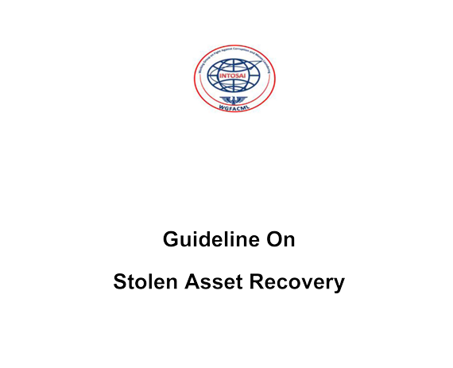
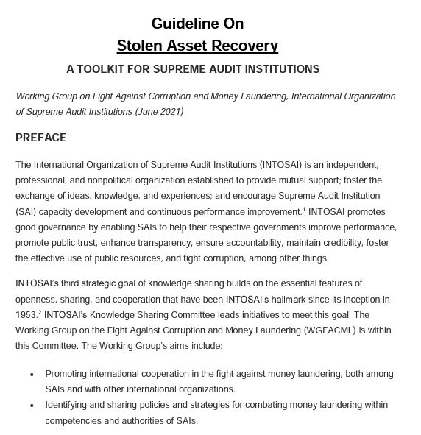
PERTAINING TO GOAL 1 DEVELOPING AND FINALIZING GUIDELINES
THE 15th INTOSAI KSC SC MEETING HOSTED BY: SAI UAE 4th of OCTOBER 2023
1-The Guideline on “Stolen Asset Recovery”:
2022
Notes:
The draft of the guide was published on the INTOSAI community portal. The presentation period ended on June 17, 2022. Currently, the Austrian Supreme Audit Institution (the head of the team responsible for preparing the guide) is summarizing the comments received from other bodies so that they can be taken into account when preparing the final version of the guide. Once completed, a quality assurance certificate will be signed for the guide.

Slide 5
THE 15th INTOSAI KSC SC MEETING HOSTED BY: SAI UAE 4th of OCTOBER 2023
1-The Guideline on “Stolen Asset Recovery”:
The Guideline was finalized and endorsed on the 8th of November 2022 during the 24th INCOSAI that was held in Brazil.
The Guideline was published on the INTOSAI WGFACML website on the INTOSAI Community Portal .
SAI USA was the Subgroup Leader.
The objectives of this document are :
Explaining the key steps of Stolen Asset Recovery efforts and thereof associated challenges, by means of summarizing the work of the experts in this field.
Providing usable guidance “a toolkit” for SAIs’ auditors working in the field of Stolen Asset Recovery.

Slide 6
THE 15th INTOSAI KSC SC MEETING HOSTED BY: SAI UAE 4th of OCTOBER 2023
2-The Guideline for “The Audit of Corruption Prevention in Public Procurement”:
2022

Slide 7
THE 15th INTOSAI KSC SC MEETING HOSTED BY: SAI UAE 4th of OCTOBER 2023
2-The Guideline for “The Audit of Corruption Prevention in Public Procurement”:
The Guideline was finalized and endorsed on the 8th of November 2022 during the 24th INCOSAI that was held in Brazil.
The Guideline was published on the INTOSAI WGFACML website on the INTOSAI Community Portal .
SAI Austria was the Subgroup Leader.
The objectives of this document are :
Providing general information on the phenomenon of corruption, represented in costs or causes of corruption on auditing the public procurement contracts.
Supporting public sector auditors in auditing the public procurements contracts or the individual public procurement policy of the entity .

Slide 8
THE 15th INTOSAI KSC SC MEETING HOSTED BY: SAI UAE 4th of OCTOBER 2023
3- The Guideline on “Auditing Anti Corruption Risk Management”:
SAI Austria is the Subgroup Leader.
Progress Accomplished:
After communicating with SAI Austria , they stated that they are in the process of identifying the potential partners for developing the guideline and they will start the work on the guideline before the end of 2023.

Slide 9
THE 15th INTOSAI KSC SC MEETING HOSTED BY: SAI UAE 4th of OCTOBER 2023
4- The Guideline on “The Audit of Whistleblowers Systems ”:
SAI Mexico is the Subgroup Leader.
The objectives of this document are :
Outlining the most relevant elements of a proper whistleblowing protection mechanism in order to serve as a supporting mechanism for SAIs to implement and/or audit Whistleblowers' protection systems.
Providing a practical tool for SAIs’ auditors to identify how to deal with Whistleblowers' protection systems.

Slide 10
THE 15th INTOSAI KSC SC MEETING HOSTED BY: SAI UAE 4th of OCTOBER 2023
Progress Accomplished:
SAI MEXICO has chosen QA level 2 for the Guideline.
SAI Mexico, the subgroup leader, has finalized the guideline’s draft project proposal for and the WG Secretariat has forwarded it to the KSC Secretariat for approval.
According to the project’s Milestones, the expected time for finalizing the Guideline is November 2024.

Slide 11
THE 15th INTOSAI KSC SC MEETING HOSTED BY: SAI UAE 4th of OCTOBER 2023
5- The Guideline on "Fighting Against Money Laundering":
The objectives of this document are :
Providing a user-friendly guideline that explains the key steps of fight against money laundering internationally.
Identifying SAIs’ potential audit areas, and providing a usable guidance for SAIs’ auditors in their audits of anti-money laundering activities.
The Guideline status
After communicating with SAI Poland (The Subgroup Leader), they notified that they can no longer pursue leading the Guideline Subgroup. Therefore, the new composition of the Guideline subgroup will be voted at the 16th WGFACML Meeting that will be held in Bangkok at the Kingdom of Thailand from the 10th to the 12th of October, 2023.

Slide 12
THE 15TH INTOSAI KSC SC MEETING HOSTED BY: SAI UAE 4TH OF OCTOBER 2023
6- The Guideline on “ Public Private Partnership Projects”:
The objectives of this document are :
Identifying the role of SAIs in the fight against corruption in the concession and public- private partnership projects.
Developing methods for the identification of the areas at risk.
Drafting practical guidelines on how to plan and conduct audits related to the fight against corruption in the concession and public –private partnership projects.
The Guideline status
After communicating with SAI Poland (The Subgroup Leader), they notified that they can no longer pursue leading the Guideline Subgroup. Therefore, the new composition of the Guideline subgroup will be voted at the 16th WGFACML Meeting that will be held in Bangkok at the Kingdom of Thailand from the 10th to the 12th of October, 2023.

Slide 13
PERTAINING TO GOAL 2 PROMOTING CAPACITY BUILDING OF SAIS’ PROFESSIONALS IN THE FIELD OF FIGHTING CORRUPTION AND MONEY LAUNDERING AS WELL AS ACTIVATING THE INTERNATIONAL COOPERATION BETWEEN THE INTOSAI WGFACML AND THE INTERNATIONAL AGENCIES
THE 15TH INTOSAI KSC SC MEETING HOSTED BY: SAI UAE 4TH OF OCTOBER 2023
The WGFACML Secretariat agreed with the World Bank representatives to conduct free training programs that would fulfil the most important needs of the WG member SAIs.
Notes:
▪.
The WG Secretariat held a series of virtual meetings with respectable representatives of the World Bank regarding conducting virtual training programs for the WGFACML member Supreme Audit Institutions, and it was agreed upon holding a set of virtual training programs during the next few months in order to fulfill the training needs of the WG member SAIs regarding issues related to fighting corruption and money laundering.

Slide 14
THE 15th INTOSAI KSC SC MEETING HOSTED BY: SAI UAE 4th of OCTOBER 2023
The WGFACML Secretariat, in collaboration with the World Bank, organized training programs for the WGFACML member SAIs such as:
A training course on “Forensic Audit” during February and March 2023.
A workshop on “Fraud and Corruption in Works Projects”-“Fraud and Corruption in Consulting Contracts” in January 2023.
A workshop on “Transnational Corruption Investigations, including -Depending on demand- with a special focus on remote and administrative instruments” in November 2022.
The cooperation is being completed between the WGFACML Sectt. and the World Bank to organize further training programs for the Working Group Member SAIs.
Notes:
▪.
The WG Secretariat held a series of virtual meetings with respectable representatives of the World Bank regarding conducting virtual training programs for the WGFACML member Supreme Audit Institutions, and it was agreed upon holding a set of virtual training programs during the next few months in order to fulfill the training needs of the WG member SAIs regarding issues related to fighting corruption and money laundering.

Slide 15
THE 15th INTOSAI KSC SC MEETING HOSTED BY: SAI UAE 4th of OCTOBER 2023
In May 2023, the WGFACML Secretariat has requested the WG member SAIs to fill out a questionnaire developed by the WG Secretariat to furnish it with their updated training needs, the best training and evaluation methods that suit them, and their preferences from educational sources or training institutions.
The on-going identification of further respectable training institutions according to the WG member SAIs needs in order to conduct other training courses that are not included in the World Bank's programs.

Slide 16
PERTAINING TO GOAL 3 SHARING BEST PRACTICES AND EXPERIENCES OF SAIS IN THE FIELD OF FIGHTING CORRUPTION AND MONEY LAUNDERING
THE 15th INTOSAI KSC SC MEETING HOSTED BY: SAI UAE 4th of OCTOBER 2023
A database has been set up on the Working Group's website including best practices, training materials, working papers and researches .
Within this framework, the WGFACML Secretariat has taken the following steps :
In May 2023, the WG Sectt. requested the best practices of the WG Member SAIs in the field of auditing in general and the fight against corruption in particular.
In August 2023, the WG Sectt. requested working papers and researches from the WG Member SAIs with relevance to the WG activities.

Slide 17
PERTAINING TO GOAL 3
THE 15th INTOSAI KSC SC MEETING HOSTED BY: SAI UAE 4th of OCTOBER 2023
In June 2023, The WG Secretariat issued the third Edition of the INTOSAI WGFACML’s Newsletter which included:
- SAIs’ publications in the field of Fighting Corruption and Money Laundering.
- The news provided by the WGFACML member SAIs regarding their activities or contributions locally or internationally.
In August 2023, preparations started for the release of the fourth Edition of the INTOSAI WGFACML’s Newsletter and therefore SAIs were requested to provide their contributions of articles, working papers, and research papers pertinent to the WG activities.

Slide 18
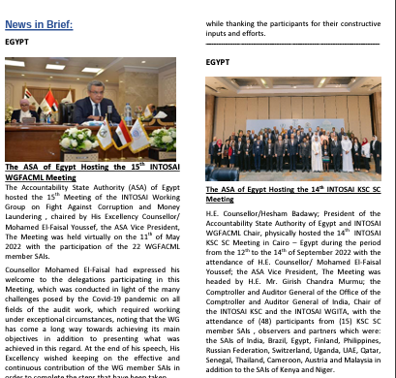
THE 15th INTOSAI KSC SC MEETING HOSTED BY: SAI UAE 4th of OCTOBER 2023
The three Issues of the Newsletter were published on the WGFACML’s website on the INTOSAI Community Portal, you can find them through the link:
https://intosaicommunity.net/wgfacml/newsletter/.

Slide 19
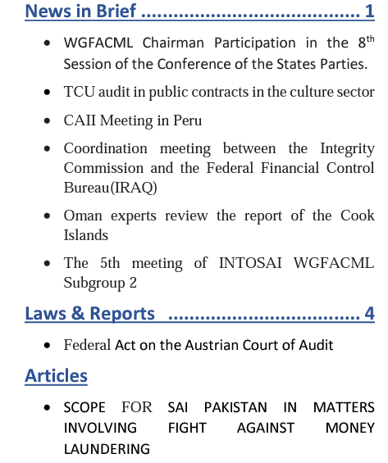
THE 15th INTOSAI KSC SC MEETING HOSTED BY: SAI UAE 4th of OCTOBER 2023
WGFACML Newsletter 1st Issue December 2019
WGFACML Newsletter 2nd Issue December 2021

Slide 20
THE 15th INTOSAI KSC SC MEETING HOSTED BY: SAI UAE 4th of OCTOBER 2023
THANK YOU.

