Slide 1
WORKING GROUP ON PUBLIC DEBT
Cora Lea A. dela Cruz
Commission on Audit
SAI Philippines
August 2017
Notes:
This year is a unique point in time for the Working Group on Public Debt (WGPD) as we endeavor to perform our mandate under a new leadership, guided by fresh strategies, and inspired by our renewed commitments.
As it sails forward to new horizons, the WGPD headed by SAI Philippines pledges to level up its sharing of the public debt knowledge and experience through stronger cooperation and support from the KSC.

Slide 2
WGPD CHAIRMANSHIP
Call for Chairmanship of the WGPD in Dec 2015 – Feb 2016
On 16 Dec 2016, Chair Michael G. Aguinaldo signified its interest to Chair the WGPD
On 19 Dec 2016, Mr. Portal confirmed the collaboration on the transition process with SAI of Philippines
Notes:
After the call for Chairmanship of the WGPD in December 2015 – February 2016, the Working Group members approved the SAI of Argentina’s application to take over the Chairmanship from 2017 onwards following a call for candidates in 2015. Weeks before the XXII INCOSAI, the SAI of Mexico received a communication from SAI of Argentina declining its nomination due to institutional changes.

Slide 3
CHAIRMANSHIP TRANSITION
A collaboration with SAIs of Mexico and Philippines
Notes:
It was in December 19, 2016 that SAI Philippines expressed its interest to spearhead the WGPD to which SAI Mexico willingly responded their support through a smooth transition process.

Slide 4
VIDEO CONFERENCES HIGHLIGHTS
14 Feb 2017
13 Mar 2017
27 Apr 2017
19 Jun 2017
Liaisons, contact information, and methodology for the smooth transition of the WG Chair defined
General overview of the WGPD Terms of Reference, Work Plan 2017-2019, Strategic Plan 2007-2016, Handbook for Meetings
Discussion of comments and suggestions of SAI Philippines on the four documents of SAI Mexico
Presentation of the WGPD Strategic Plan 2017-2022 Revision
15 Jun 2017
Confirmation on the continuance of the collaboration on the transition of WGPD Chairmanship by SAI Mexico
Notes:
From then on, both SAIs engaged in cooperative means of exchange as part of the transition process – Videoconferences were held on 14 February 2017, 13 March 2017, 27 April 2017, 15 June 2017, and 19 June 2017.

Slide 5
HAND-OVER OF DOCUMENTS AND MATERIALS BY SAI OF MEXICO
WGPD Terms of Reference
WGPD Strategic Plan 2007-2016
Handbook for Meetings of the INTOSAI WGPD
WGPD Draft Work Plan 2017-2022
WGPD Site Map
Notes:
Turn-over of documents from SAI Mexico to SAI Philippines happened at the onset of the transition process which started in February 2016 to August 2017. These documents became the focal point of the discussion in those five videoconferences as both SAIs did a walkthrough of WGPD documents to ensure that the transition process is in order.

Slide 6
PROJECTS AND ACTIVITIES
Notes:
The cooperation between the two SAIs reaped a number of results such as:
Drafting of the Guidance Materials to Revise the Working Group’s Strategic Plan. This document was exposed to all Task
Team members (SAIs of Russia, Moldova, US GAO), IDI as stakeholder, and Mexico as task team collaborator
- Draft work plan 2017 – 2019
With the generous help and support from Mexico, we, the WGPD, is ready to take on its projects and activities. (show Slide 7)

Slide 7
WGPD WORK PLAN 2017-2019
Dissemination of the Draft Work Plan to SAI members for comment and suggestions
Survey to identify the Project Task Teams for Project 2.9 of the IFPP on the Harmonization of ISSAIs on Public Debt with ISSAI 100
Revision of the WGPD Strategic Plan 2017-2019 aligned with the KSC Work Plan 2017-2019 and IFPP Strategic Development Plan 2017-2019
INITIATIVES/ACTIONS TAKEN
Notes:
Status of Projects and Activities
SAI Phils and Mexico with guidance from KSC drafted jointly the WGPD Workplan 2017-2019, which initially covered the activities indicated in the minutes of the 2016 WGPD meeting in Nanjing, China. The draft WP was revised in consideration of the following: (i) Project 2.9 on harmonization of existing ISSAIs on public debt as indicated in the SDP IFPP 2017-2019; (ii) development of the WGPD Strategic Plan 2017-2019.
Thus, to come up with a more concrete WP, we have so far conducted a survey inviting and encouraging our members to take part in Project 2.9. (Project and its status to be discussed in succeeding slides). Also, steps until initial draft version of the StratPlan were pursued. (Project and its status to be discussed in succeeding slides).
For Project 2.9 which aims to consolidate and align the audit of public debt with ISSAI 100, refer to slide 8.

Slide 8
Project 2.9 of the SDP for the IFPP Consolidation of Public Debt ISSAIs
ISSAI 5410
ISSAI 5411
ISSAI 5421
ISSAI 5422
ISSAI 5430
ISSAI 5440
Guidance for Planning and Conducting an Audit of Internal Controls of PD
Debt Indicators
Guidance on definition and Disclosure of PD
An Exercise of Reference of Terms to Carry Out Performance Audit of PD
Fiscal Exposures: Implications for Debt Management and the Role of SAIs
Guidance for Conducting a PD Audit: The Use of Substantive Tests in Financial Audits
Consolidating and aligning the audit of public debt with ISSAI 100
Notes:
Strategic Development Plan (SDP) for the INTOSAI Framework of Professional Pronouncements (IFPP) 2017-2019
a. Project 2.9 of the SDP for the IFPP falls within tentative projects under priority 2 which deals with consolidating and aligning the audit of public debt with ISSAI 100. As noted in Project 2.9 “consolidating and aligning the audit of public debt with ISSAI 100”, as one of the tentative projects under Priority 2 (Guidance by 2019 to support ISSAI implementation of the SDP), there is a lot of repetition and numerous redundancies in the existing documents. These should be cleared and merged and furthermore be aligned with ISSAI 100 “Fundamental Principles of Public-Sector Auditing”.
b. Task teams for Project 2.9 will be created based on the survey results; since only xx out of xx members had responded to the survey, a follow up email shall be sent to solicit more task members (until August 15, 2017)
c. TWG of the WGPD Phils has started mapping the items in these ISSAIs which need harmonization and alignment with ISSAI 100; thereafter, a guidance material on how to revise or harmonize these ISSAIs shall be prepared for comment by or discussion with the WGPD members at the Annual Meeting in September.

Slide 9
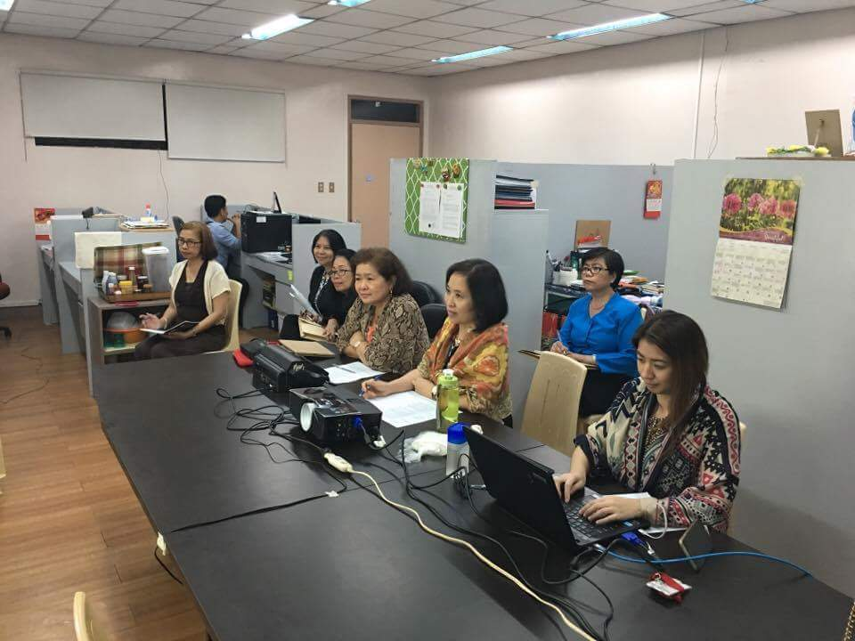
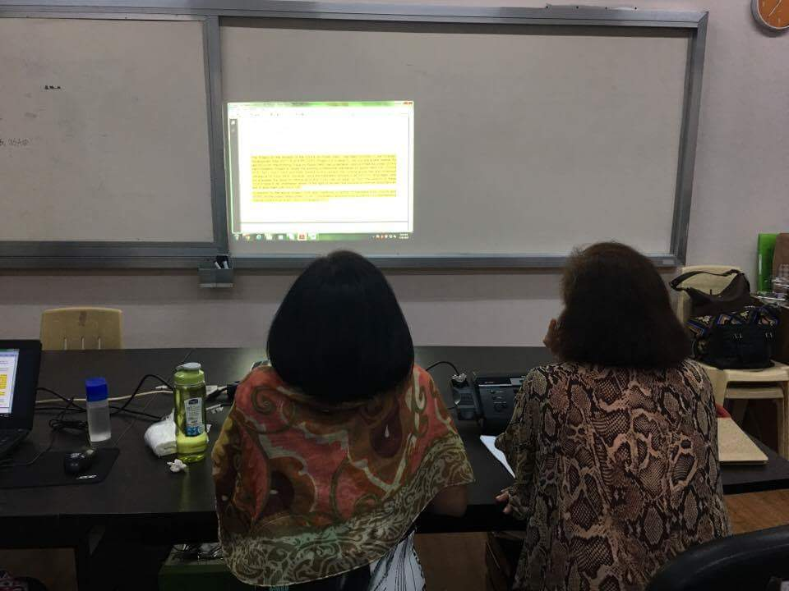
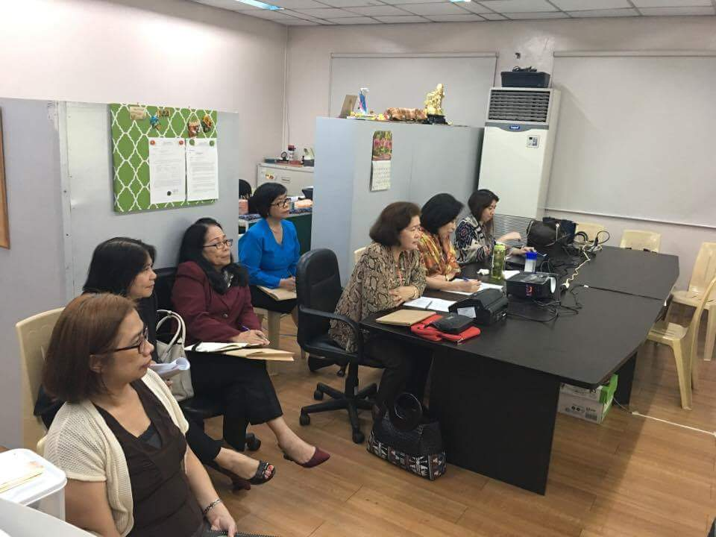
TELECONFERENCE HIGHLIGHTS IFPP SDP 2017-2019
Agreements of the Teleconference
Concentration on Project 2.9 of the IFPP SDP 2017-2019
Submission of the Project Proposal to FIPP after the 2017 WGPD Annual Meeting on September 2017
Assistance and guidance by Mr. Novy Pelenkahu, FIPP Liaison Officer
TELECONFERENCE WITH FIPP
20 JULY 2017 | 08:30 PM – 9:00 PM MNL
Notes:
Following the Research Paper related to Project 2.9 by Mr. Novy Pelenkahu, FIPP Member, Liaison Officer for Project 2.9, a teleconference was scheduled on 20 July 2017 with FIPP to provide clarifications and guidance to the WG.
Agreements reached during the teleconference, among others, are as follows:
Mr. Novy Pelenkahu, Liaison Officer, FIPP, suggested to postpone the Guideline on Public Debt Management Office and the WGPD to concentrate on Project 2.9;
Submission of the Project Proposal to FIPP after the 2017 WGPD Annual Meeting on September 2017; and
Regular assistance and guidance by Mr. Pelenkahu on issues and concerns in Project 2.9

Slide 10
SURVEYS TO WGPD SAI MEMBERS
(1)
Call for comment on the Draft Work Plan 2017-2019
(2)
Call for Participation in Project 2.9 of the IFPP SDP 2017-2019
(3)
Call for participation on WGITA, WGAP, and WGADA projects on audits of internal control, privatization, and disaster-related aid
Notes:
As we intend to take a lead on the projects and activities of the WG for 2017-2019, three (3) surveys were conducted in July 2017 – (i) call for participation in Project 2.9 of the IFPP SDP 2017 – 2019; (ii) call for participation on WGITA, WGAP, and WGADA projects on audits of internal control, privatization, and disaster-related aid; and (iii) call for comments on the Draft Work Plan 2017 – 2019. Another survey that was initiated by SAI Mexico was conducted in June 2016 on updating of public debt experts’ database.
Call for comment on the Draft Work Plan 2017-2019
We have disseminated the draft work plan to SAI members, for comments and suggestions thru e-mail on 13 July 2017 as shown in slide 7.
Call for participation in Project 2.9 of the IFPP SDP 2014-2019
Following the e-mail communications from the SAI of India as KSC Chair relative to the various projects of the WGPD under the SDP of IFPP 2017-2019
The call for participation on WGITA, WGAP, and WGADA projects on audits of internal control, privatization, and disaster-related aid, respectively
Coordination with FIPP thru KSC on projects under the SDP of IFPP 2017-2019 (2.5 Consolidated and improved guidance on understanding internal control in an audit, 2.7 Consolidating and aligning guidance for audits of Privatization with ISSAI 100, and 2.10 Consolidating and aligning the audit of disaster-related aid with ISSAI 100). These were discussed in the teleconference with FIPP representatives on 20 July 2017 on guidance for Projects 2.9 and 2.5.
Updating of data of experts in public debt auditing

Slide 11
Survey Status – Project Task Teams Call for Participation in Project 2.9 of the IFPP SDP 2017-2019
13 out of 25 SAI members acknowledged receipt
9 SAI member-respondents
Survey Results as of 18 August 2017
Role | ISSAI 5410 | ISSAI 5411 | ISSAI 5421 | ISSAI 5422 | ISSAI 5430 | ISSAI 5440 | GUID on Audit of PDMO
Task Leader | USA | - | - | - | - | USA | -
Task Member | Chile, China, India | Chile, China, Fiji, India, Portugal | Chile, China, India, Portugal, Ukraine | Chile, Fiji, India, USA | Brazil, Chile, China, India, USA | Austria, Chile, China, India | Chile, Portugal
Notes:
13 SAI members with acknowledgement receipt on survey re- Project Task Team for project 2.9, to wit:
Austria; 2) Brazil; 3) Chile; 4) China; 5) Fiji; 6) Finland; 7) India; 8) Korea; 9) Lithuania; 10) Portugal; 11) Russia; 12) Ukraine; and 13) USA
From among the 13 SAI members above, 4 SAIs did not respond with their duly accomplished survey forms and/or would not be able to participate on the said project, to wit:
1) Finland; 2) Korea; 3) Lithuania; and 4) Russia

Slide 12
Survey Status – Draft Work Plan Call for comment on the Draft Work Plan 2017-2019
Responses as of
18 Aug 2017
Argentina
Research Technical Proposal for ISSAIs harmonization on Public Debt
China
We think that it would be better to harmonize ISSAI 5450 with the new ISSAI 100 this time. Considering that the work plan covers 3 years, though approved in 2016, ISSAI 5450 should be updated by 2019, and by then all ISSAIs related to public debt would have been harmonized with ISSAI 100
Fiji
I would agree with the comment not to include ISSAI 5420 till the translation is completed to ensure that it is understood by all
Georgia
USA
10 out of 25 SAI members acknowledged receipt
5 SAI members submitted comments on the draft Work Plan (ver. 08 March 2017)
Our team expresses the readiness to contribute to the fulfilment of the announced obligations
I suggest that ISSAI 5450 be treated like the rest of the ISSAIs/GUID and included in the harmonization. This will help ensure consistency among all of the ISSAIs
Notes:
9 SAI members with acknowledgement receipt on e-mail re- call for comment on the draft work plan, to wit:
Argentina; 2) Austria; 3) China; 4) Fiji; 5) Finland; 6) Georgia; 7) Korea; 8) Lithuania; 9) Ukraine; and 10) USA
From among the 10 SAI members above, 5 SAIs confirmed no comment on the draft work plan, to wit:
1) Austria; 2) Finland; 3) Korea; 4) Lithuania; and 5) Ukraine

Slide 13
Survey Status – Other Projects under SDP of IFPP Call for participation on WGITA, WGAP, and WGADA projects on internal control, privatization and disaster-related aid
As of 18 August 2017
Fiji
We would like to express our interest in participating in the preliminary group of SAIs to assess the need to revise the ISSAIs relative to the Privatisation (Project 2.7) and Disaster-related aid (Project 2.10).
Romania
We would like to inform you about our interest to participate in the project 2.10 having as representative Mrs. Carmen Stanescu, councellor of accounts and member of the Court and Mrs Eugenia Iancului, auditor as contact person.
USA
We are supportive of the initiative for the WGPD and WGITA to work together on internal control guidance.
Philippines
Ukraine
7 out of 25 SAI members acknowledged receipt
SAI of Philippines and 4 other SAI members expressed interest to participate on the project/s
We will also take active participation in Projects 2.5, 2.7, and 2.10
We would like to express our interest in participating in the Project 2.10 – Disaster-related aid.
Notes:
7 SAI members with acknowledgement receipt on e-mail re- call for participation on WGAP, WGITA and WGADA projects on audits of internal control, privatization, and disaster-aid, respectively, to wit:
Austria; 2) Fiji; 3) Finland; 4) Korea; 5) Romania; 6) Ukraine; and 7) USA
From among the 7 SAI members above, 3 SAIs did not signify their interest to participate and/or would not be able to participate on any other SDP above-stated projects, to wit:
1) Austria; 2) Finland; and 3) Korea

Slide 14
Network of Experts Updating of Experts Database
Bulgaria
Philippines
Fiji
Korea
Russia
Moldova
5 out of 25 SAI members with updated data of Expert in Public Debt Auditing
As of 18 August 2017
Notes:
As of August 2017, five SAIs (Bulgaria, Fiji, Moldova, Korea, and Russia had updated their list of experts in public debt auditing.

Slide 15
WGPD REPORTING DASHBOARD
WGPD Contribution to the implementation of the Strategic Objectives and Cross-Cutting Priorities
Notes:
Slide 15.
To conform with the requirements of the KSC, we report the following actions and status to implement the strategies and initiatives that have been initially identified as part of the WGPD Contribution to the implementation of the strategic objectives and cross cutting priorities. Please note that due to the prevailing circumstances on the WGPD Chairmanship for 2017 – 2019 that affected the activities of the WGPD, these strategies and activities as well as the projects previously presented, will have to be discussed to the WGPD members at its annual meeting scheduled on September 27 – 29, 2017.
The WGPD will strive to contribute to the implementation and eventual success of the KSC strategic objectives and/or priorities that are aligned with the Strategic Plan 2017 – 2022 of the INTOSAI. (Read the slides 16 to 19)

Slide 16
Reporting Dashboard to KSC
INTOSAI Strategic Plan
2017-2022
KSC Work Plan 2017-2019
WGPD Strategic Plan
2007-2016
Notes:
Main Point - Reporting Dashboard : WGPD Contribution to the implementation of the strategic objectives and cross cutting priorities
The Reporting Dashboard will be prepared based on the matrix of comparison between the INTOSAI SP 2017-2022; KSC WP 2017-2019; WGPD SP 2007-2016; This will then be the basis for the drafting of the WGPD SP 2017-2022, which shall be sent to SAIs of Russia, US GAO and Moldova for comment.

Slide 17
Reporting Dashboard to KSC
INTOSAI Strategic Plan
2017-2022
KSC Work Plan 2017-2019
WGPD Strategic Plan
2007-2016
Notes:
Main Point - Reporting Dashboard : WGPD Contribution to the implementation of the strategic objectives and cross cutting priorities
The Reporting Dashboard will be prepared based on the matrix of comparison between the INTOSAI SP 2017-2022; KSC WP 2017-2019; WGPD SP 2007-2016; This will then be the basis for the drafting of the WGPD SP 2017-2022, which shall be sent to SAIs of Russia, US GAO and Moldova for comment.

Slide 18
Reporting Dashboard to KSC
INTOSAI Strategic Plan
2017-2022
KSC Work Plan 2017-2019
WGPD Strategic Plan
2007-2016
Notes:
Main Point - Reporting Dashboard : WGPD Contribution to the implementation of the strategic objectives and cross cutting priorities
The Reporting Dashboard will be prepared based on the matrix of comparison between the INTOSAI SP 2017-2022; KSC WP 2017-2019; WGPD SP 2007-2016; This will then be the basis for the drafting of the WGPD SP 2017-2022, which shall be sent to SAIs of Russia, US GAO and Moldova for comment.

Slide 19
Reporting Dashboard to KSC
INTOSAI Strategic Plan
2017-2022
KSC Work Plan 2017-2019
WGPD Strategic Plan
2007-2016
Notes:
Main Point - Reporting Dashboard : WGPD Contribution to the implementation of the strategic objectives and cross cutting priorities
The Reporting Dashboard will be prepared based on the matrix of comparison between the INTOSAI SP 2017-2022; KSC WP 2017-2019; WGPD SP 2007-2016; This will then be the basis for the drafting of the WGPD SP 2017-2022, which shall be sent to SAIs of Russia, US GAO and Moldova for comment.

