Slide 1
Status of Activities Working Group on Public Debt
Commissioner Roland Café Pondoc
Representative, Chair of the WGPD
Commission on Audit

Slide 2
On SO 1. Develop and maintain expertise in the various fields of public-sector auditing and help to provide content to the IFPPs.
IFPP Project 2.9
On consolidation and alignment of PD ISSAIs with ISSAI 100
(GUID 5250 – Guidance on the Audit of Public Debt – to be formally pronounced at the 2022 INCOSAI)
On withdrawal of existing Public Debt ISSAIs
(to be initiated by the PSC)
1
2

Slide 3
On relevant PD ISSAIs’ provisions not included in the GUID 5250 but may be developed as non IFPP guidance material mapped and analyzed
Ongoing
Non-IFPP product
(WGPD WP 2020-2022)
An Audit Reference on Fiscal Exposures (ED posted at the KSC Community Portal for public exposure until November 2, 2022)
Proposed non-IFPP products
(WGPD WP 2023-2025)
Role of SAIs in Debt Sustainability
Compendium of Audit Objectives and Procedures in the Audit of Internal Control of PD
General Guidance on the Definition, Structure, and Disclosure of PD
PD Bibliogra-phies and Glossary

Slide 4
Non-IFPP guidance material relevant to PD Auditors in light of COVID-19 pandemic
Ongoing Non-IFPP product
(WGPD WP 2020-2022)
ED under development
Compendium of Case Studies: Impact of Recent Health and Other Crises to Public Debt and Debt Management

Slide 5
Other Projects carried forward from WGPD Workplan 2017-2019
Ongoing Non-IFPP products
(WGPD WP 2020-2022)
Understanding PD Authorization, Contracting, and Legal Framework of Different Countries
Mapping of SAIs’ Mandates on the Audit of PD, Institutional Capacities, & the Regional Organizations’ support and Resources
Guidelines in the Audit of Government Guarantees
ED posted at the KSC Community Portal for public exposure until September 30, 2022
ED under development

Slide 6
On SO 2. Enable wide exchange of knowledge and experience among INTOSAI members
Virtual Meetings
Three (3) annual meetings of the WGPD
WGPD CoP
Announcements and important information
WGPD FB page
Launched in July 2022
Meetings with project groups & stakeholder partners
Shared audit reports from SAIs
Announcements and important information

Slide 7
On Generation and dissemination of knowledge and experiences
Events jointly organized
Debt Management Auditors’ Week
Webinars jointly hosted
Role of External Audits in Improving PDM
Special Session for Debt Managers & Auditors
Updated DeMPA Methodoly
Webinar invitations
● DeMPA Facilitated e-Course
● Sovereign Debt Managers and Investors: Bridging the Gaps on Environmental, Social, and Governance Issues
● The Impact of Climate Change on Soverign Risks
● 2021 Perspective on Business Continuity Organizational Resilience in DMOs

Slide 8
On Stakeholder engagement: Improved level of perception on the relevance of the WGPD
Increasing membership & Regional representation
Enhance collaboration with external stakeholders
A total of 40 members representing all Regional Organizations
Participation in the development of the handbook on on Promoting Independent External Audits on Credibility of Government Budget
Foster inclusivity & balanced regional representation in WGPD activities
Creation of a WGPD Steering Committee represented by members from each RO

Slide 9
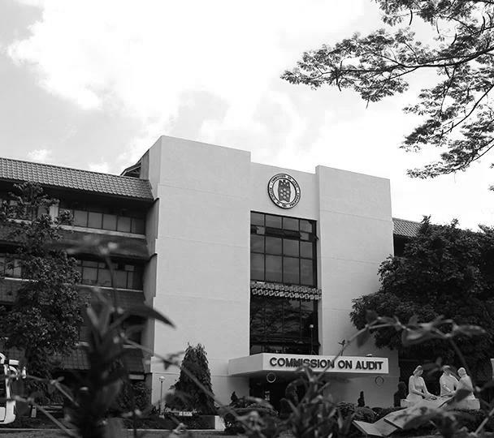
Thank you for your attention!

