Slide 1
THE INTOSAI WORKING GROUP ON KEY NATIONAL INDICATORS
WORKING GROUP ACTIVITIES REPORT (2016 – 2017)
The Secretariat of the INTOSAI Working Group on Key National Indicators
Bali, August 23-25, 2017

Slide 2
THE WORKING GROUP ACTIVITIES REPORT
10th meeting of the Working Group on KNI in Brazil (Brasilia), April 2016
an ISSAI development (based on the guidance document ‘Key National Indicators: Guidance for Supreme Audit Institutions’):
Initial assessment
Project proposal
an interim report on the subproject ‘Key National Indicators and Public Governance’
a new subproject on development of Guidance on audit of macroeconomic forecasts
development of the Knowledge base on KNI (Twitter initiative)
results of the Expert group activities

Slide 3
THE WORKING GROUP ACTIVITIES REPORT
Professional standard on audit of the use and development of key national indicators
The main task is to clarify:
What are KNI and what is a KNI system?
What is the role of KNI verifying the goal attainment in the sphere of the socio-economic development?
How is data quality defined?
What is the role of auditing the use and development of KNI in strategic task solving and strategic goal attainment?
What are the peculiarities of using the KNI in knowledge-based economies and in developing economies?

Slide 4
THE WORKING GROUP ACTIVITIES REPORT
Professional standard on audit of the use and development of key national indicators
International documents where the key indicators are considered:
Macroprudential Policy: an Organising Framework, IMF 2011.
Key Aspects of Macroprudential Policy, IMF, 2013.
A Framework to Measure the Progress of Societies, OECD, 2010.
Handbook on Constructing Composite Indicators. Methodology and User Guide, OECD, 2008.
OECD Guidelines on Measuring Subjective Well-Being, OECD, 2013.

Slide 5
THE WORKING GROUP ACTIVITIES REPORT
Subproject ‘Key National Indicator Systems and Public Governance’
(coordinator – SAI of Brazil)
The WG members were reported the results of the tentative survey aimed to evaluate the preparedness of governments and SAIs with regard to KNI and public governance.
The survey dealt with KNI as a tool for the public decision-making process and observed the role that the SAI could play in strengthening the public administration.
More detailed information is presented in the Brazilian presentation (http://kniknowledgebase.org/Discussion/topic/materials-of-the-wgkni-10th-meeting/)

Slide 6
THE WORKING GROUP ACTIVITIES REPORT
Subproject ‘Guidance on the audit of macroeconomic forecasts’
(coordinator – SAI of Russia)
Aims of the project :
• to enhance SAIs’ role in the assessment of reliability and soundness of macroeconomic forecasts;
• to expand the scope of analysis of fiscal projections conducted by SAI’s with an auditors opinion on the reliability and soundness of macroeconomic forecasts;
• to highlight the importance of reliable macroeconomic forecasts in policy development and achievement of strategic goals;
• to support feasibility of strategic goals attainment via application of reliable macroeconomic forecasts in decision making process.

Slide 7
THE WORKING GROUP ACTIVITIES REPORT
Subproject ‘Guidance on the audit of macroeconomic forecasts’
(coordinator – SAI of Russia)
Tasks of the project:
• determine the place of audit of macroeconomic forecasts within SAI’ activities;
• review the best practice of the audit of macroeconomic forecasts;
• arrange (systematize) the process and procedures within the audit, audit issues, criteria and methods;
• develop proposals on the SAI’ capacity building.

Slide 8
THE WORKING GROUP ACTIVITIES REPORT
Knowledge base on KNI – kniknowledgebase.org
Knowledge base contains:
About us
Glossary
Group members
Discussion
Analytical materials and other sources
Videoconference
Surveys

Slide 9
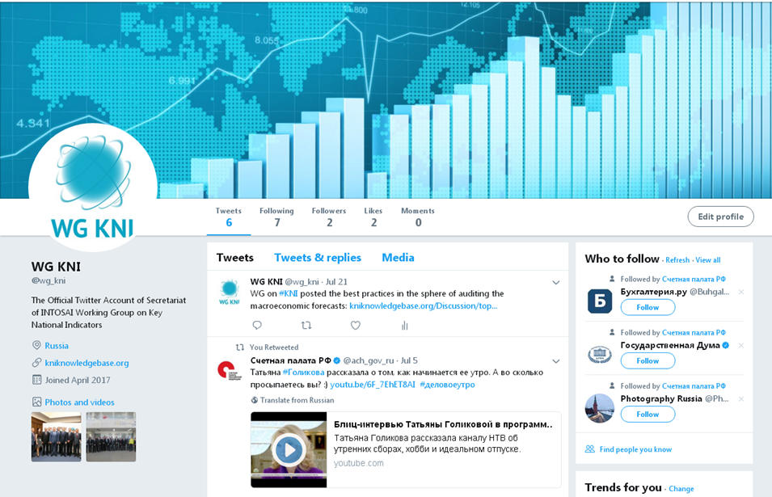
THE WORKING GROUP ACTIVITIES REPORT
Working group on KNI on Twitter
(www.twitter.com/wg_kni)

Slide 10
THE WORKING GROUP ACTIVITIES REPORT
10th meeting of the Expert group on KNI in Kazakhstan, June 2017
an interim report on the subproject on studying the issues of sustainable development in CIS member-states
a questionnaire on the macroeconomic forecasts’ issues

Slide 11
THE WORKING GROUP ACTIVITIES REPORT
working plan for 2017 adopted
11th Meeting of the Working Group on KNI to be held in Italy in spring 2018

Slide 12
THE WORKING GROUP ACTIVITIES REPORT
Main directions of the Group’s activities in 2017
starting the development of the professional standard on audit of the use and development of key national indicators
joining the efforts of SDG implementation
developing the Knowledge base on KNI
approving the draft framework agreement on cooperation between INTOSAI and the OECD
developing the subproject ‘Key national indicators systems and public governance’
finalizing the Expert group on KNI subproject on studying the issues of implementing sustainable development goals in CIS to incorporate the results in the future standard
starting a new subproject on the audit of macroeconomic forecasts

Slide 13
THE WORKING GROUP ACTIVITIES REPORT
THANK YOU!

