Slide 1
INTOSAI WGEA
The 14th Steering Committee Meeting of the INTOSAI KSC
Dr. Vivi Niemenmaa, 13 September 2022

Slide 3
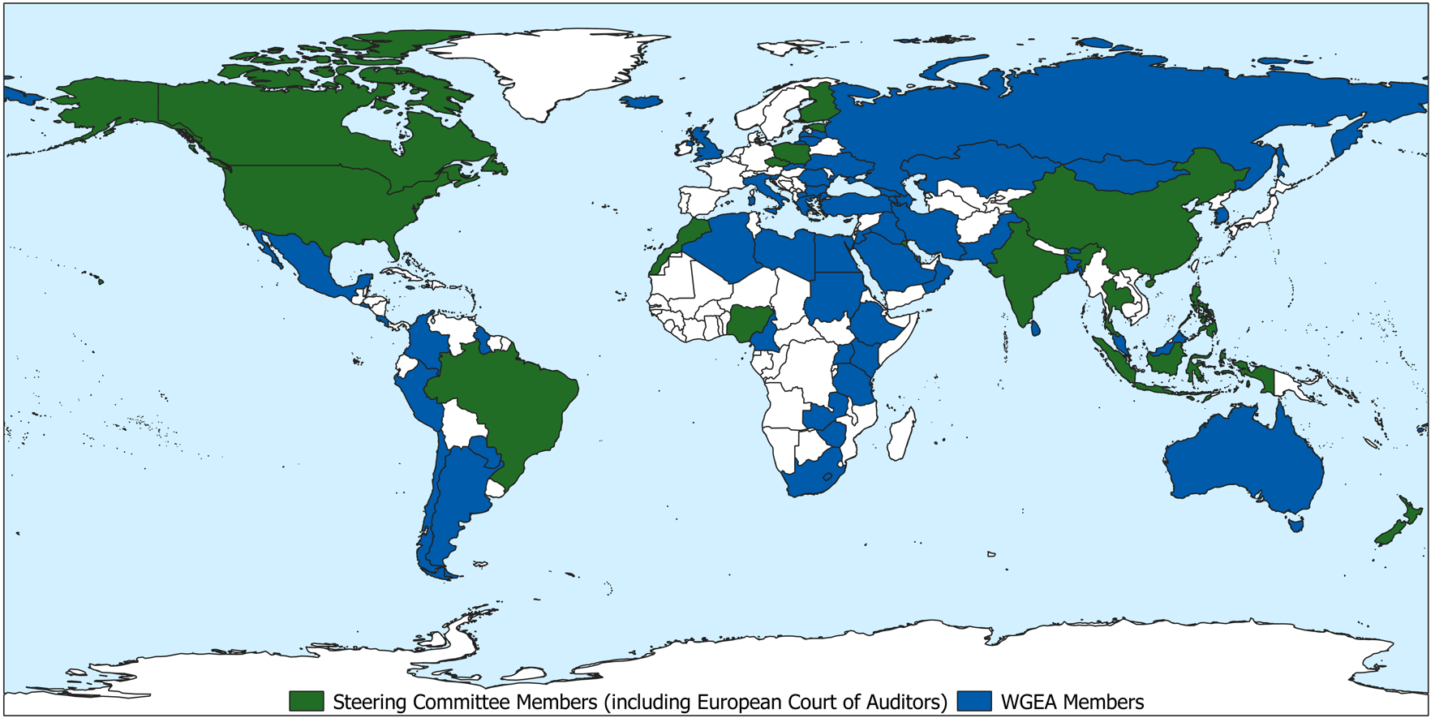
Currently 82 Member SAIs

Slide 4
Six Regional Working Groups
AFROSAI (Nigeria)
ARABOSAI (Kuwait)
ASOSAI (China)
EUROSAI (Poland)
COMTEMA (Brazil)
PASAI (New Zealand)

Slide 5
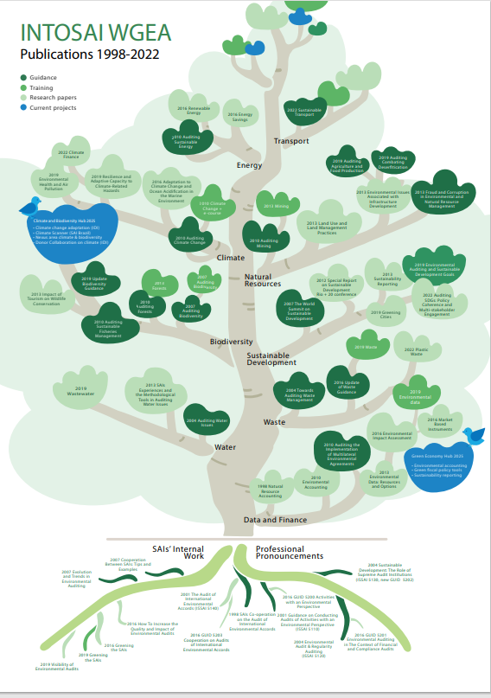

Slide 6
VISION For a common sustainable future – innovative environmental auditing

Slide 7
KEY GOALS: Increase the expertise in environmental auditing globally Enhance environmental governance with high-quality contribution and visibility

Slide 8
WGEA contribution to the implementation of the KSC strategic objectives

Slide 9
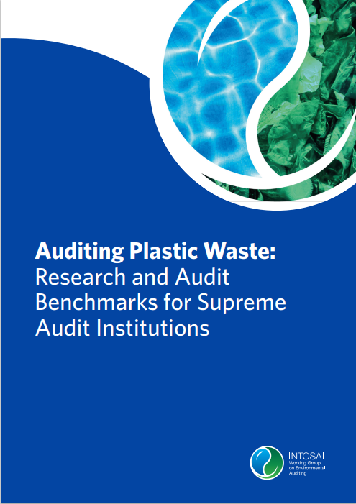
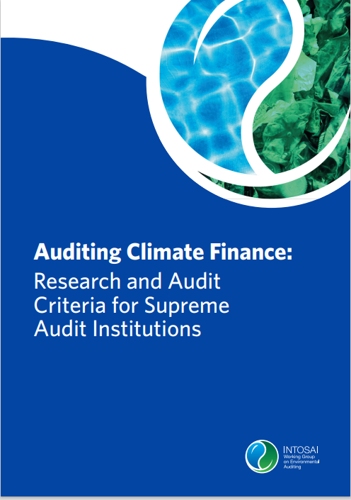
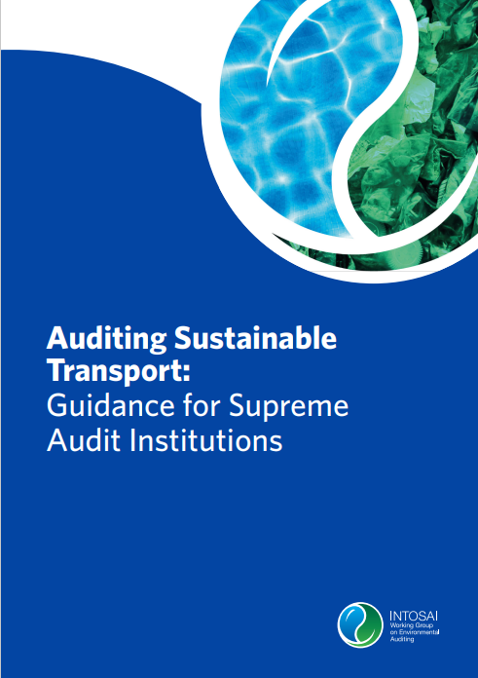
KSC 1: Develop and maintain expertise in the various fields of public–sector auditing and help to provide content to the IFPP
In 2020-2022, WGEA published four reports with level-3 quality assurance:

Slide 10
…KSC 1 on GUIDs
2021
An attempt to update the GUID 5202 on sustainable development in cooperation with WGSDG KNI
2023–2025
Merging the environmental GUIDS 5200, 5201 and 5203, as well as relevant parts of GUID 5202 in order to streamline the framework and make the GUID more user friendly

Slide 11
…KSC 1
Other publications
Summary report on the Work Packages
Seminar summaries on the Assembly topics (circular economy and upcoming one on climate resilience)
Experience sharing material on Citizen Participatory Audit
Bulletins (climate, SDG 14 & SDG 15, 30 years of WGEA)
Launch of a blog series
Collaboration with stakeholders
Large round of stakeholder interviews in 2021 to build and deepen existing relationships and get input for the strategy and work plan

Slide 12
KSC 2: Enable wide exchange of knowledge and experience among INTOSAI members
Two large Assemblies
Full virtual 20th Assembly in January 2021
Hybrid 21st Assembly in July 2022
Launch of an annual webinar in the context of climate COP climate conferences
Training activities: iCED training centre in India, MOOCs by SAI Estonia
Website, LinkedIn, Twitter
Environmental audit database allows benchmarking
These activities will continue in 2023-2025, with incresed focus on:
Diversity of products, including short seminars and podcasts
Piloting of twinning between newcomers and more experienced auditors and SAIs

Slide 13
KSC 3: Working with the CBC, IDI, and other INTOSAI entities, facilitate continuous improvement of SAIs through knowledge sharing
WGEA applied for an observer status in the CBC
Collaboration with IDI especially with SDG-related topics
In 2023-2025, a collaborative audit project on climate change adaptation together with the IDI and collaboration with IDI Donor Cooperation on climate change

Slide 14
Longer-term strategy up to 2030 Work Plan 2023-2025

Slide 15
CLIMATE AND
BIODIVERSITY HUB
GREEN
ECONOMY HUB
Climate Scanner: Collaborative Rapid Reviews, Cooperation with SAI Brazil
Environmental Accounting
Collaborative Audits on Climate Change
Adaptation, Cooperation with IDI
Green Fiscal Policy Tools
INTOSAI-Donor Cooperation on Climate Change
Sustainability Reporting
Nexus Area: Climate and Biodiversity

Slide 16
Contact:
www.wgea.org
@WGEASecre
intosaiwgea@vtv.fi

Slide 17
Thank you!

