Slide 1
INTOSAI WGEA PROGRESS REPORT
The 10th INTOSAI KSC MEETING
20 – 22 AUGUST 2018
KAMPALA, UGANDA
Notes:
Greetings

Slide 2
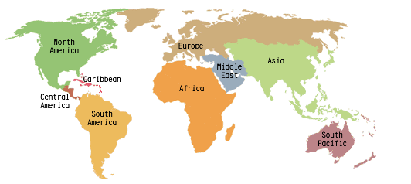
WGEA MEMBERSHIP
77 members
WGEA Sterring Commitee Members (16 members)
Brazil, Cameroon, Canada, China, Czech Republic, European Court of Auditors (ECA), Estonia, India, Indonesia, Kuwait, Lesotho, Morocco, New Zealand, Pakistan, Philippines, United States
Coordinators of Regional WGEA
ACAG/PASAI: New Zealand
AFROSAI: Cameroon
ARABOSAI: Kuwait
ASOSAI: China
EUROSAI: Estonia
OLACEFS:Brazil

Slide 3
The 2017 – 2019 Work Plan
Goal 1
Goal 2
Goal 3
Up-date existing and develop new guidance materials available to SAIs, conduct research studies on emerging topics in environmental auditing
Facilitate concurrent, joint, and coordinated audits
Enhance information dissemination, exchange, and training
Goal 4
Increase cooperation between the WGEA, international organizations and other INTOSAI bodies
www.wgea.org

Slide 4
MILESTONE
1
Draft project plan
April 2017
2
Comments from SC members
April – May 2017
3
Approval of project plan
Sept 2017
4
Final version project plan
Oct 2017
5
Elaborated table of contents
Dec 2017
6
Draft output
July 2018

Slide 5
Goal 1
Guidance Materials:
Climate Change
Agriculture and Food Production
Land Organization and and soil quality management
SDGs – through environmental auditing
Research Papers:
Visibility of environmental auditing
Environmental Health
Waste Water
Greening Cities

Slide 6
Goal 2
Encourage regional Cooperative Audits
Encourage other Cooperative Projects in Regional WGEA

Slide 7
Goal 3
Assembly Meetings, Regional Annual Meetings
Trainings on Environmental Auditing
Develop new Training Tools
Publish Greenlines
9th Environmental Survey
Audit report collection

Slide 8
Goal 4
Cooperation with the CBD Secretariat (Convention on Biological Diversity)
Auditing Biodiversity: Guidance for Supreme Audit Institutions
Continuous cooperation with the UNEP, UNDESA
Establishing new partnerships

Slide 9
QA LEVEL
No | Project | QA LEVEL
Guidance
1 | Climate Change: Strengthen resilience and adaptive capacity to climate-related hazards and natural disasters in all countries | QA 3
2 | Auditing Agriculture and Food Production: Guidance for SAIs | QA 3
3 | Auditing Land organization and soil quality management - Combating desertification: Guidance for SAIs | QA 2
4 | Delivering the 2030 Agenda (Sustainable Development Goals) through Environmental Auditing | QA 2
5 | Update the INTOSAI WGEA 2007 Guidance Material on Auditing Biodiversity | QA 2

Slide 10
QA LEVEL
No | Project | QA LEVEL
Research Projects
6 | Visibility on Environmental Auditing (Communication) | QA 3
7 | Environmental Health (focus on Air Pollution) | QA 3
8 | Greening Cities | QA 3
9 | Water Sanitation (Waste Water) | QA 3
Training tools
10 | E-learning Course (MOOC) on waste | QA 2
11 | Training tools on greening the SAIs | QA 3
12 | Training Tool on: Environmental Data: Resources and Option for SAIs | QA 3

Slide 11
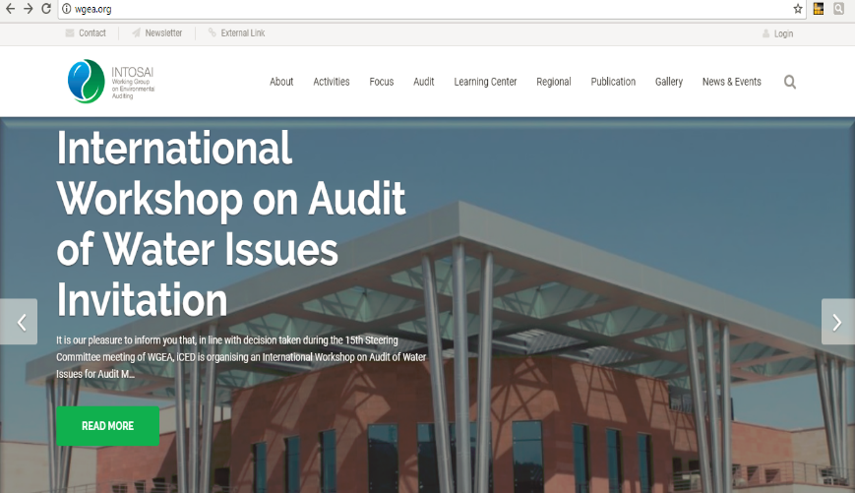
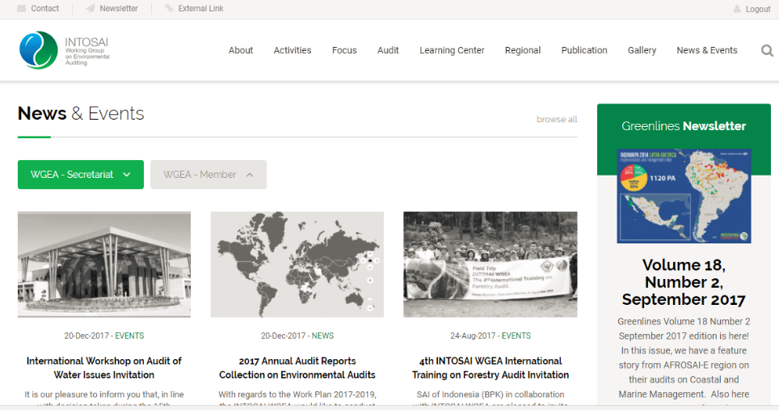
More information, please click www.wgea.org

