Slide 1
INTOSAI Working Group on Big Data
INTOSAI KSC
National Audit Office of China
CONTRIBUTION TO THE IMPLEMENTATION OF THE STRATEGIC OBJECTIVES AND CROSSCUTTING PRIORITIES
20-22 August 2018, Kampala, UGANDA
Natiaonal Audit Office of China

Slide 2
CONTENT
The strategic objectives and crosscutting priorities
Update on WGBD
Big data audit practice on SDG implementation
Developing Workplan 2020-2022

Slide 3
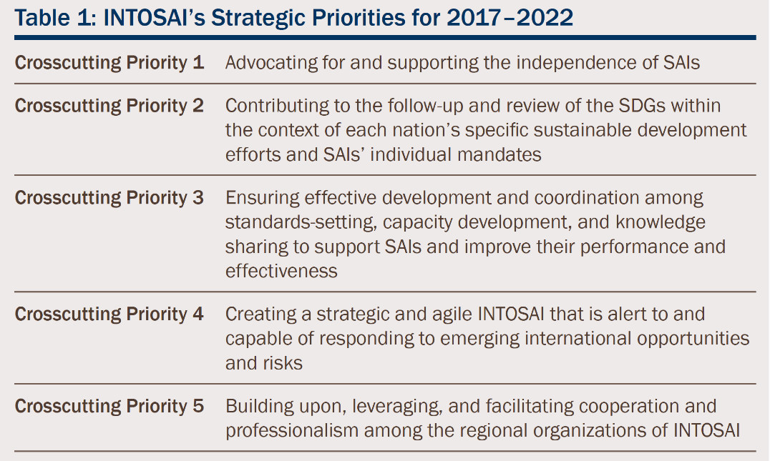
THE STRATEGIC OBJECTIVES AND CROSSCUTTING PRIORITIES
INTOSAI Strategic plan 2017-2022

Slide 4
THE STRATEGIC GOALS OF WGBD
1.
2.
Identify opportunities and challenges SAIs are facing in a big data world to make recommendations to SAIs.
Summarize the know-how, experiences and good practices concerning big data audit to help SAIs boost relevant skills.
3.
4.
Develop guidelines and research reports to share knowledge and support capacity building activities in big data audit.
Strengthen bilateral, regional and INTOSAI-wide cooperation among SAIs in big data audit.
Notes:
Established in December 2016, in Abu Dhabi, UAE
Listed under Goal 3 - Knowledge Sharing Committee.

Slide 5
WGBD
Chair
China
Vice Chair
United States
Members:
Austria, Bangladesh, Bhutan, Brazil, Denmark, Ecuador, Finland, India, Indonesia, Mexico, the Netherlands, New Zealand, Norway, Pakistan, the Russian Federation, Thailand and the United Kingdom.
New Members
Argentina, Fiji, Republic of Korea, Kuwait, Peru, Philippines, Portugal, Senegal
Observers
Estonia, AFROSAI-E, ECA

Slide 6
Research on
Big Data auditing technologies innovation
Task team formed by SAI Indonesia(leader), Austria, Norway, Denmark, United Kingdom, Brazil, Russian.
Draft paper are expected to be ready for comments before 4th meeting of WGBD
Big data auditing practice to Sustainable Development Goals
Cases shared in the 2nd meeting and framework distributed to participants
Draft paper are expect to be ready before INCOSAI 2019

Slide 7
2030 AGENDA FOR SUSTAINABLE DEVELOPMENT

Slide 8
INTOSAI’s Strategic Priorities for 2017–2022
Crosscutting Priority 1 | Advocating for and supporting the independence of SAIs
Crosscutting Priority 2 | Contributing to the follow-up and review of the SDGs within the context of each nation’s specific sustainable development efforts and SAIs’ individual mandates
Crosscutting Priority 3 | Ensuring effective development and coordination among standards-setting, capacity development, and knowledge sharing to support SAIs and improve their performance and effectiveness
Crosscutting Priority 4 | Creating a strategic and agile INTOSAI that is alert to and capable of responding to emerging international opportunities and risks
Crosscutting Priority 5 | Building upon, leveraging, and facilitating cooperation and professionalism among the regional organizations of INTOSAI

Slide 9
Four approaches to SDGs
Auditing national systems of follow-up
Performance audit of SDG programmes
Assessing and supporting SDG 16
being models of transparency and accountability
Notes:
Auditing national systems of follow-up (assessing the readiness of national systems to report on progress towards the achievement of the SDGs);
2. Performance audit of SDG programmes (undertaking performance audits that examine key government programmes contributing to the SDGs);
3. Assessing and supporting SDG 16 (assessing and supporting the implementation of SDG 16, which relates to transparent, efficient, and accountable institutions);
4. Being models of transparency and accountability (being models of transparency and accountability in their own operations)

Slide 10
Characteristics of Big Data Audit
Multi-source
Multi-technique
Multi-Relationship
Multi-Pattern
Multi-Perspective
Notes:
Multi-source: big data auditing need to collect various source of data
Multi-technique: big data auditing includes many kinds of technologies, such ashadoop, spark, R language,Pathon, etc.
Multi-perspective: we can not only find clues at micro-level, but also the hidden risks, policy implementation effect from macor-level.
Multi-relationship: , we can collect various kinds of data, those data help us to make cross-field analysis for finding something wrong or abnormal
Multi-pattern: big data auditing work pattern include onsite audit,offsite audit, remote audit and so on.

Slide 11
Practice of SAIs in context of Big Data
Open data and Data reliability
Performance Audit
On government programmes that contribute to specific aspects of the SDGs by data analytics
Financial Audit
use big data technology in collecting evidence, data analytics and reporting
SAI performance
Big Data helps SAIs to promote efficiency and transparency.

Slide 12
Developing WGBD’s plan 2020-22
Main challenges in data analytics to member SAIs
Legal and Policy issue
Data analytics tools, Training and Knowledge Sharing
Quailty Control
Suggestion to WGBD’s plan
Quailty Control
Guidance
Capacity Building

Slide 13
Website
Working Group Website
www.audit.gov.cn/WGBD
Ready to revamp to KSC-IDI portal

Slide 14
Stakeholders
AFROSAI-E
European Court of Auditors (ECA)
ISO PC 295 (Audit data collection)
AFROSAI-E and ECA are observers of WGBD. ISO PC 295 and WGBD exchange information from time to time. But WGBD hasn't signed any MoU with the stakeholders.

Slide 15
Thank You
Email : intosai-wgbd@audit.gov.cn

