Slide 1
WORKING GROUP ON PUBLIC DEBT
CONTRIBUTION TO THE IMPLEMENTATION OF THE STRATEGIC OBJECTIVES AND CROSSCUTTING PRIORITIES
Commission on Audit
Republic of the Philippines
Notes:
It has been a year ago when the Philippines’ Commission on Audit took over as the Chair of the INTOSAI Working Group on Public Debt. As you may recall, in the 2017 Annual Meeting of the KSC in Bali, Indonesia, we pledged to level up its sharing of the public debt knowledge and experience through stronger cooperation and support from the KSC. This year, as we marked our first year of leadership in the WGPD, the accomplishments of the WG were successfully collaborated with the KSC.

Slide 2
ACCOMPLISHMENTS
Revision of the Strategic Plan 2017-2022
Revision of the WGPD Terms of Reference
Revision of WGPD Workplan 2017-2019
Revision of the Handbook for WGPD Meetings
Notes:
The accomplishments for the past year:
Revisions of the:
Strategic Plan 2017-2022;
WGPD Terms of Reference;
WGPD Workplan 2017-2019;
Handbook for the WGPD Meetings

Slide 3
ACCOMPLISHMENTS
Development of WGPD Workplan 2020-2022
WGPD Website hosted by the Commission on Audit
Project 2.9 – GUID on Audit of Public Debt (draft)
Notes:
2. Development of the:
Working group’s next three-year workplan 2020-2022
WGPD website hosted by the Commission on Audit
3. Approval by FIPP, thru KSC, of the Project Proposal of the GUID on Audit of Public Debt under Project 2.9 of the SDP of IFPP 2017-2019

Slide 4
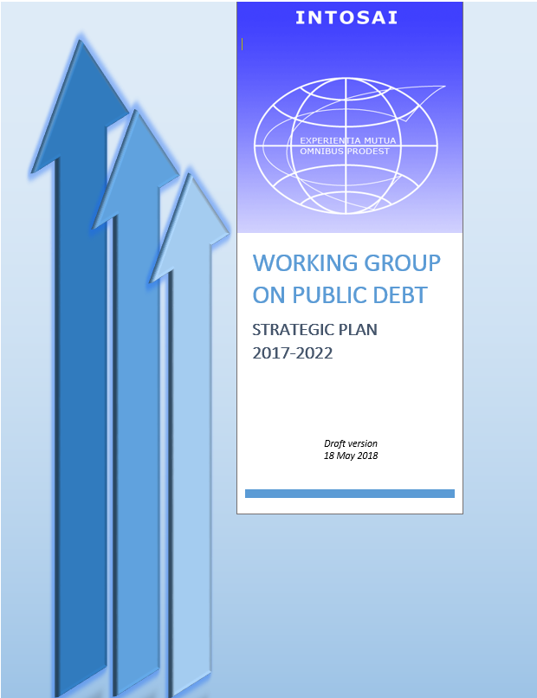
WGPD STRATEGIC PLAN 2017-2022
KSC Strategic Goals and Objectives
WGPD Strategic Goals and Objectives
WGPD Strategies
Notes:
The WGPD developed a Strategic Plan 2017-2022 which was anchored on the principles, goals, and cross-cutting priorities of the INTOSAI Strategic Plan 2017-2022 for Goal 3 - KSC.
Likewise, the WGPD Strategic Plan was in consideration of the KSC’s key Strategies to achieve Goals and Objectives as provided in its three-year Workplan 2017-2019.
In the recently-held annual meeting of the WGPD in Telangana, India in July 2018, the final draft Strategic Plan was presented for adoption of the working group. [Note: pending 2018 meeting agreements re Strategic Plan]
During the 2017 Annual Meeting in Manila, Philippines in September, a Task Team on the revision and updating of the working group’s strategic Plan composed of SAIs of Georgia, Russian Federation, USA and Philippines was constituted. After a thorough evaluation of the Task Team and considering the many developments in the initiatives of the Working Group, there was a felt need to update the mandate of the WGPD. The idea of updating the Mandate of the Working Group was being consulted with the KSC as well as to all members of the Working Group. It was indeed a successful consultation as we were able to receive as many valuable inputs from the members and the KSC in coming up with the revised Strategic Plan as well as on the issue of updating the Mandate statement. It was noted that the mandate is something we are not at liberty to modify as we may think best because the mandate was established by the Governing Board of INTOSAI, at its 35th meeting in October 1991, when the constitution of the working group was authorized, hence, any modification has to be approved by the same authority.

Slide 5
WGPD MANDATE
Existing Mandate
To publish guidelines and other informational materials to be used by Supreme Audit Institutions to encourage proper reporting and sound public debt management.
Revised Mandate (proposed)
To develop guidelines and other informative materials for the use of SAIs to encourage proper reporting and sound public debt management; and
To support SAIs in developing their knowledge and skills in Public Debt Audit through exchange of knowledge, experiences, information and collaboration among WGPD members, partners and stakeholders.
Notes:
The Existing Mandate is:
To publish guidelines and other informational materials to be used by Supreme Audit Institutions to encourage proper reporting and sound public debt management.
While the revised Mandate was proposed to read as:
One of the proposed revision is the updating of the Mandate of the Working Group. To develop guidelines and other informative materials for the use of SAIs to encourage proper reporting and sound public debt management; and
To support SAIs in developing their knowledge and skills in Public Debt Audit through exchange of knowledge, experiences, information and collaboration among WGPD members, partners and stakeholders.

Slide 6
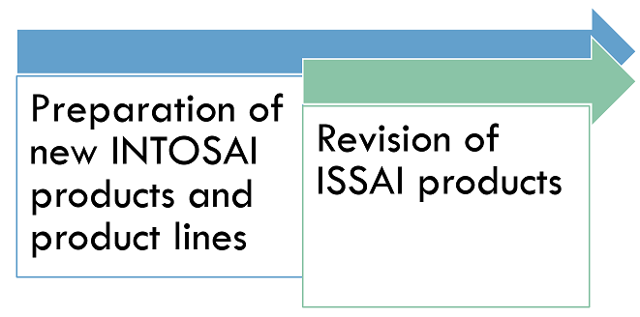
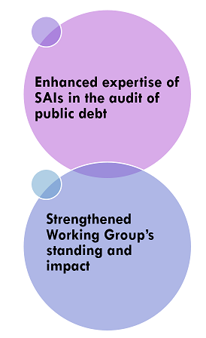
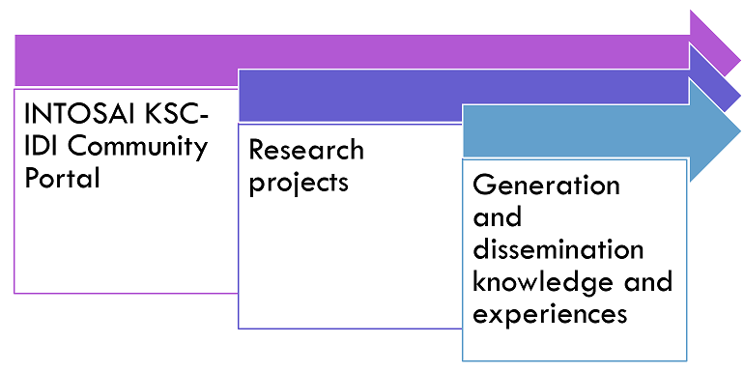
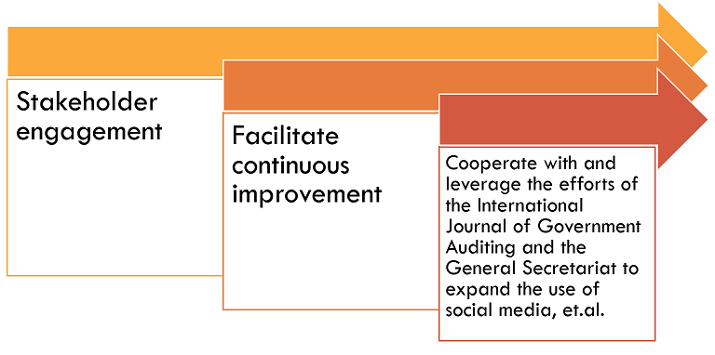
Intosai sp vs wgpd sp (2017-2022)
Key Strategies/ Objectives INTOSAI SP
Strategic Objectives for Goal 3 (KSC)
INTOSAI SP
Strategic Goals
(WGPD SP)
Develop and maintain expertise in various fields of public-sector auditing and provide content to the IFPP
Enable wide exchange of knowledge and experience among INTOSAI members
Working with the CBC, IDI, and other INTOSAI entities, continuous improvement, et.al.
Notes:
The Strategic Goals provided in the WGPD Strategic Plan 2017-2022 was in alignment with the Strategic Objectives for Goal 3 – KSC of the INTOSAI Strategic Plan 2017-2022 and its Key Strategies.
[The succeeding information shall refer to this slide’s illustration]
The WGPD Strategic Plan is composed of two Strategic Goals:
Enhanced expertise of SAIs in the audit of public debt; and
Strengthened Working Group’s standing and impact
The 1st Strategic Goal (Enhanced expertise of SAIs in the audit of public debt) was anchored with the INTOSAI Strategic Objective 1 (Develop and maintain expertise in the various fields of public-sector auditing and help to provide content to the INTOSAI Framework for Professional Pronouncements) and Objective 2 (Enable wide exchange of knowledge and experience among INTOSAI members), and in accordance with the Key Strategies 1 and 2 of the INTOSAI SP.
INTOSAI SP Key Strategies to achieve Goal 3 and Strategic Objectives:
1 – Preparation of new INTOSAI products and product lines
2 – Revision of ISSAI products.
The 2nd Strategic Goal (Strengthened Working Group’s standing and impact) was anchored with the INTOSAI Strategic Objective 2 (same above) and Objective 3 (Working with the CBC, IDI, and other INTOSAI entities, facilitate continuous improvement of SAIs through knowledge sharing on the crosscutting lessons learned from the results of peer reviews and SAI PMF), and in accordance with the Key Strategies 3 to 8 of the INTOSAI SP.
INTOSAI SP Key Strategies to achieve Goal 3 and Strategic Objectives:
3 - INTOSAI KSC-IDI Community Portal
4 - Research projects
5 - Stakeholder engagement
6 - Facilitate continuous improvement
7 - Cooperate with and leverage the efforts of The International Journal of Government Auditing and the General Secretariat to expand the use of social media, video, and interactive tools to ensure “real-time” communication across INTOSAI, its partners, and with other interested parties.
8 - Use working groups, task forces, and communities of practice open to all interested SAIs as vehicles for generating and disseminating knowledge and experiences.

Slide 7
PROGRESS report
REPORTING DASHBOARD As of 31 july 2018
Notes:
To conform with the requirements of the KSC, we report the following status of the activities/initiatives of the working group based on the Progress indicator indicated in the Reporting Dashboard as of 31 July 2018 to implement the strategies and initiatives that have been initially identified as part of the WGPD Contribution to the implementation of the strategic objectives and cross cutting priorities.
The WGPD will strive to contribute to the implementation and eventual success of the KSC strategic objectives and/or priorities that are aligned with the Strategic Plan 2017 – 2022 of the INTOSAI. (Read the slides 8-10)

Slide 8
Enhanced expertise of sais in audit of public debt
New INTOSAI products
Project 2.9 – GUID on Audit of Public Debt
Revision of ISSAI products
Co-opting of WGPD with KSC task team on Project 2.5 (Internal Control)
Project behind schedule
Not yet scheduled to start
Notes:
On the Preparation of new INTOSAI products and product lines under the INTOSAI Strategic Objective 1
Consolidation and alignment of public debt ISSAIs with ISSAI 100 or the Project 2.9 of the SDP for the IFPP 2017-2019 GUID on Audit of Public Debt – Project behind schedule
The Consolidation Team (Task Lead and Sub-Task Lead) met on 12 July 2018 at the 2018 WGPD Annual Meeting in India and discussed the issues and challenges faced by the Team at the development stage of the Exposure Draft of the GUID. The Team agreed to request deferment of the submission of the Exposure Draft to the FIPP to 09 October 2018 in consideration of the quality review process that the draft will have to undergo as per the TOR.
On 14 July 2018, the Team drafted and communicated its revised workplan and timelines for the development and submission of the Exposure Draft for Project 2.9 to all sub-tasks for information and guidance.
On 16 July 2018, the Task Lead submitted the initial consolidated draft of the GUID to the FIPP Liaison Officer, Mr Novy Pelenkahu, together with an update on the discussions and agreements at the Annual Meeting related to Project 2.9; and communicated the request for deferment on the submission of the Exposure Draft by 09 October 2018.
Action items/key next items:
The Consolidation Team shall continue to work on the development of the GUID while waiting for the official response and guidance from the FIPP LO; Consequently, a revised TOR was drafted in consideration of the updates in Section V – Project Milestones on the submission of the Exposure Draft of the GUID.
The sub-tasks shall also continue to work on their assigned portions of the GUID (FA, CA, PA, and Appendices) in consideration of the comments received from other sub-tasks, its members, and the PSC sub-committees.
As agreed, the sub-tasks shall submit the revised/updated drafts to the PSC sub-committees for a second review by 4 September 2018 after incorporating their comments on the first draft.
The Exposure draft shall be submitted to the FIPP, thru the KSC on 09 October 2018.
On the Revision of ISSAI products under the INTOSAI Strategic Objective 1
Co-opting of WGPD with KSC task team on Project 2.5 (Internal Control) – Not yet scheduled to start
Two WGPD members (USA and Philippines) signified interest in joining this project
Action items/key next items:
WGPD shall await further information from KSC/WGITA regarding this project.

Slide 9
Strengthened working group’s standing and impact
INTOSAI KSC-IDI Community Portal
Utilized the INTOSAI tools (Communities of Practice and other ICT-based mechanisms, such as webinar, videoconferences, etc.) in the conduct of seminars, fora, capacity-building programs and workshops.
Research projects
cooperative/joint audits, internship programs, staff exchange agreements, technical visits, trans-regional programs, and/or peer reviews
Generation and dissemination knowledge and experiences
seminars, fora, capacity-building programs and workshops in collaboration with other parties/stakeholders
Serious difficulties
Not yet scheduled to start
Notes:
On the INTOSAI KSC-IDI Community Portal under INTOSAI Strategic Objective 2
Utilized the INTOSAI tools (Communities of Practice and other ICT-based mechanisms, such as webinar, videoconferences, etc.) in the conduct of seminars, fora, capacity-building programs and workshops – Serious difficulties
Progress to date:
Initial communication from KSC relative to the revamping of the existing INTOSAI KSC-IDI Community Portal was received thru e-mail on 3 January 2018. In the same e-mail, the INTOSAI KSC proposed design templates where the working groups under INTOSAI can choose from. In consideration of all the feedback received by the KSC from all the working groups, it has finally opted for a webpage design (WGITA webpage template), contained in their e-mail dated 27 March 2018.
On the basis of this information, the WGPD Secretariat developed the working group’s website folder structure based on the chosen webpage design. The folder structure was submitted to KSC on 4 April 2018.
The CoP was established on the new portal on 7 June 2018 and has 15 members at present. The CoP is active with threads, news, etc. SAI India is the designated CoP Manager for the WGPD.
Action items / key next items:
The temporary website of the WGPD which is hosted by SAI Philippines is accessible at www.coa.gov.ph/wgpd. Materials from SAI Mexico, former Chair, and materials from the 2017 annual meeting of the working group were uploaded in this website. The Secretariat is in the process of classification of files to be migrated to the INTOSAI Community Portal, based on the submitted folder structure. The Secretariat shall accordingly inform the rest of the WGPD member-SAIs the readiness of the website using the new format, once the files in the current WGPD website are completely migrated to the Community Portal.
In the recently-concluded WGPD Annual Meeting (11-13 July 2018), as a start, it was suggested that the 7 SAIs which did presentations on the theme "Towards a robust public debt audit" shall be responsible to submit to the WGPD CoP Manager, topics for discussions pertaining to the subject matter of their presentations. However, the other member-SAIs are not precluded from sharing best practices in the audit of public debt and such important matters that will enrich the audit-members' knowledge of the audit of public debt.
On the Research projects under INTOSAI Strategic Objective 2
No. of cooperative/joint audits, internship programs, staff exchange agreements, technical visits, trans-regional programs, and/or peer reviews on public debt auditing among the INTOSAI members promoted/engaged/conducted – Not yet scheduled to start
Progress to date and action items/key next items – To be determined yet
On the Generation and dissemination knowledge and experiences (workshops, training, benchmarking exercise, joint/ collaborative audits, outreach activities etc.) under INTOSAI Strategic Objective 2
No. of seminars, fora, capacity-building programs and workshops in collaboration with World Bank, IDI, and other parties/stakeholders
Action items / key next items:
Related activities are proposed in the WGPD WorkPlan 2020-2022; Initial exploratory talks are being carried out with World Bank/IMF, IDI, and other stakeholders.

Slide 10
Strengthened working group’s standing and impact
Stakeholder engagement
Developed participation guidelines for the WG’s members
Facilitate continuous improvement
TBD
Cooperate with and leverage the efforts of the International Journal of Government Auditing and the General Secretariat to expand the use of social media, et.al.
Established close coordination with the KSC-IDI, INTOSAI General Secretariat (Website), and US GAO (Journal) for the timely publication of WGPD outputs on public debt auditing issues
Project on schedule
Project on schedule
Notes:
On the Stakeholder engagement under INTOSAI Strategic Objective 3
Developed participation guidelines for the WG’s members – Project on schedule
Progress to date:
WGPD has collaborated with the IDI on the QA process for co-branding of the non-IFPP document and IDI Global Public Goods, specifically the Handbook on Audit of Public Debt Management: A Guide for SAIs.
Action items / key next items:
WGPD shall develop internal guidelines on the QA process for co-branding of this Handbook in support of the Certification to be issued by the WGPD Chair and the Goal Chair.
On the Facilitation continuous improvement under INTOSAI Strategic Objective 3
Progress indicator, Progress to date and action items/key next items – To be determined yet
On the Cooperation with and leverage the efforts of the International Journal of Government Auditing and the General Secretariat to expand the use of social media, video, and interactive tools to ensure “real-time” communication across INTOSAI, its partners, and with other interested parties under INTOSAI Strategic Objective 3
Established close coordination with the KSC-IDI, INTOSAI General Secretariat (Website), and US GAO (Journal) for the timely publication of WGPD outputs on public debt auditing issues - Project on schedule
Progress to date:
The Revised Terms of Reference of the WGPD and the WGPD Handbook of Meetings were sent to the KSC for their review, on the same e-mail. In their e-mail response dated 28 March 2018, the WGPD Secretariat got the nod of the KSC for the Handbook of Meetings. On the other hand, the KSC suggested some revisions to the Terms of Reference; but overall, it was also approved.
Action items / key next items:
The Minutes of the 2018 Annual Meeting of the WGPD will, likewise, be uploaded in the WGPD website and in the INTOSAI Community Portal. The WGPD Secretariat, with the help of Secretariat-IT Support, is now in the process of classifying the files of our current website with the submission of the web contents targeted on 31 August 2018
In the same way, an article highlighting the agreements reached in the 2018 Annual Meeting of the WGPD shall be submitted to the INTOSAI Journal on 15 August 2018 for inclusion in the Autumn 2018 issue as requested by Heather Santos in her e-mail dated 6 July 2018

Slide 11
Thank you!!!
Notes:
Thank you.

