Slide 1
Project 2.12
Jurisdictional activities of SAIs
KSC-SC meeting Uganda August 20th to 23rd 2018
Mr. Alban Baric International officer Cour des comptes – SAI France

Slide 2
To be discussed by the KSC –SC :
Agreement of an adjusted project proposal and justification statement for project 2.12 : Fundamental principles of jurisdictional activities of SAIs to be then forwarded to the FIPP for examination.

Slide 3
Relationship with the FIPP:
July / November 2017: FIPP conditionally approves inclusion of this project in the INTOSAI Standards Development Strategy Plan (2017/2019). Conditions:
- Submission of a justification statement
- Linking the group with the compliance audit subcommittee
- The preference for drafting a GUID rather than an ISSAI
March 2018: FIPP meeting in Paris - Presentation of a justification statement not confirming or infirming the status of the document ( ISSAI or GUID).
June 2017: the project group submits its project proposal to the various INTOSAI authorities.

Slide 4
Activities of the Group
1
December 2016: Forum plenary meeting in Abu Dhabi decides to establish Working Group
2
3
October 2017: Meeting of the working group in Marrakech on the basis of a first working document
Spring 2017: Members work on SAI PMF jurisdictional indicators to identify points of agreement between them.
January 2017: The working group is formed on a voluntary basis by the SAIs of Chile, Ecuador, Greece, Morocco, Peru, Portugal, Senegal, Togo, Turkey, Brazil, Spain, Italy and France.
June 2017: the group agrees on a project proposal to be submitted to the FIPP.
December 2017: First draft document circulated to WG members

Slide 5
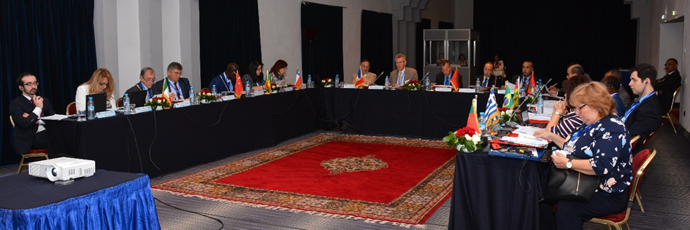
Marrakech’s meeting

Slide 6
Working Group Activities
4
January 2018: Analysis of comments received on the first draft and drafting of the second draft
5
6
April/May/June 2018: Drafting and distribution of a third draft following the remarks of the FIPP
February/March 2018: drafting of the second draft
February 2018: Distribution of the first justification statement to FIPP members.
March 2018 : FIPP meeting in Paris – Presentation of the Justification statement
July 2018: Endorsement of the 4th draft to the Forum at the Santiago meeting in Chile as well as an adjusted project proposal and justification statement

Slide 7
Adjusted Project Proposal
This project is a completion of ISSAI 100 paragraph 15:
“In certain countries, the SAI is a court, composed of judges, with authority over State accountants and other public officials who must render account to it. There exists an important relationship between this jurisdictional authority and the characteristics of public-sector auditing. The jurisdictional function requires the SAI to ensure that whoever is charged with dealing with public funds is held accountable and, in this regard, is subject to its jurisdiction.”
The fundamental principles derived from ISSAI 100 (ISSAI 200, 300, 400) cannot be considered appropriated to frame the core principles of jurisdictional activities of SAIs.
Furthermore, the current set of ISSAIs, and more specifically, those on compliance audit (ISSAI 4000) do not appear enough to the represented the needed specific standard on jurisdictional activity. For this reason, we suggest including this project as a direct derivative of article 15. of ISSAI 100, at the same level, named ISSAI 110.

Slide 8
Justification statement: Professional pronouncement on Jurisdictional activities of SAIs

Slide 9
26% of the Supreme Audit Institutions ( i.e. 50 SAIs) perform specific control activities called “jurisdictional”
Definition from the Oxford dictionary : jurisdictional, adjective
- “Relating to the official power to make legal decisions and judgements.”
A SAI can be considered “jurisdictional” when it is recognized as a jurisdiction and as such vested with the powers to pass judgements on managers of public funds

Slide 10
Total: 50 countries

Slide 11
Jurisdictional activities are not included in the INTOSAI framework for Professional Pronouncement
Forum of SAIs with jurisdictional functions tasked a group with drafting a Professional pronouncement
Jurisdictional activities correspond to a core, structural and historical mission of SAIs
Reason 1
Recognition to the specific competences of those SAIs and shed light on their added value.
Reason 2
Ensuring homogeneous practices and methods amidst SAIs.
Reason 3
Better understanding in capacity-building programs.

Slide 12
Contrary to what is written in the FIPP decisions point: jurisdictional competences are not a mere “additional mandate” that was granted, on top of performance or compliance audits, to some SAIs.
They are often the original mission of these SAIs, predating other competences that were added later on, and are as such at the core of the SAIs’ organization, status and practices.
It is the strongest pillar of their independence

Slide 13
History of public finance oversight: two models developed simultaneously.
A form of Supreme Audit Institution appeared in the British Parliament, following the endorsement of the Magna Carta in 1215 and later on in the Bill of Right in 1688.
In continental Europe, public finance oversight was entrusted to a specialized institutions of a judicial nature.
Example: In the Kingdom of France, the first regal edict on public finance jurisdictional oversight, signed by King Louis the IXth dates back to 1256. Original royal Chamber of accounts was set up by King Phillip the IVth in 1309 and Philipp the Vth in 1319.

Slide 14
Basic prerequist for capacity building
A professional pronouncement on jurisdictional activities is essential for capacity-building efforts of the INTOSAI community.
Basic principles of jurisdictional activities have to be included in the capacity building program for all of the countries where the SAI are built on this model.
Example: Indicators on jurisdictional activities in the SAI Performance Measurement Framework (SAI PMF) are the only indicators not based on a professional pronouncements.

Slide 15
Fundamental principles of jurisdictional activities of SAIs
Forth draft July 12th 2018
1 INTRODUCTION
Objectives of the standard
Introductory remarks
Context and other relevant standards
2 THE AUTHORITY OF THIS ISSAI
3 EXPLANATIONS, DEFINITION AND STAKEHOLDERs OF THE JURISIDICTIONAL ACTITIVIES OF THE SAIs
Explanations and definitions
General Jurisdictional competences:
Judgement of accounts
Judgement of the managers of public funds and alike:
Persons accountable under the law:
Stakeholders
those instructing:
“Financial judges” or “members of the jurisdictional formation”:
Public Prosecutor or assistant public prosecutor, when the Law provide:

Slide 16
4 GENERAL PRINCIPLES SPECIFIC TO JURISDICTIONAL COMPETENCES
Legal basis of the liability and sanction regime
Right to a fair trial
Independence of the members of the formation of the court
Impartial Judgement
Freedom of access to information
Judgement in a reasonable period
Quality control
Communication to the public
Effectiveness of jurisdictional competence
Existence of remedies
Principle of the cumulation of sanction for the same irregularity
Statutes of limitations (prescription)

Slide 17
To be discussed by the KSC –SC :
Agreement of an adjusted project proposal and justification statement for project 2.12 : Fundamental principles of jurisdictional activities of SAIs to be then forwarded to the FIPP for examination.

Slide 18
Thank you for your attention

