Slide 1
REPORT OF THE WORKING GROUP ON AUDIT OF EXTRACTIVE INDUSTRIES – STATUS OF CONTRIBUTION TO INTOSAI 2017-2022 STRATEGIC GOALS
Presentation to the 9th Meeting of the Steering Committee OF KSC 25th August, 2017 Bali, Indonesia 2017
By Maxwell Poul Ogentho, Director, SAI Uganda, On Behalf of John FS Muwanga & Auditor General

Slide 2
EXTRACTIVE INDUSTRIES

Slide 3
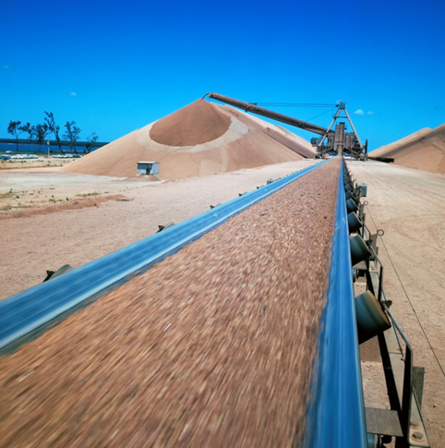
Achievements –strategic objective 1
Develop and maintain expertise and provide content to INTOSAI framework for Professional Pronouncements:
Developing specific guidance products: GAO-USA; Iraq, South Africa, Uganda, Ecuador, Zimbabwe and Vietnam
Undertake & Published research in extractive
industry topics

Slide 4
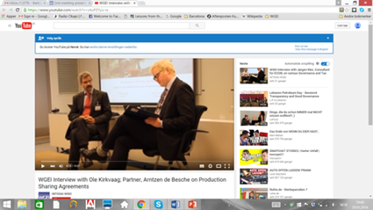
Achievements –strategic objective 2
Enable wide exchange of knowledge and experience among INTOSAI members:
Share published Audit reports in Extractive industries on WGEI website to be migrated to Community portal
Quarterly newsletter
Benchmarking
More SAI participation: 44 Members : New Participants: Saudi Arabia, Iran, Qatar, Mali, Senegal, Sudan, Botswana, Morocco and Zimbabwe

Slide 5
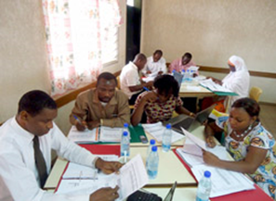
Achievements –strategic objective 3
Working with CBC, IDI and Other INTOSAI entities:
Collaboration with CBC- Contact established
Collaboration with existing training arrangements:
SAI India –Jaipur
GAO-Centre of Excellence-Washington DC
AFROSAI-E Training arrangement
Jarkata- Indonesia

Slide 6
Way forward
Popularise WGEI activities at all seven INTOSAI regions:
Attract more leadership in WGEI
Encourage more SAIs to participate in sharing their experience and those of others

Slide 7
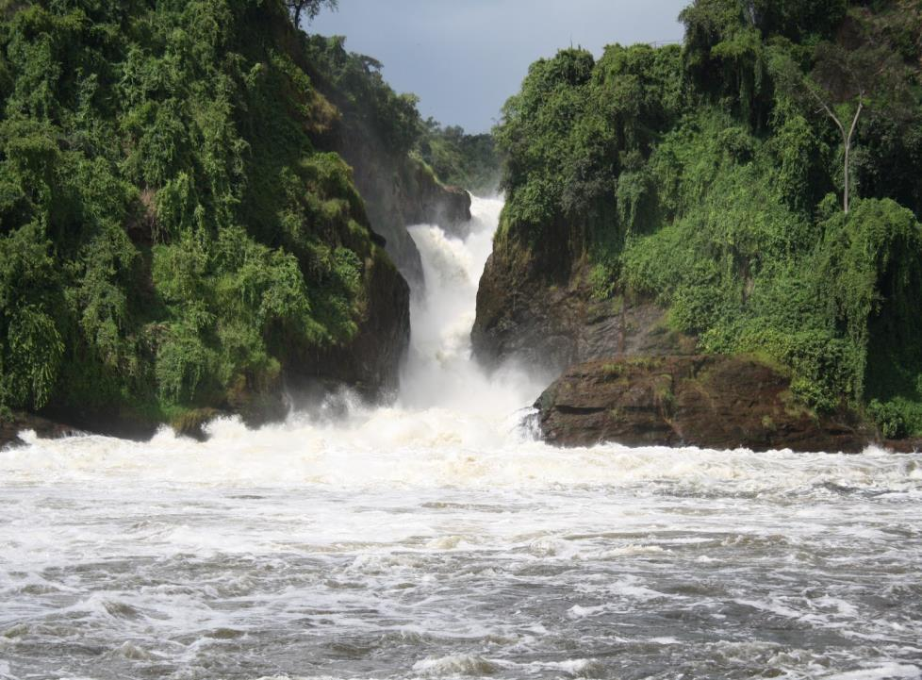

Slide 8
.

