Slide 1
10th MEETING OF THE STEERING COMMITTEE OF KSC
WORKING GROUP ON AUDIT OF EXTRACTIVE INDUSTRIES – (WGEI)
21st August, 2018 Kampala, Uganda 2018
By Maxwell Poul Ogentho on Behalf of John F.S. Muwanga & Auditor General

Slide 2
.

Slide 3
Background information to WGEI
Membership of working group -45
Steering Committee:
SAI Uganda, Norway , USA, South Africa, Iraq &
SAI India, Fiji, Zambia, Ghana Ecuador
Community of Practice –Sheila Ngira

Slide 4
WGEI contribution to INTOSAI Strategic objectives
3. Working with IDI, CBC & other INTOSAI entities
2. Enable wide exchange of knowledge & experience
1. Develop & maintain expertise in public sector fields

Slide 5
Develop & maintain expertise in public sector fields
New INTOSAI products: Non IFPP :
EI toolkit
SAI USA, Iraq, South Africa, Uganda, Ecuador, Zimbabwe & Vietnam

Slide 6
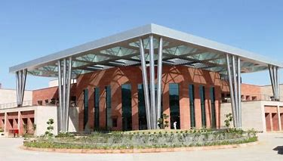
Develop & maintain expertise in public sector fields
ii. EI training Curriculum –Jaipur India –draft 1
Present: SAI Uganda, India, Ghana, Zambia, AFROSAI-E ; Written comments & remarks from SAI: Iraq, Vietnam, Fiji, Ecuador, Zimbabwe, SA, Estonia, China, Kuwait, Mali, Nigeria, Qatar, USA, Indonesia

Slide 7
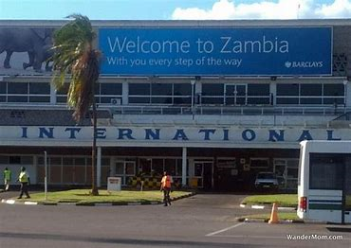
Develop & maintain expertise in public sector fields
ii. EI training Curriculum –Lusaka Zambia–final 1
Present: SAI Uganda, Ghana, India, Norway, Iraq, Vietnam, Zambia, Zimbabwe & AFROSAI-E

Slide 8
Documents approval & utilization
Final comments -received and incorporated
Chair WGEI to launch and release the final extractive industry audit learning curriculum as a product for implementation by any WGEI member SAI or training centre -15th July
Upload the curriculum on the WGEI website – wait for feedback & comments to the secretariat.
Seek input -developing and implementing e-learning course. Expects input from e. g. SAI Norway, USA, and India & AFROSAI-E.
Input of KSC is appreciated.

Slide 9
2. Enable wide exchange of knowledge & experience among INTOSAI members
Use of INTOSAI KSC IDI Community Portal: COP
i. Share audit report & resources-over 70 resources
Iraq, Fiji, Norway, Ecuador & Zimbabwe

Slide 10
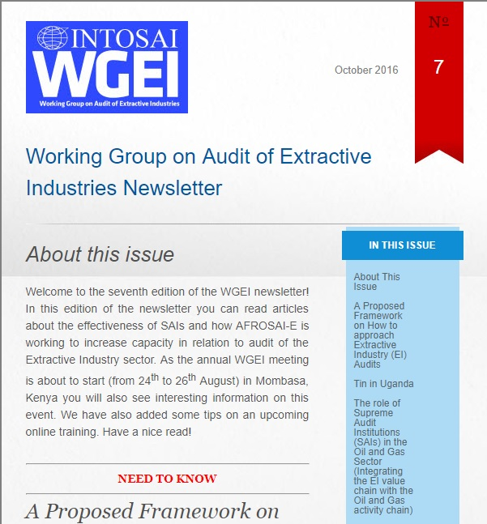
2. Enable wide exchange of knowledge & experience among INTOSAI members
ii. Quarterly newsletter : 350 readers-Issue No. 11 – May 2018
Iraq, Fiji, Norway, Ecuador & Zimbabwe

Slide 11
2. Enable wide exchange of knowledge & experience among INTOSAI members
Research projects in EI: Work in progress-concept
SAI SA, Zambia, US & Iraq

Slide 12
Generation and dissemination and experience
i. Training avenues for EI within SAIs
Jaipur –India
GAO- Centre of excellence
Jakarta-Indonesia
AFROSAI-E
National Resource Governance Institute(NRGI)
1st training based on the EI curriculum

Slide 13
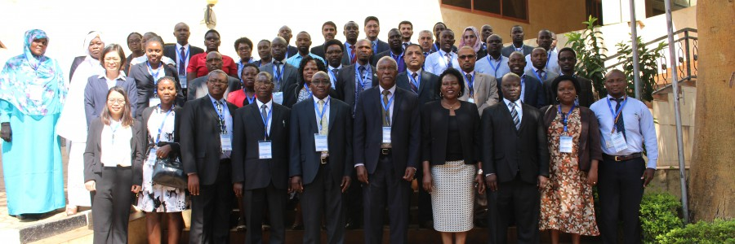
Generation and dissemination and experience
ii. Trainings undertaken: SAI Uganda-other trainings
SAI Uganda, September 2017: Iraq, Vietnam, Botswana, Ghana, Kenya, Tanzania, Saudi Arabia, Sudan, Zambia and Uganda.

Slide 14
Generation and dissemination and experience
Benchmarking among SAIs
Visits among themselves or through Chair WGEI
Notable benchmarks SAI Kenya, Zambia with Uganda, USA and India.
Consultative meetings
Monthly steering committee electronic coordination meetings- shift to use facility within KSC –IDI Community portal and physical meeting annually
All members annual meeting every three years –next 2019.

Slide 15
3. Working with IDI, CBC & other INTOSAI entities
Collaboration with CBC/IDI and WGEA
Initiated on matters of capacity building
ii. Engagement with stakeholders-
SAI Norway developed briefing note on role of SAI in good governance in EI as a sensitization material

Slide 16
Way forward
Popularise WGEI activities at all seven INTOSAI regions:
Attract more participation in WGEI projects
Encourage more SAIs to participate in sharing their experience and those of others

Slide 17
