Slide 1
PROFESSIONAL & RELEVANT SAIs
Moving from Programmes to Workstreams

Slide 2
To share ideas on moving towards ‘professional and relevant SAIs workstreams

Slide 3
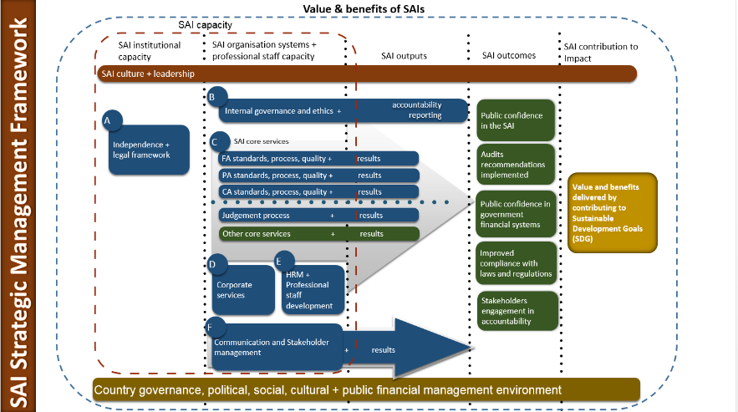

Slide 4
Where are we now ?
3i Programme
Auditing SDGs Programme
Enhancing eLearning Programme
SAI Young Leaders

Slide 5
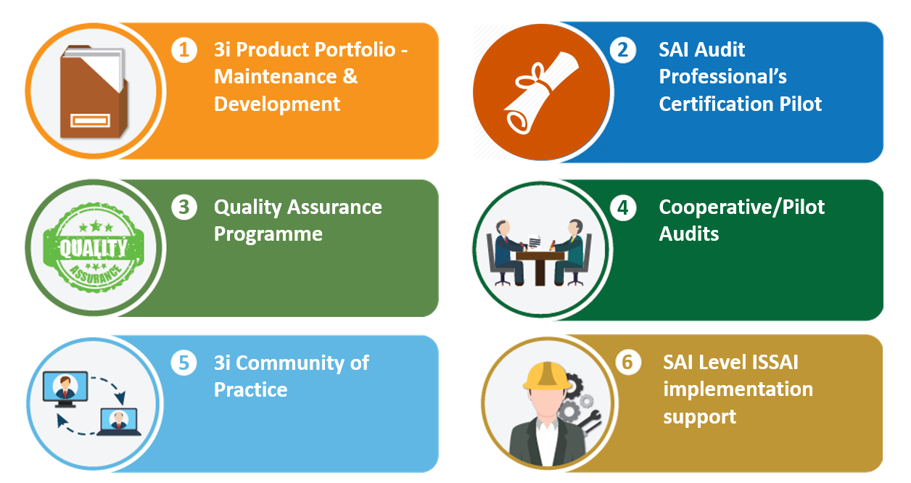
ISSAI Implementation Initiative (3i Programme)
‘SAIs move towards ISSAI compliant audit practices’

Slide 6
3i Programme so far
Quality Assured 3i Products ( iCATs, ISSAI Implementation Handbooks, QA tool & guidance)
More than 400 ISSAI facilitators
Pilot training for QA Reviewers, QA for cooperative audit, QA at SAI level
Cooperative Audits supported in all regions FA, PA, CA
3i Community Portal integrated into IDI website
SAI level ISSAI Implementation support pilots in SAI Bhutan and SAI Tonga

Slide 7
AUDITING SDGs PROGRAMME
Support SAIs in conducting high quality audits of SDGs
Partners : KSC, UNDESA, KNI, INTOSAI Regions, CAAF, IBP, GAB
Advocacy & Awareness Raising
Guidance on Performance Audit of Preparedness for Implementation of SDGs
Cooperative Performance Audit of Preparedness for Implementation of SDGs
Lessons Learned and Compendium of Audit findings
Community of Practice of SDG Auditors
Massive Open Online Course on : Leave no one Behind

Slide 8
AUDITING SDGs PROGRAMME so far
UN-IDI SAI Leadership & Stakeholder Meetings, Regional Meetings, participation in webinars and seminars
Guidance on Performance Audit of Preparedness for Implementation of SDGs
Version 0 to be exposed
Cooperative Performance Audit of Preparedness for Implementation of SDGs – More than 70 SAIs (English speaking, OLACEFS, CREFIAF )
Lessons Learned and Compendium of Audit findings in 2019. Cobranded with UNDESA
Community of Practice of SDG Auditors
Massive Open Online Course on : Leave no one Behind ( 2018 – 2019)

Slide 9
Enhancing eLearning Capacity so far
IDI eLearning platform and LMS since 2014
IDI eLearning Handbook Version 0 to be exposed
Pool of 69 LMS Administrators
71 Certified eLearning specialists ASOSAI, OLACEFS
32 Certified blended learning specialists ASOSAI
Support to ASOSAI, CAROSAI, EUROSAI
eLearning portfolio on number of topics

Slide 10
Changed SAI YOUNG LEADERS contributing to positive change in SAIs
SYL Integrated Change Plan
Global SYL Network
SAI Top Management
SAI Coach
SAI Young Leader
SYL’s Team
Discover Self
Grow People
Discover Universe
Create Value

Slide 11
The journey so far….
25 SYLs selected out of 70 applications received
SYL & Coaches International Interaction
SYL Page
EI Assessments & Coaching
SYL Integrated Plans & SAI Level Interaction
SYL & SAI Leadership Interaction
Lessons Learned
Argentina, Bhutan, Botswana, China, Cook Islands, Costa Rica, Ecuador, Estonia, Fiji, FSM Pohnpei, Finland, India, Liberia, Maldives, Malta, Samoa, South Africa, Thailand, Tonga, Zambia

Slide 12
Key Lessons Learned
1. Need for continuous and regular support
2. Need for SAI level support to facilitate sustainable change
6.Need to explore new methodologies & technology to stay relevant
3. SAI Leadership & Stakeholder engagement are key
7. Leave no one behind
4.Critical mass of professional people
5. Focus on soft skills
8. Coherence & Integration

Slide 13
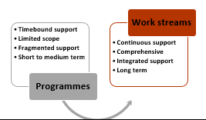
Move from Programmes to Workstreams
Professional SAIs
High Quality Audits
Relevant SAIs
Contributing to effective governance
Leadership, Stakeholder engagement, learning methodology, strategic partnerships

Slide 14
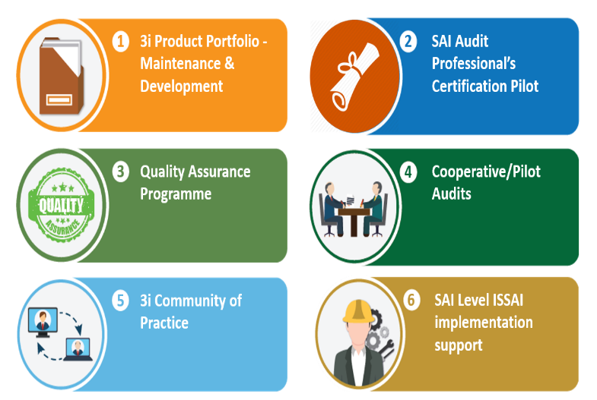
Professional SAIs
Competency based
Blended with practical element
Focus on cross cutting & functional competencies
To include leadership and stakeholder engagement competencies
To be delivered on regular basis
Provision of governance and QA arrangements
Evaluation framework and evaluation
Use of education material for other support activities e.g. SAI level support.
Participation based
Blended
One off
Scoped to ISSAIs
Technical skills
PESA
ISSAI Certification Programme
Enhance support in six focus areas

Slide 15
Strategic framework for SAI engagement with SDGs
Support in auditing implementation of individual goals as per country priorities ( poverty, education, food, health, gender etc )
Explore and innovate methodology
Support SAIs in auditing inclusiveness, performance indicators, centre of governance, integration and coherence.
Support SAIs in use of data analytics
Learn lessons
Support at SAI level
Advocacy
Guidance
Support for Performance Audit of Preparedness for Implementation of SDGs
Whole of Government audit approach
Support at global and regional level
Exploring partnerships
Relevant SAIs
Auditing SDGs Programme
Relevant SAIs

Slide 16
Discussion
1. Your thoughts on Professional and Relevant SAI workstreams ?
2. How can we work together to strengthen support provided in each workstream ?

