Slide 1
Report of the INTOSAI Chair
KSC Steering Committee Meeting
Mr. Timur Makhmutov
Director, Department for International and Regional Cooperation The Accounts Chamber of the Russian Federation

Slide 2
Working Groups – Brief Summary
1 potential member: SAI Jamaica
Exposure Draft GUID 5280 “Guidance for Audits of Public Procurement”. Presented at FIPP on 9 September.
Further materials on Public Procurement (Handbook)
Set of measures based on the Open Discussion within the First Online INTOSAI International Scientific and Practical Conference under the auspices of the INTOSAI Chair
5 new members: SAIs Canada, Estonia, Malaysia, the Philippines
2 potential members: SAIs Chile, Jamaica
Knowledge Base on Macroeconomic Forecasts
3 Newsletter issues
Update of GUID 5202 “Sustainable Development: The Role of Supreme Audit Institutions”
WG SDG KSDI
WG PPA
Chaired by
SAI Russia
KSC Steering Committee Meeting

Slide 3
KSC Working Groups – Brief Summary
1 potential member: SAI Jamaica
Exposure Draft GUID 5280 “Guidance for Audits of Public Procurement”. Presented at FIPP on September 9.
Further materials on Public Procurement (Handbook)
Set of measures based on the Open Discussion within the First Online INTOSAI International Scientific and Practical Conference under the auspices of the INTOSAI Chair
5 new members: SAIs Canada, Estonia, Malaysia, the Philippines
2 potential members: SAIs Chile, Jamaica
Knowledge Base on Macroeconomic Forecasts
3 Newsletter issues
Update of GUID 5202 “Sustainable Development: The Role of Supreme Audit Institutions”
WG SDG KSDI
WG PPA
Chaired by
SAI Russia
KSC Steering Committee Meeting

Slide 4
New Working Group – WGHA Proposal
A SCEI Initiative
Open and voluntary membership for all interested INTOSAI members
Focus on SDGs and COVID-19 pandemic response and effects on healthcare, social security and support systems
Aimed at developing universal approaches to healthcare and social systems audis and
Promoting knowledge-sharing and the use of advanced analysis
Advocates engagement of practitioners and experts from the field
WG PPA
WG HA
KSC Steering Committee Meeting

Slide 5
The INTOSAI University is…
(U-INTOSAI)
Open online educational platform for the INTOSAI community
Digital space for the knowledge and best practices sharing
Integrating tool for INTOSAI educational activities to create synergy
Website: u-intosai.org
Launched on 12 April
KSC Steering Committee Meeting

Slide 6
U-INTOSAI Goals:
Unite and systemize on one platform information about INTOSAI educational activities without any competition
1
IDI
KSC
Formats of courses:
Showcase with active links to the existing platforms
Courses fully uploaded to the platform
Working Groups
General Secretariat
CBC
Regional Organizations
Website: u-intosai.org
Launched on 12 April
KSC Steering Committee Meeting

Slide 7
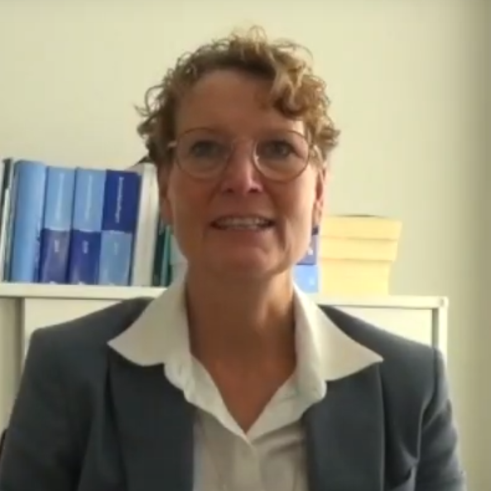
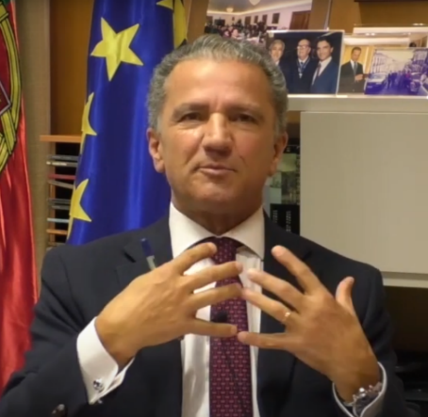
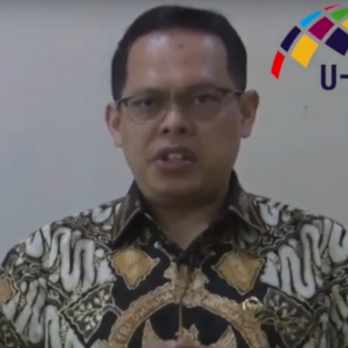
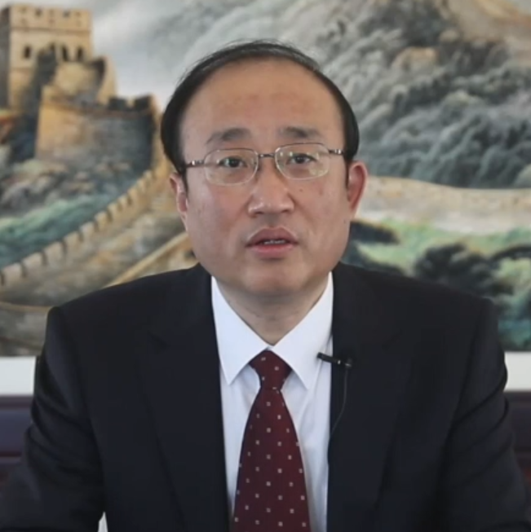
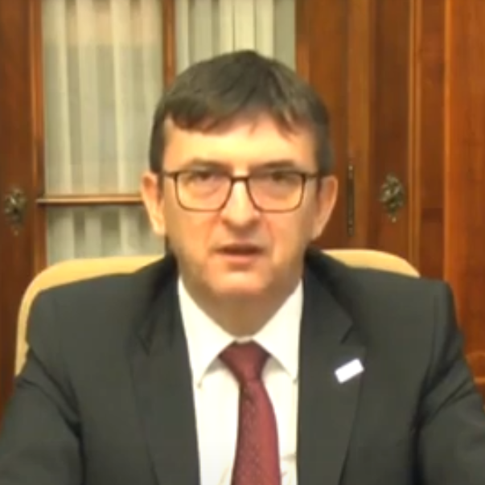
U-INTOSAI Goals:
Promote the principles of the INCOSAI final documents
2
Pilot Course on the Moscow Declaration:
20 videos on 10 Provisions of the Moscow Declaration
17 SAIs’ experience and projects
Decisions and plans for the future
Website: u-intosai.org
Launched on 12 April
KSC Steering Committee Meeting

Slide 8
U-INTOSAI Goals:
Explain the value of audit for the professional community and for citizens
3
Website: u-intosai.org
Launched on 12 April
KSC Steering Committee Meeting

Slide 9
U-INTOSAI Today:
5 Months of work
5 Languages of operation
1500+ Users weekly
28 Courses available
8 Authors (SAIs, Google)
350+ Registered users
Website: u-intosai.org
Launched on 12 April
KSC Steering Committee Meeting

Slide 10
Expected Outcomes
2020
Starting Point
Effective tool for the promotion and implementation of the core provisions of the Congress’ final documents
Open online platform, which unites INTOSAI educational activities
Multilingual environment for the community based on openness and inclusiveness
Late 2022
Key Milestone
KSC Steering Committee Meeting
Notes:
Для загрузки собственных курсов с сертификацией необходимо привлечение дополнительных ресурсов на привлечение к работе методолога, а также запись профессиональных роликов

Slide 11
Thank you for attention!
Accounts Chamber of the Russian Federation
2021
Notes:
Шрифт TT Jenevers, кегль 80пт
Альтернатива: Times New Roman

