Slide 1
Professional
Standards
Committee - PSC

Slide 2
TOPICS
SDP
IFPP
TSF
Issai.org

Slide 3
SDP 2017-2019
Priority 1
1.1 Preamble INTOSAI P-10
1.2 ISSAI 200
1.3 Practice Notes

Slide 4
SDP 2017-2019
Priority 2
2.1 Financial Reporting
2.2 Regularity and Proprietary CA
2.3 Combined Audits
2.5 Internal Control
2.6 Internal Auditors

Slide 5
IFPP
Migration

Slide 6
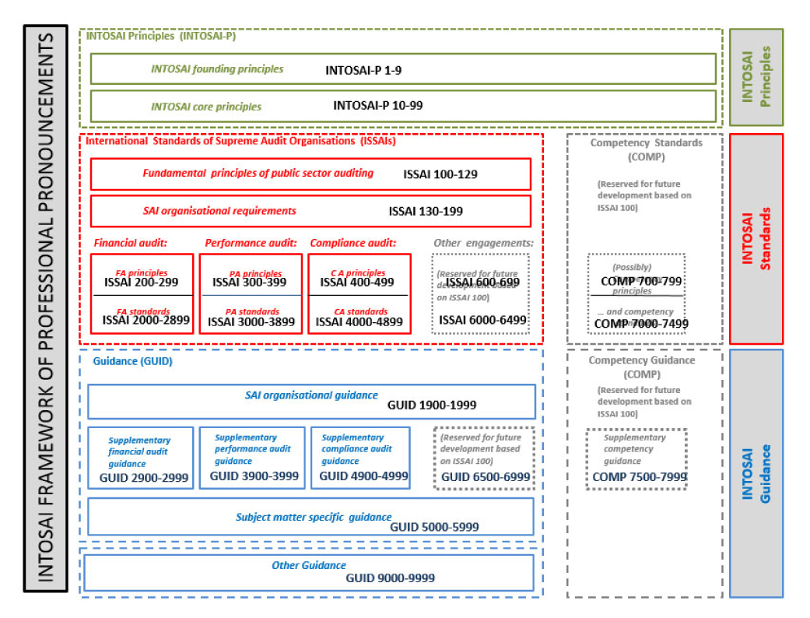
IFPP

Slide 7
TSF
Support to
Standard Setting

Slide 8
Technical Support Function
Proof of Concept
for 2020
Management
by PSC
Support to
PGs on standard
setting
5 years
3-5 staff
Secondment model
Host SAI
GB 2018
Goal 1
SP

Slide 9
issai.org
Communicating

Slide 10
Outdated design
Lost in the maze
Turning the
first page

Slide 11
Enhancing
Partnerships

Slide 12
Thank you!
Paula Hebling Dutra
dutraph@tcu.gov.br

