Slide 1
Changes in INTOSAI
Standard Setting Process

Slide 2
TOPICS
SDP
IFPP
Due Process

Slide 3
SDP 2017-2019
General Strategy
+ Working Plan
under implementation
revision in 2017

Slide 4
SDP 2017-2019
Recommendations from
the PSC-SC (June 2017)
Consider
withdraw
Fit into
categories of
new IFPP
Work
capacity
Description of
scope + relevance
Priority 1

Slide 5
Strategic Development Plan
Stage ZERO
of the Due Process

Slide 6
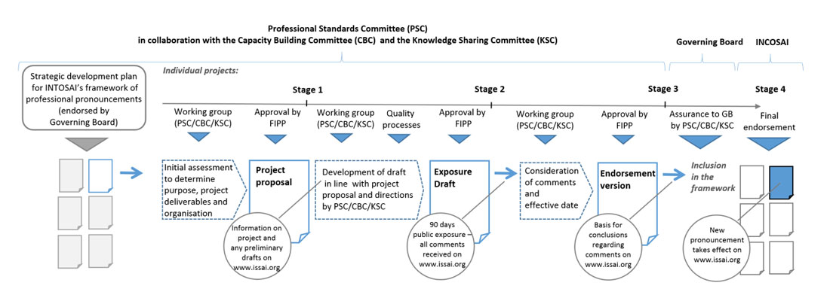
Due Process
4 main stages

Slide 7
Due Process – developing pronouncement
1
2
3
4
The project
proposal
The exposure
draft
The endorsement
version
The final
pronouncement

Slide 8
Due Process – developing pronouncement
Applies to:
NEW
pronouncements
INCORPORATION
of pronouncements
issued by other
organisations
CHANGES of
substance

Slide 9
1
Working Group
– Makes Initial Assessment
– Makes Project Proposal:
purpose
project deliverables
timeline / project group
The project
proposal

Slide 10
1
Goal Chair
– allocates resources
– considers timeliness
–Strategic Plan alignment
The project
proposal
refers project to FIPP

Slide 11
1
FIPP
… approves that project
– addresses identified issues
– provides sufficient direction
– has adequate organization and timeline
The project
proposal
Approved project proposal
on issai.org

Slide 12
2
Working Group
Develops draft pronouncement
The exposure
draft
Attention to
Quality
Processes

Slide 13
2
FIPP
… approves exposure draft that:
– fulfils purpose of project
– is in line with approved project proposal
– has high quality
– has adressed overlaps + inconsistencies (IFPP)
The exposure
draft

Slide 14
2
Public
Approved exposure draft on issai.org for comments (90 days)
The exposure
draft
INTOSAI
members
External
stakeholders

Slide 15
3
Working Group
– collects and post comments
– analyses comments
– finalises endorsement version
New exposure
might be necessary
The endorsement
version
back to
stage 2

Slide 16
3
FIPP
…approves:
– comments are reflected
– document is ready for endorsement
The endorsement
version

Slide 17
3
Working Group
– comments, conclusions and endorsement version are published on issai.org
– translate pronouncement
into 5 official
INTOSAI languages
The endorsement
version

Slide 18
Goal chair
4
Presents
Endorsement
Version
Assures due
process was
followed
Governing Board
The final
pronouncement
INCOSAI - for final endorsement

Slide 19
The
End
Working Group
– prepares Executive Summaries for INTOSAI website
– decides on maintenance frequency

Slide 20
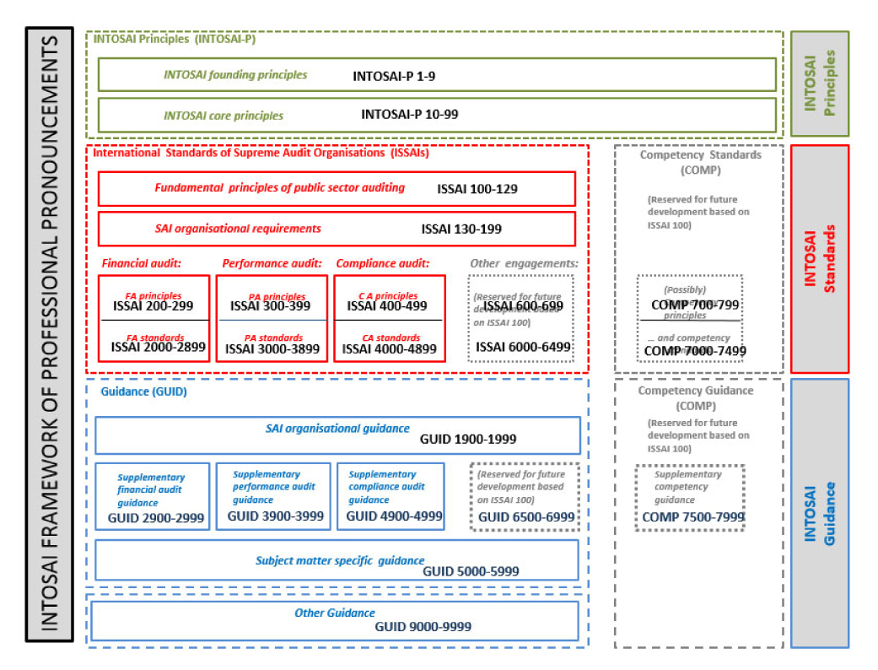
IFPP

Slide 21
2017-2019:
IFPP
Migration to
new framework (SDP)

Slide 22
IFPP
Clarifies scope of the framework and claim of ISSAI compliance
Opportunity to systematically review existing documents
Concern with overloading
the framework

Slide 23
Thank you!
PSC Secretariat
psc@tcu.gov.br
eca-psc@eca.europa.eu
Paula Hebling Dutra
dutraph@tcu.gov.br

