Slide 1
THE 2017-2019
WGEA WORKPLAN
INTOSAI WGEA Secretariat
The 9th INTOSAI KSC Meeting
Bali, Indonesia, 23 – 25 August 2017

Slide 2
OUTLINE
WGEA membership
The 2017 – 2019 work plan
WGEA contribution to INTOSAI strategic objectives and crosscutting priorities

Slide 3
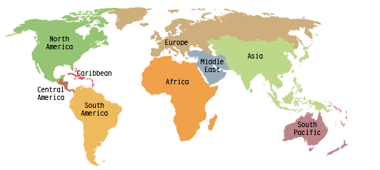
WGEA MEMBERSHIP
78 members
17 Steering Commitee Members
Coordinators of Regional WGEA
ACAG/PASAI: New Zealand
AFROSAI: Cameroon
ARABOSAI: Kuwait
ASOSAI: China
EUROSAI: Estonia
OLACEFS: Paraguay

Slide 4
The 2017 – 2019 Work Plan
Goal 1
Goal 2
Goal 3
Up-date existing and develop new guidance materials available to SAIs, conduct research studies on emerging topics in environmental auditing
Facilitate concurrent, joint, and coordinated audits
Enhance information dissemination, exchange, and training
Goal 4
Increase cooperation between the WGEA, international organizations and other INTOSAI bodies
www.wgea.org

Slide 5
Goal 1
Guidance Materials:
Climate Change (USA)
Agriculture and Food Production (Cameroon)
Land Organization and Soil Quality Management (Pakistan)
Delivering the 2030 Agenda (SDGs) through Environmental Auditing (Brazil, Canada, Indonesia)
Research Papers:
Visibility of Environmental Auditing (ECA)
Environmental Health (Philippines)
Waste Water (Morocco)
Greening Cities (Czech Rep.)

Slide 6

Goal 2
Regional Cooperative Audits
In progress:
EUROSAI: Audits on Multilateral Environmental Agreements on Air Pollution, Energy Efficiency in Public Buildings, and Mediterranean Marine Protected Areas
Other Cooperative Projects in Regional WGEA

Slide 7
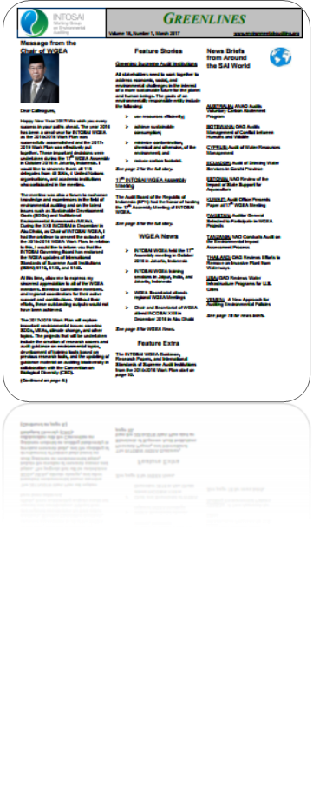
Goal 3
Assembly, Steering Committee and Regional Meetings
Trainings on Environmental Auditing
  Environmental auditing (India)
  Forestry auditing (Indonesia)
Develop new Training Tools
  Massive Open Online Course (MOOC) on
  Waste Management (Estonia)
  Training Tool on Greening the SAIs (ECA)
  Training Tool on Environmental Data (India)
Greenlines Newsletter (USA)
Updating website –www.wgea.org
9th Environmental Survey and Audit Collection

Slide 8

Goal 4
Cooperation with the CBD Secretariat (Convention on Biological Diversity)
  Auditing Biodiversity: Guidance for Supreme Audit Institutions
Continuous cooperation with the UNDESA, UNEP, UNFCCC
Establishing new partnerships

Slide 9
PROJECT MILESTONE
Sept 2017
Project Plan Approval
Dec 2017
Project’s Elaborated Table of Content Submission
Mid 2018
Draft Project Presentation (Assembly)
April 2017
Project Plan Submission
Sept 2019
Project Output Approval (Assembly)
Nov 2018
Final Draft Submitted for Comment

Slide 10
WGEA contribution to strategic objectives and crosscutting priorities
SO 2: Enable wide exchange of knowledge and experience among INTOSAI members
SO 3. Working with the CBC, IDI, and other INTOSAI entities, facilitate continuous improvement of SAIs through knowledge sharing on the crosscutting lessons learned from the results of peer reviews and SAI PMF.
Goal 1, 2 & 3
(Research, guidance, training, survey, coordinated audit, news letter, audit collection)
SO.1: Develop and maintain expertise in the various fields of public-sector auditing and help to provide content to the INTOSAI Framework for Professional Pronouncements.
Strategic Goal 3: Knowledge Sharing
Goal 1
Reviewing ISSAI 5130
Goal 4
Increase cooperation with international organization and INTOSAI bodies
WGEA Work plan 2020 - 2022
WGEA Work plan 2017 - 2019

Slide 11

WGEA contribution to strategic objectives and crosscutting priorities
Crosscutting Priority 2: “contributing to the follow-up and review of the SDGs within the context of each nation’s specific sustainable development efforts and SAIs’ individual mandates”.
Preparing the WGEA Audit Guideline Plan on Delivering the 2030 Agenda (Sustainable Development Goals) through Environmental Auditing.

Slide 12
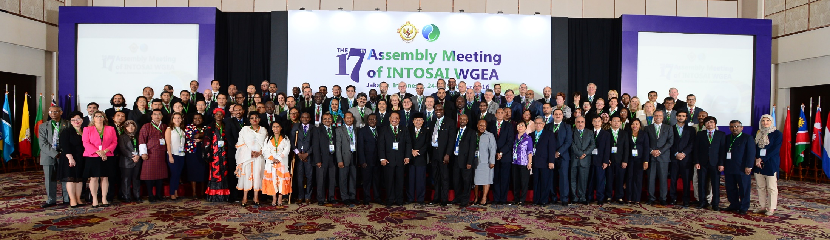
TERIMAKASIH

