Slide 1
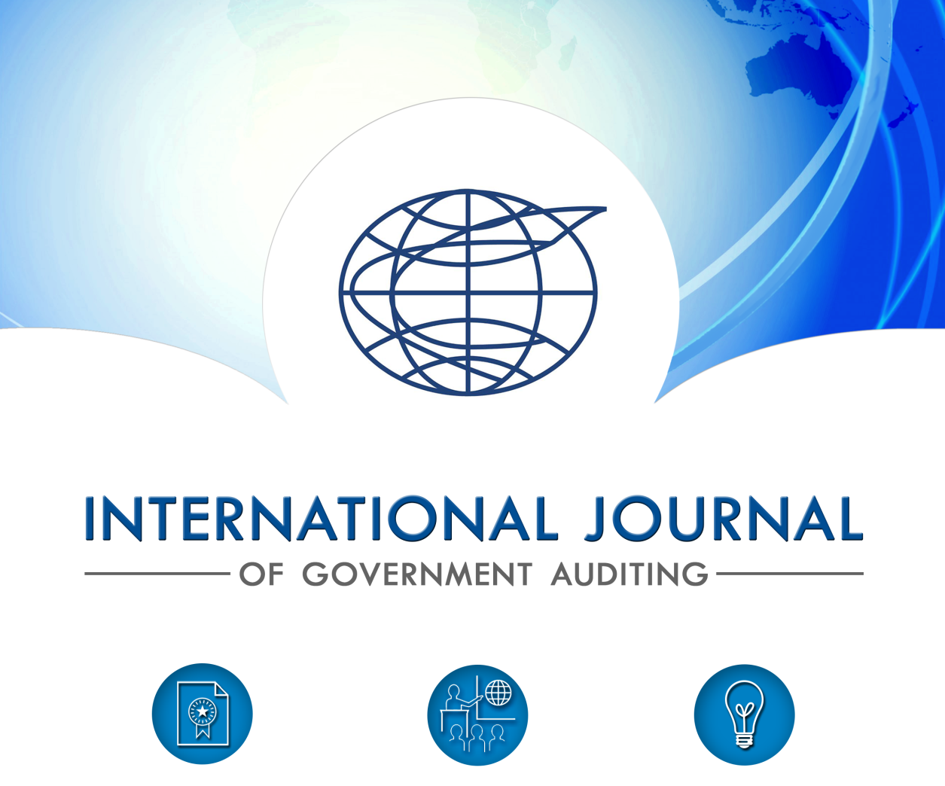
International journal of government auditing
11th KSC Steering Committee Meeting
Pampanga, Philippines
June 2019

Slide 2
JOURNAL WEBSITE
New website launched in April 2018
Responsive, engaging, modern, navigable design
Increased multimedia use
Dynamic, consistent customer experience with sharing, feedback capabilities
Ability to provide more timely, relevant news

Slide 3
KEY WEBSITE STATISTICS: FIRST YEAR
10,266 site visits
Most traffic organically sourced
77% readers use desktop, followed by 20.2% accessing site via mobile device
Top Pages
Home
Current Journal Landing Page
Archives
Top Nations Accessing Site
United States
Indonesia
India
Germany
Traffic Mobility
Notes:
Measured April 30, 2019

Slide 4
SOCIAL MEDIA PRESENCE, GROWTH, IMPACT
Key Social Media Points:
Twitter is primary news-sharing platform, particularly for live event coverage
Promoting stronger efforts to capitalize on INTOSAI-member coordination, tagging and hashtag use to increase event exposure
Social media used as drivers to web content
Social media outreach extends well-beyond INTOSAI and member-SAIs, which greatly enhances global communications, impact

Slide 5
INCREASED NEWS RELEVANCY, TIMELINESS, SYNERGIES
More thematic approach to Journal issues
Increasing timeliness by posting on website followed by publication incorporation
Boosting visibility through continued Journal presence at INTOSAI and regional events and expanding reach through coordination and connectivity with INTOSAI community to push news via social media
Collaborating to synergize communication efforts, share meaningful information, best practices, events with global audit community

Slide 6
CONCLUSION
Grateful for continued in-kind contributions for translations, as well as SAI article, editorial, news, special contribution submissions
Continue to serve as INTOSAI’s voice for information and resource sharing
Desire increased value through content relevancy, timeliness
Always welcoming suggestions for improvement
Budgetary oversight and diligence continues to ensure innovation and efficiency

