Slide 1
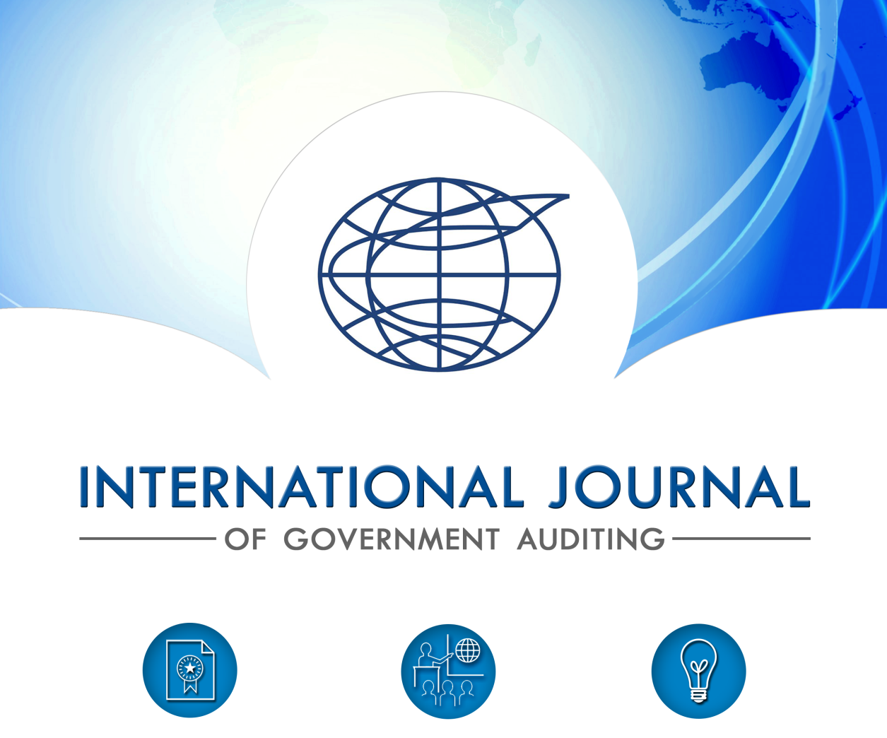
International journal of government auditing
9th Meeting of the Steering Committee of the
INTOSAI Committee on Knowledge Sharing and Knowledge Services
August 23-25-2017

Slide 2
WEBSITE
Transformation of Journal’s online presence underway (finalizing contract now)
Engage audience via modern, clean, intuitive website
Desired end-state is enhanced site
Brand consistent
Helpful, relevant content
Increased use of imagery, both video and still
Online submissions
Pop-up subscription form

Slide 3
THE JOURNAL’S SOCIAL MEDIA PRESENCE
STATS (2016)
Facebook followers 747
Twitter audience 450
Instagram followers 22

Slide 4
THE JOURNAL’S SOCIAL MEDIA PRESENCE
STATS (2017)
Facebook followers 877
Twitter audience 642
Instagram followers 58

Slide 5
SAI WEB AND SOCIAL MEDIA PRESENCE
Environmental Scan June 2017

Slide 6
EVENT COVERAGE AND REPORTING
Increased, More Robust On-Site Coverage
Congresses, General Assemblies
Goal Chair Meetings
Relevant, Innovative Topics
Live Reporting and Follow Up Article for Larger Events
Sharing attendees’ and organization’s tweets, posts, photos
Capitalize on using trends, handles
Grass roots, networking, collaborative approach
Help solicit increased interest, contributions in Journal as communications resource
Focus on content (auditing, outcomes-, achievement-based stories)

Slide 7
CONCLUSION
Grateful for:
In-kind contributions for translations
SAI article submissions
Continue to serve as INTOSAI’s voice for information and resource sharing
Desire to add value through unique, relevant content relevancy
Always welcoming suggestions for improvement
Budgetary oversight and diligence to ensure innovation and efficiency

