Slide 1
SAI Capacity Development Database & MoU Principles

Slide 2
SAI Capacity Development Database
http://intosaidonor.org/project-database/

Slide 3
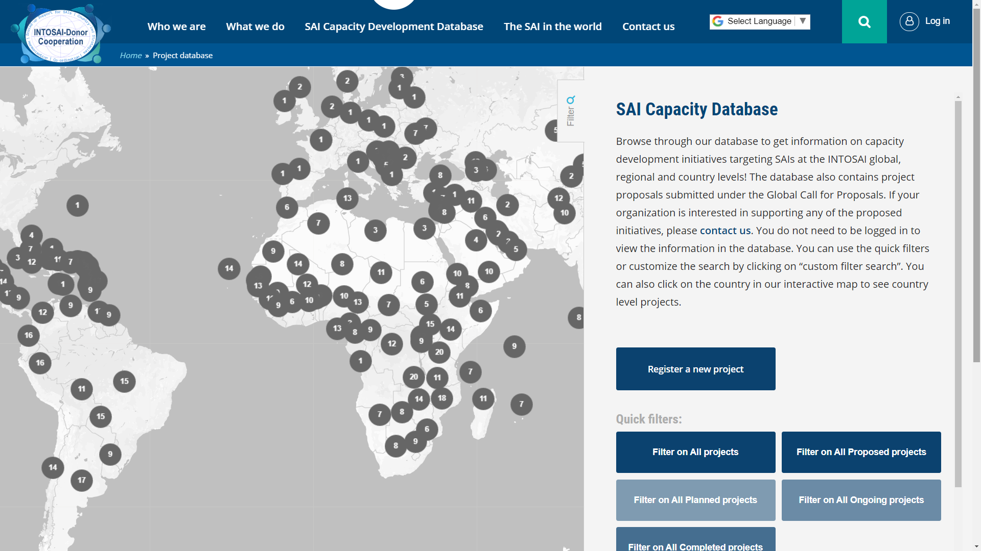

Slide 4
What can the database help you with?
See capacity development projects around the world
Monitor donor activity
Monitor regional activity
Highlight completed and ongoing projects in your region to donors
Identify needs
Showcase projects that have been carried out according to MoU principles

Slide 5
What are the MoU Principles?
Scaled-up support
2) SAI-led strategies
3) Harmonization
4) Coordination

Slide 6
Discussion Questions
Are the MoU Principles being followed in your region?
Why/why not?
2) What activities do you currently undertake at the regional level to promote the MoU Principles?
What activities or initiatives could you undertake in the future?
3) What can the INTOSAI Donor-Cooperation do to help the regions and SAIs ensure that donor-funded capacity building projects follow MoU principles?

