Slide 1
Assisting SAIs to remain resilient during the Pandemic 13 KSC SC Meeting
16 September 2021

Slide 2
Presentation plan
IDI Performance and Accountability Report 2020
IDI response to COVID-19

Slide 3
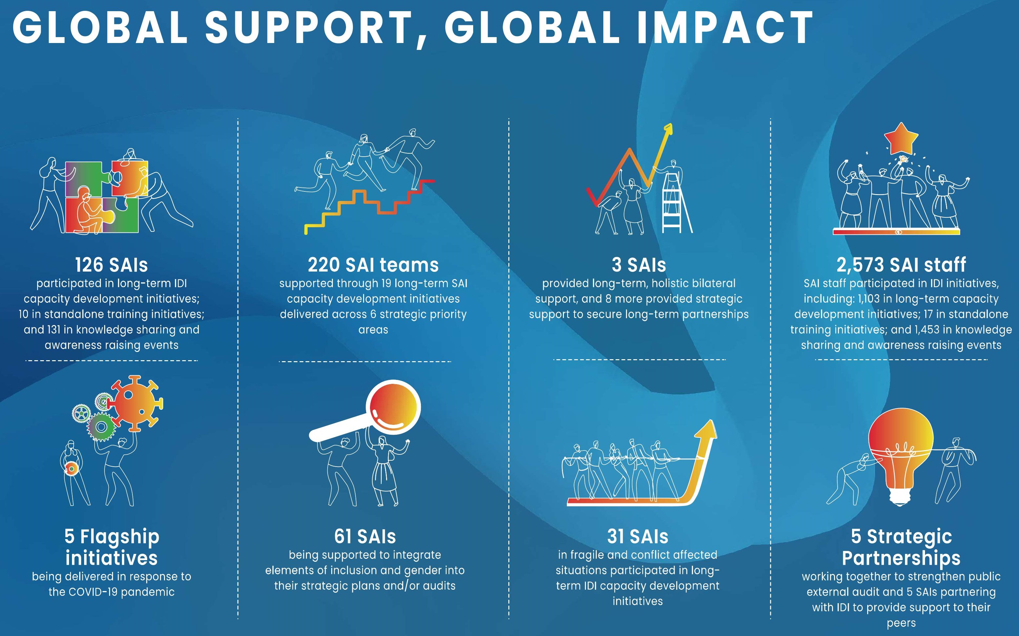
IDI Outreach 2020

Slide 4
IDI Performance 2020
Independent SAIs Work Stream
Well-Governed SAIs Work Stream
Professional SAIs Work Stream
Coordinated advocacy efforts through SIRAM
TAI launched to support 50+ SAIs to audit use of emergency funds
SAI Independence Resource Centre launched to support independence in a digital age
43 SAIs supported on strategic planning during COVID
Over 30 ongoing SAI PMFs and 77 finalised
21 SYLs supported SAI change & graduated
8 SAIs in South East Asia supported in financial audit
SAI Strategic Management Handbook Published
Relevant SAIs Work Stream
Bilateral Support
Global Foundations
SAI Innovations webinars on flexibility, agility & resilience for 500+ auditors
South Sudan & Somalia deliver critical audits with IDI support
“All Hands on Deck” joint report with IBP published & launched, calling for stronger accountability & oversight
55 SAIs auditing SDG implementation issues – health, sustainable procurement, and gender based violence
Major peer-peer support mobilised for Madagascar & Gambia (IDI-led), and Niger
4 SAIs supported to report publicly on their performance
34 SAIs funded under INTOSAI Continuity of Operations grant, with IDI support
SAI Stocktaking and Global Survey 2020
Cross Cutting Priority: Inclusiveness and Gender

Slide 5
IDI response to COVID-19 Cross-cutting COVID-19 priorities
Supporting SAIs to:
prepare for the new normal
audit relevant to the new normal
enhance ICT and connectivity
leverage new technology
communicate effectively using electronic media
Focus on building agility and resilience

Slide 6
IDI response to COVID-19 COVID-19 Flagship Initiatives
TAI: Transparency, Accountability and Inclusiveness Audits on use of emergency funds
3D audits: audit of strong and resilient national public health systems
Partnering to leverage IMF influence
Examination of compliance of transactions in high- risk areas
Conclusions on transparency, accountability and inclusiveness of compliance frameworks and transactions
57 participating SAIs from all regions
2020-21: IMF provided over US$ 110 billion in Covid-19 related emergency financing to 85 countries.
Letters of Intent (LoI) call for a SAI audit.
Joint paper prepared which notes that SAIs play a key role in the audits of emergency finance.
Precursor to further cooperation.
IDI, KSC, ASOSAI, ARABOSAI and CAROSAI partner to support a cooperative audit of strong and resilient national public health systems (linked to SDG target 3.d).
Main objective is to contribute to strong and resilient national public health systems
39 participating SAIs
Shadow pandemic: audit of elimination of intimate partner violence against women
Compliance audits of use of COVID-19 funds in The Gambia and Madagascar
Pilot support to SAIs on ICT governance, and risk & crisis management
linked to SDG 5.2 - A pilot audit by SAI Uganda
Examine government efforts in progressing towards nationally agreed targets of elimination of intimate partner violence linked to SDG 5.2.
The audit framework for EIPVW will be based on IDI’s SDGs Audit Model (ISAM)
Research the possibility of accessing and using the results of existing assessments of SAI ICT needs using tools such as ITSA
Develop a holistic overview of what ICT in a SAI should look like in a standard case.
Choose appropriate risk management framework and adapt for SAIs
Explore and develop crisis management approaches for SAIs and build partnerships with SAIs and other actors
Support to prioritized audits and related capacities, especially COVID-19 compliance audit and policy evaluation (The Gambia)
Support for compliance audit on COVID-19 and policy evaluation related to water and hygiene (Madagascar)

Slide 7
IDI-KSC Cooperation
Research project on SAI Independence
Partnership on SDGs with KSC
IDI-KSC-ASOSAI - ARABOSAI - CAROSAI Audit of Strong & Resilient National Public Health Systems (linked to SDG 3.d)
Disseminate results from 2020 Global SAI Stocktaking report on areas of interest to KSC
Cooperation with WGITA, WG SDG KSDI, WGBD, WGISTA

Slide 8
Thank you

