Slide 1
Supporting SAIs in Auditing SDGs

Slide 2
IDI-KSC AUDITING SDGs Programme (2016-2019)
Support SAIs in conducting high quality audits of SDGs
Partners : KSC, UNDESA, KNI, INTOSAI Regions, CAAF, IBP, GAB
Advocacy & Awareness Raising
Guidance on Performance Audit of Preparedness for Implementation of SDGs
Cooperative Performance Audit of Preparedness for Implementation of SDGs
Are Nations prepared for implementing SDGs : SAI insights and recommendations

Slide 3
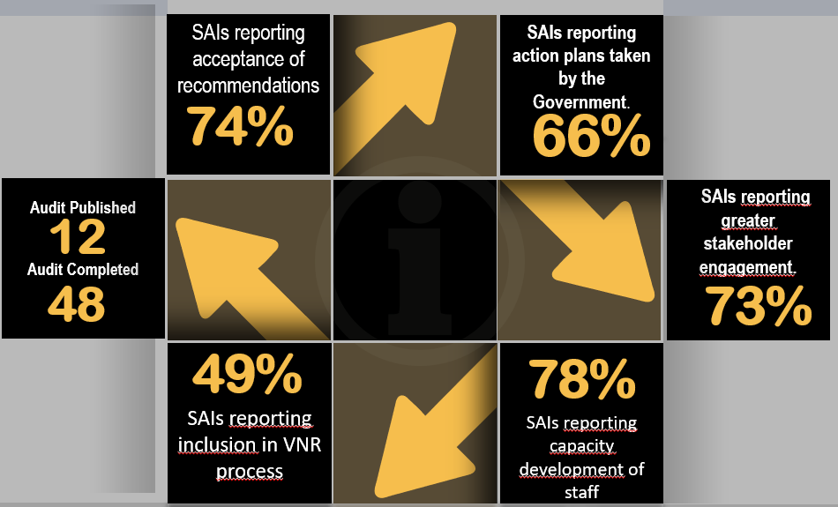
What have supported SAIs achieved ?

Slide 4
Highlights of IDI- KSC support
Guidance on performance audit of preparedness for implementation of SDGs available in four languages.
4500 downloads
73 SAIs and one subnational provided holistic support in conducting an ISSAI based performance audit of preparedness for implementation of SDGs
Advocacy and Awareness raising through multiple stakeholder engagement

Slide 5
Lessons Learned
What worked
Innovation
Inclusion
What could be done better
More ‘how to support’
Strategic options
Partnerships
Stakeholder engagement
Advocacy and Awareness raising
Focus on ISSAIs
Visibility
Value addition
Wider strategic alliances
Support for strategic considerations
Global outreach
Audit impact
Common understanding and coordinated effort
Move from CoP to work areas

Slide 6

Future Plans ( 2019 – 2023)
IDI SDG Audit Model ( ISAM)
SDG Digital Education
SDG Advocacy and Awareness Raising
SDG Cooperative Audits
SDG Audit Impact
SDG Strategic Considerations/ SAI Level
SDG Strategic Partnerships
SDG Leadership
SDG Innovation & Data Analytics
IDI SP 2019-2023
IDI will continue to support SAIs in auditing SDGs ….IDI will support SAIs in auditing implementation of specific SDG goals and targets

Slide 7
From preparedness to implementation
PA of Preparedness | ISAM
Audit of Preparedness | Audit of Implementation
Across the agenda | Related to individual SDG targets
Performance Audit | Link between Financial, compliance & performance audit
Individual audit level | SAI level and individual audit level
Focus on coherence, integration, inclusion, participation | Focus on coherence, integration, inclusion, participation
Performance Audit Preparedness for Implementation of SDGs
Audit of Implementation of SDGs

Slide 8
Focus on outcomes
Recognise SAI Diversity
ISSAI Based
Inclusiveness
Add Value
ISAM Principles

Slide 9
Leave no SAI behind
Doable for SAIs with different capacity levels, mandates and environments
‘How To’
Provides detailed tools and techniques
Innovative
Explores innovative audit approaches, tools and techniques
ISSAI Based
PA, FA and CA ISSAIs used as quality benchmarks
Mainstream Gender /inclusiveness
Provide for gender/inclusiveness considerations at SAI level and individual audits

Slide 10
Define Auditing Implementation of SDGs
Audit of SDG goals/targets using WoG and SDG principles
Audits of entities or programmes contribution to implementation of SDG goals and targets

Slide 11
Two Levels
SAI Level & Individual Audit Level
Strategic Considerations at SAI Level for SDG Relevant Audits
SDG Relevant Individual Audits
FA, CA, PA

Slide 12
Effective Organisational setup
SAI Audit Planning
Professional Capacity
Audit Methodology
Achieve Audit Impact
Strategic Partnerships
Leveraging on technology
Strategic Considerations at SAI level

Slide 13
One multi Disciplinary Team
Coordinating Mechanism between teams
Each team has multidisciplinary skills
Coordination with sub nationals
SDG Audit unit
Effective Organisational setup for auditing implementation of SDGs

Slide 14
Performance Audit
Financial Audit
Compliance Audit
Audit of Implementation of SDGs

Slide 15
PA
Entity, programme, process based
Examination of coherence not required
Inclusion questions may not be included
Limited stakeholder engagement
PA of implementation of SDGs
Outcome based
Cross cutting across entities and programmes
Examination of coherence and integration required
Inclusion questions need to be included
Multi stakeholder engagement
Performance Audits of Implementation of SDGs

Slide 16

SDG target 16.5
Anti corruption
Compliance Audit ISSAIs
SDG target 12.7
Sustainable Procurement
Innovation in audit – use of data analytics
Quality management & audit impact
Cooperative Compliance Audit of
Sustainable Procurement
using data analytics sing

Slide 17
Working Together
Agree on a common definition of ‘ auditing implementation of SDGs’ ( including saying what is not auditing implementation of SDGs)
ISAM as a base model providing methodological guidance as per ISSAIs, using WoG approach and SDG principles
Using ISAM as a basis, working groups build subject matter guidance related to goals and targets relevant to the subject matter dealt with e.g. WGEA

Slide 18
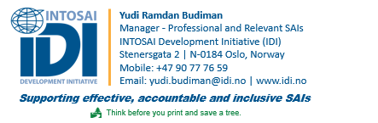
Thank you
For further information
Please contact:

