Slide 1
Auditing SDGs Programme

Slide 2

Auditing SDGs Programme
The main intention of the programme is
to contribute to INTOSAI efforts by supporting SAIs
in conducting high-quality ISSAI-based performance audits
of preparedness for implementation of the 2030 Agenda
thereby contributing to the value and benefits for citizens

Slide 3










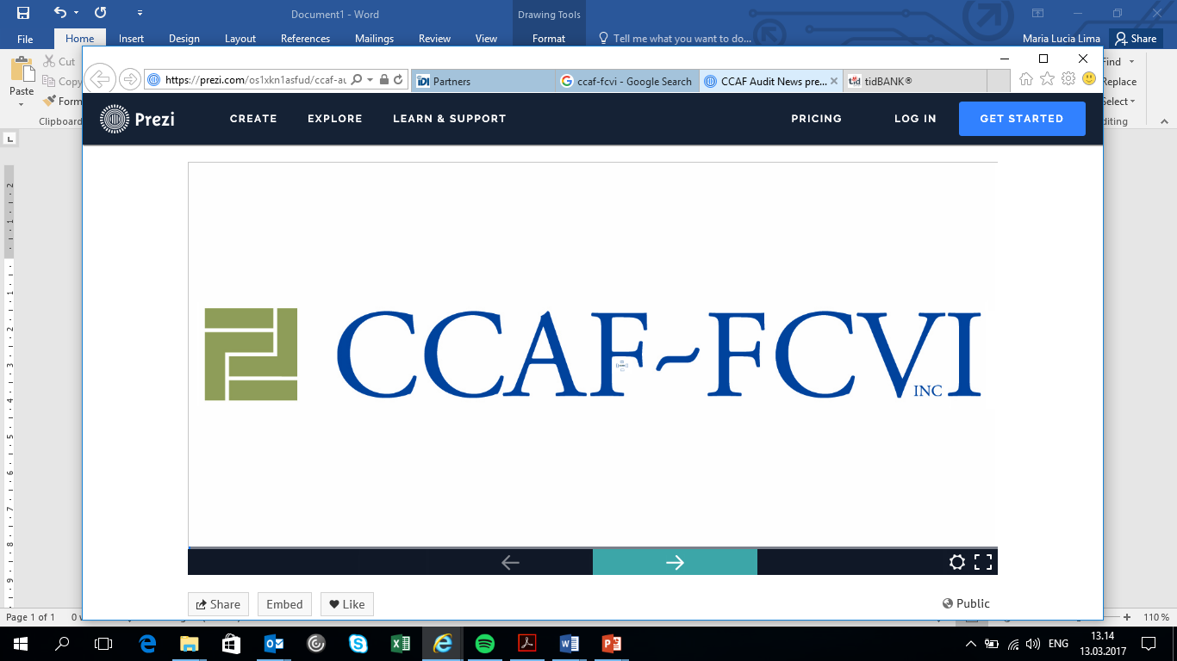


PARTNERS

Slide 4

SAIs participating in Programme
EUROSAI: 4 SAIs
ASOSAI : 17 SAIs
ARABOSAI (*)
CAROSAI: 2 SAIs
CREFIAF(*)
Auditing Prep for
implemementation of SDG 5
OLACEFS: 14 SAIs,
Auditing Prep for
implementation of SDG 5
PASAI : 14 SAIs
AFROSAI-E: 7 SAIs
(*) 13 SAIs in ARABOSAI and 14 in CREFIAF indicated interest in participate in programme in 2018

Slide 5
Results Framework
CoP
Auditing Implementation of SDGs
GPG
Guidance Auditing of Preparedness for Implementation
Cooperative Audit of Preparedness for Implementation
Lessons Learned and Compendium of Audit findings

Slide 6
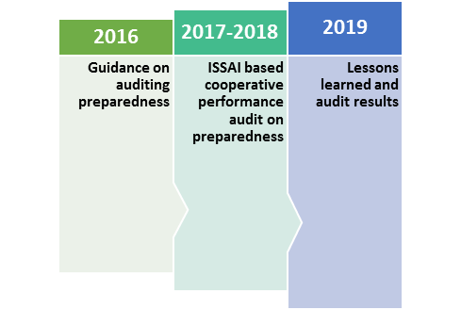
Auditing SDGs Programme
Advocacy & Awareness Raising
Community of Practice

Slide 7
Guidance
Guidance
Guidance has 3 parts:
Part 1 – UN2030 Agenda and SDGs
Part 2 – SAIs and SDGs
Part 3 – Performance Audit of preparedness for implementation of SDGs
Guidance can be downloaded at http://www.idi.no/en/elibrary/cpd/auditing-sustainable-development-goals-programme#document-auditing-preparedness-for-implementation-of-sdgs-a-guidance-for-supreme-audit-institutions

Slide 8
IDI cooperative Audit support model
Middle level management involved in audit process
Guidance on Auditing Preparedness Q 1 - 2017
Agenda 2030
SAIs and SDGS
Audit Model
Performance Audit of Preparedness
eLearning programme Q 3 - 2017
1 to 2 week mentor training
8 week mentor led eLearning course for audit teams on subject matter & methodology
Support during the audit process Q4 2017 onwards
Audit
Planning Meeting
Audit Review Meeting
Quality Assurance - 2019
Independent assurance of audit quality
SAI Commitment and Readiness Q 1 - 2017
SAI includes the audit in their annual plan
Readiness to provide resources and to conduct the audit
Agreement with SAI leadership
Participation of middle management
SAIs contribute to value & benefits through independent oversight and constructive recommendations
SAIs have a voice in SDG implementation in their countries and are not left behind
SAIs develop capacity to conduct PAs on SDGs
Onsite/online support during audit

Slide 9
Audit Objectives
Audit model and objectives
Whole of Government approach – WoG is an overarching term for a group of responses to the problem of increased fragmentation of the public sector and public services and a wish to increase integration, coordination and capacity.
Audit Objective 1 – To what extent has the government adapted the 2030 agenda into its national context?
Audit Objective 2 – Has the government identified and secured resources and capacities (means of implementation) needed to implement the 2030 Agenda?
Audit Objective 3 – Has the Government established a mechanism to monitor, follow-up, review and report on the progress towards the implementation of the 2030 Agenda?

Slide 10

THANK YOU

