Slide 1
Working Group on IT Audit
10th Meeting of KSC Steering Committee
Kampala
(20-24 August 2018)
SAI-India

Slide 2
WGITA projects (2017-19)
WGITA Work Plan 2017-19 includes five projects:
series
Name of the Project | Nature of Deliverables
Updating the ISSAI 5300 on Information Systems audit and 5310 on Information Systems’ Security Audit including Cyber Security as GUIDs under IFPP (SAI India) | Part of SDP 2017-19 of IFPP. Will result in two GUIDS in 5100 series in new IFPP framework
General Capacity Requirements for SAIs for conducting IT Audit (SAI South Africa) | Non-IFPP Documents placed at Level 2 of QA. Projects would be completed before the next INCOSAI in 2019
Data Analytics (Area: IT Audit Techniques) (SAI Indonesia)
Documentation Requirements of an IT Audit including Audit Management System (Area: Audit process) (SAI Mexico)
Development of roadmap for future GUIDs in the 5100 series (SAI Pakistan) | Roadmap for future GUIDs under 5100 series to be ready by December 2018

Slide 3
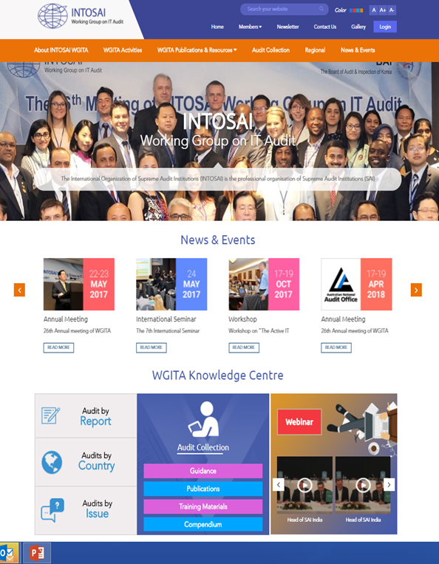
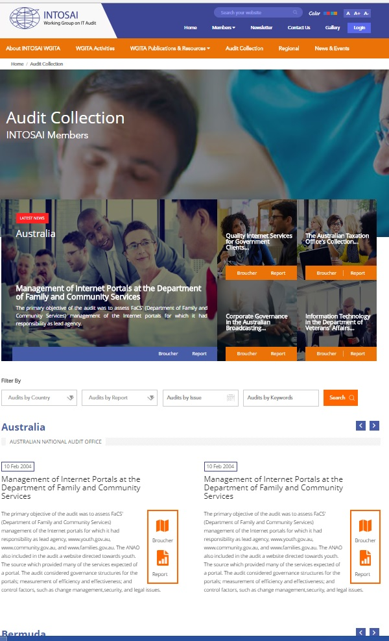
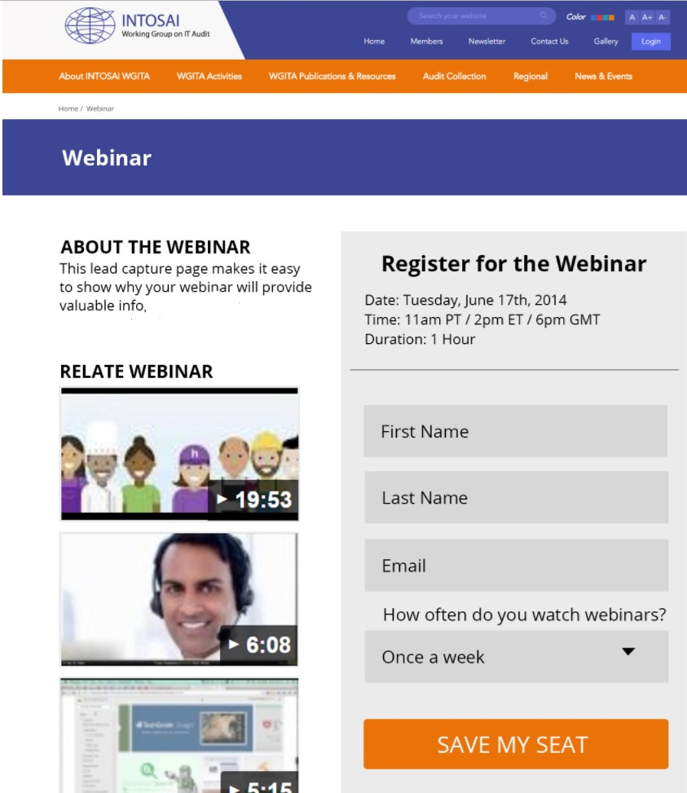
Dissemination and exchange of knowledge
Working Group webpage in the INTOSAI Community Portal is used as information interchange platform
(http://www.intosaicommunity.net/wgita/)
Last WGITA meeting held in Sydney in April 2018:
Bhutan offered to maintain IT Audit Database
Georgia offered to host Webinar every six months
Designated International Centre for Information system and Audit (iCISA) of SAI India as Global Training Facility of WG.
Preparation of Global Curriculum to commence in 2019

Slide 4
Dissemination and exchange of knowledge
WGITA in the 27th Annual meeting held in Sydney saw country paper presentation from 8 SAIs/ISACA.
Seminar on “Embedding data assurance to drive audit efficiency and quality” was held by ANAO, Australia in conjunction with WGITA Seminar
WGITA in coordination with GAO, USA holds triennial Performance Auditing Seminars on topical subjects related to IT Audit. Last PAS held in 2016.

Slide 5
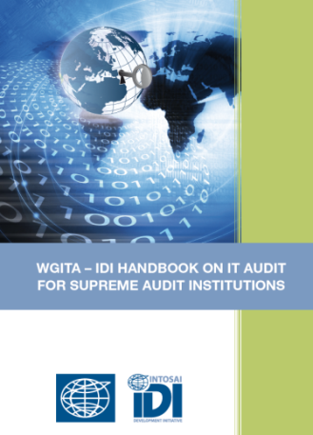
Stakeholder engagement for greater synergy
WGITA in collaboration with the INTOSAI Development Initiative (IDI) developed an IT Audit Handbook
Handbook available in the WGITA page of INTOSAI Community Portal
Being continuously updated by standing team led by USA
IDI in collaboration with WGITA will undertake QA evaluation of handbook as per IDI QA protocol
AFROSAI-E and Information Systems Audit and Control Association (ISACA) are observers of WGITA and are involved in various projects of WGITA
Enables WGITA to get Regional perspective and guidance from a professional organization of International repute.

Slide 6
THANK YOU

