Slide 1
Emerging Issues
10th Meeting of KSC Steering Committee
Kampala
(20-24 August 2018)
SAI India

Slide 2
Supervisory Committee on Emerging Issues
Need to respond to changes, challenges and emerging issues of international dimensions
SCEI established in 2012 at 63 meeting of GB in Chengdu, China.
To report under chairmanship of INTOSAI chair directly to GB
INTOSAI Strategic Plan 2017-2022 entrusts following responsibilities to SCEI:
Preparing the Governing Board and other INTOSAI stakeholders for emerging issues
Undertaking enterprise risk management function on behalf of the Governing Board of INTOSAI
Chaired by SAI UAE.

Slide 3
Expert Group - SCEI
Expert group, within SCEI members to provide independent assessment of issues raised and provide recommendations on proposed solutions
Members of Expert Group:
Austria
India
Norway
USA
Brazil
Spain
Tunisia
Chile
South Africa

Slide 4
Definition
Emerging issues are external developments that will fundamentally:
impact the audit practice in the future, or
affect the reputation of SAIs/INTOSAI

Slide 5
Examples of emerging issues
IT, e.g. big data, internal controls, need for data scientists
International corruption
Migrant crisis
Climate change
SDGs

Slide 6
Categorisation of Responses
Immediate response : To be coordinated by the General Secretariat in conjunction with the SCEI.
Strategic Response : To be brought to the attention of the GB and any other relevant stakeholders through the Annual Submission of the SCEI to the GB.
Outreach opportunities: To prepare key publications for outreach opportunities as determined and prepared by the expert group and approved by the SCEI membership and submitted to the GB for approval as part of the annual GB submission.

Slide 7
Circulation of Templates through KSC Portal
SCEI has devised two templates for collecting the emerging issues and risks from various INTOSAI Organs
The templates are posted in the INTOSAI Community Portal (www.intosaicommunity.net)

Slide 8
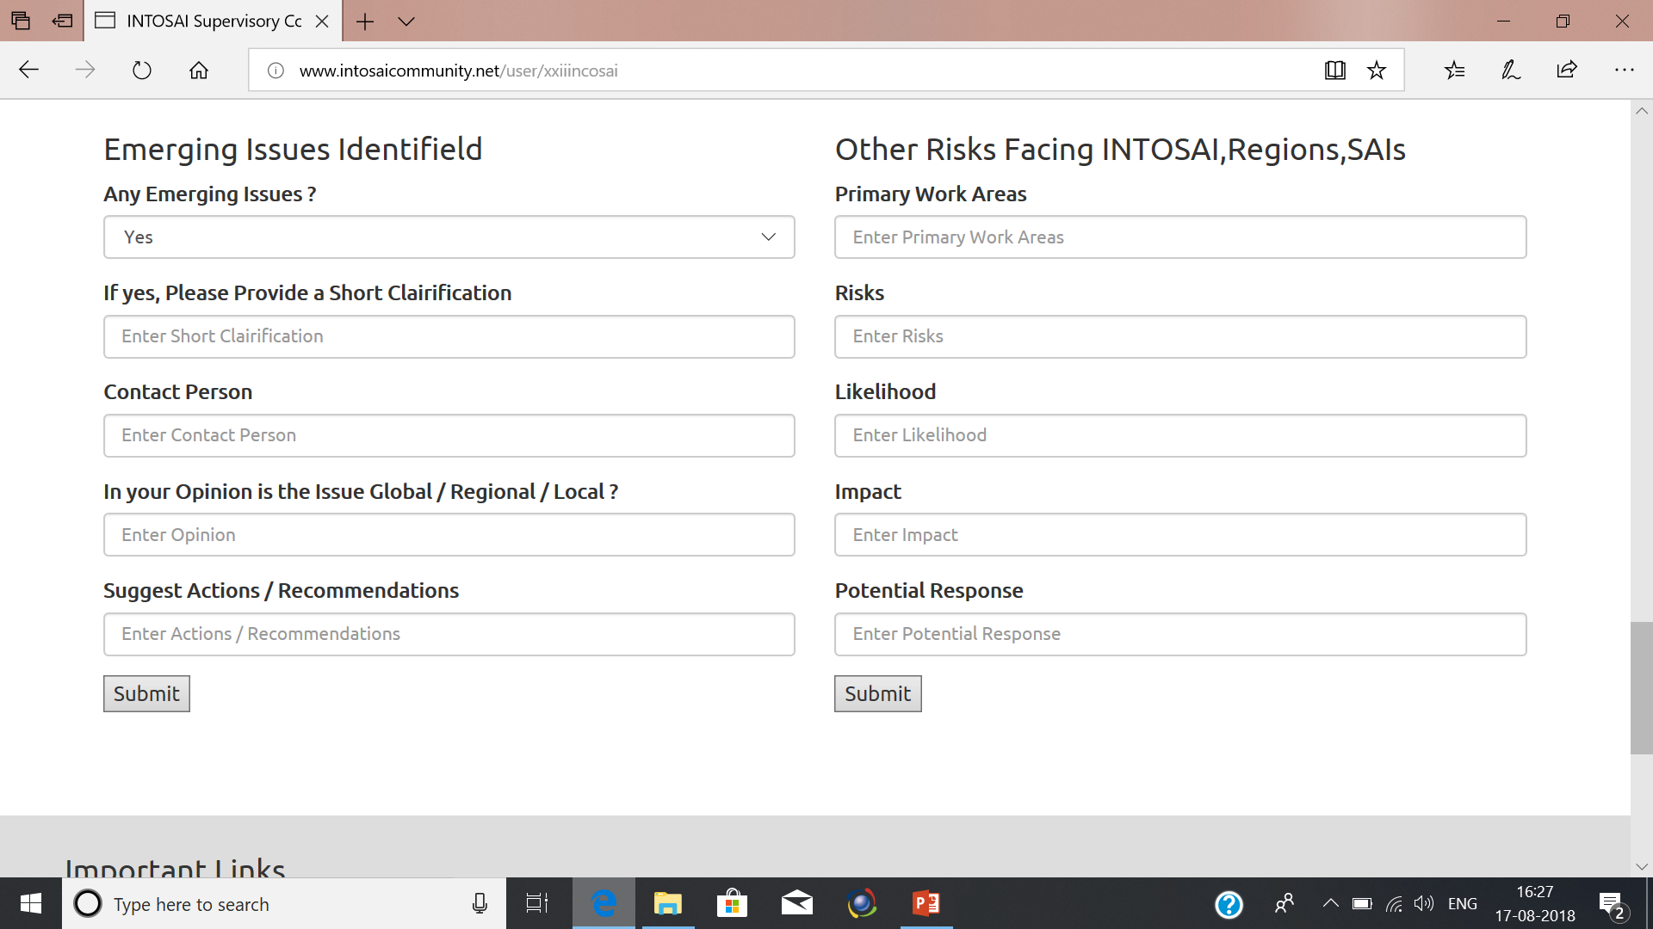
Templates in KSC Portal

Slide 9
Discussion questions
Exercise undertaken by Working Groups to scan for emerging areas.
Could also act as feeder for topics for research projects for next KSC work Plan
Provide inputs in annex I and II circulated by SCEI on emerging issues and risks and post in the INTOSAI Community Portal on regular basis.

Slide 10
THANK YOU

