Slide 1
INTOSAI Community Portal
10th Meeting of KSC Steering Committee
Kampala
(20-24 August 2018)
SAI India

Slide 2
INTOSAI Community Portal
Initiative of KSC and IDI
Single window on the activities of KSC & its 11 Working Groups
Main features
Register on the portal
Request a video conference
Write a blog
Start a chat
Participate in Community of Practice
Article for Library
Post an exposure draft
Post an event in the Calendar
Post a video/ photo

Slide 3
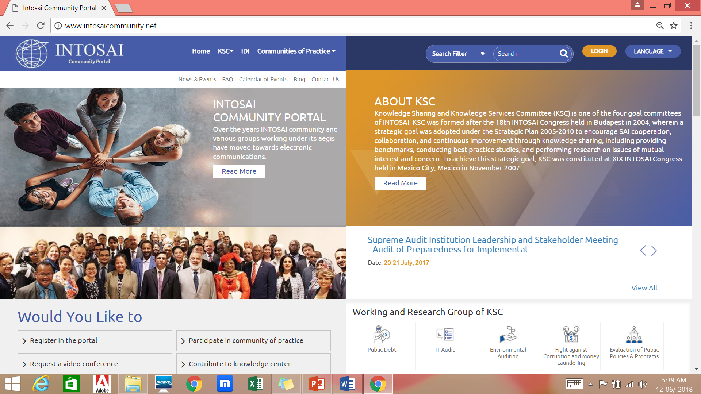
INTOSAI Community Portal (www.intosaicommunity.net or www.intosaiportal.org )
Central repository of information
Information on Working Groups
Separate page for SCEI
Hosts Communities of Practice (closed groups) to facilitate virtual meetings
Provision for polls, surveys, news
Exposure Drafts

Slide 4
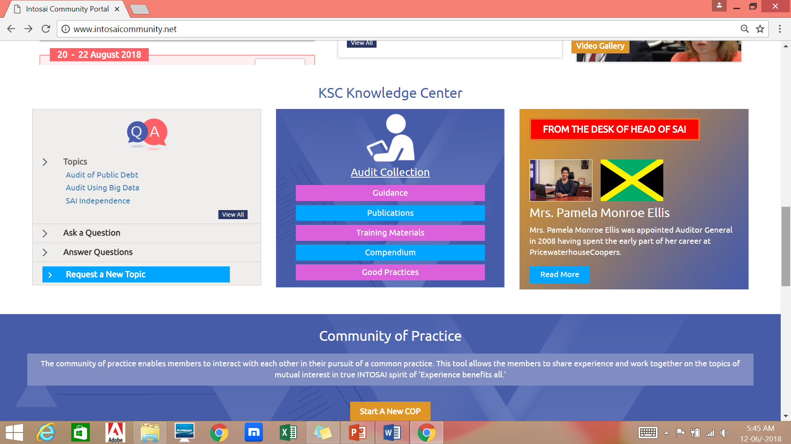
Auditor Centric
To cater to needs of field practitioner of public auditing
Knowledge Centre: access to guidance, compendiums and best practices
Provision for Q & A: Auditors may seek and provide answers on different areas of public auditing

Slide 5
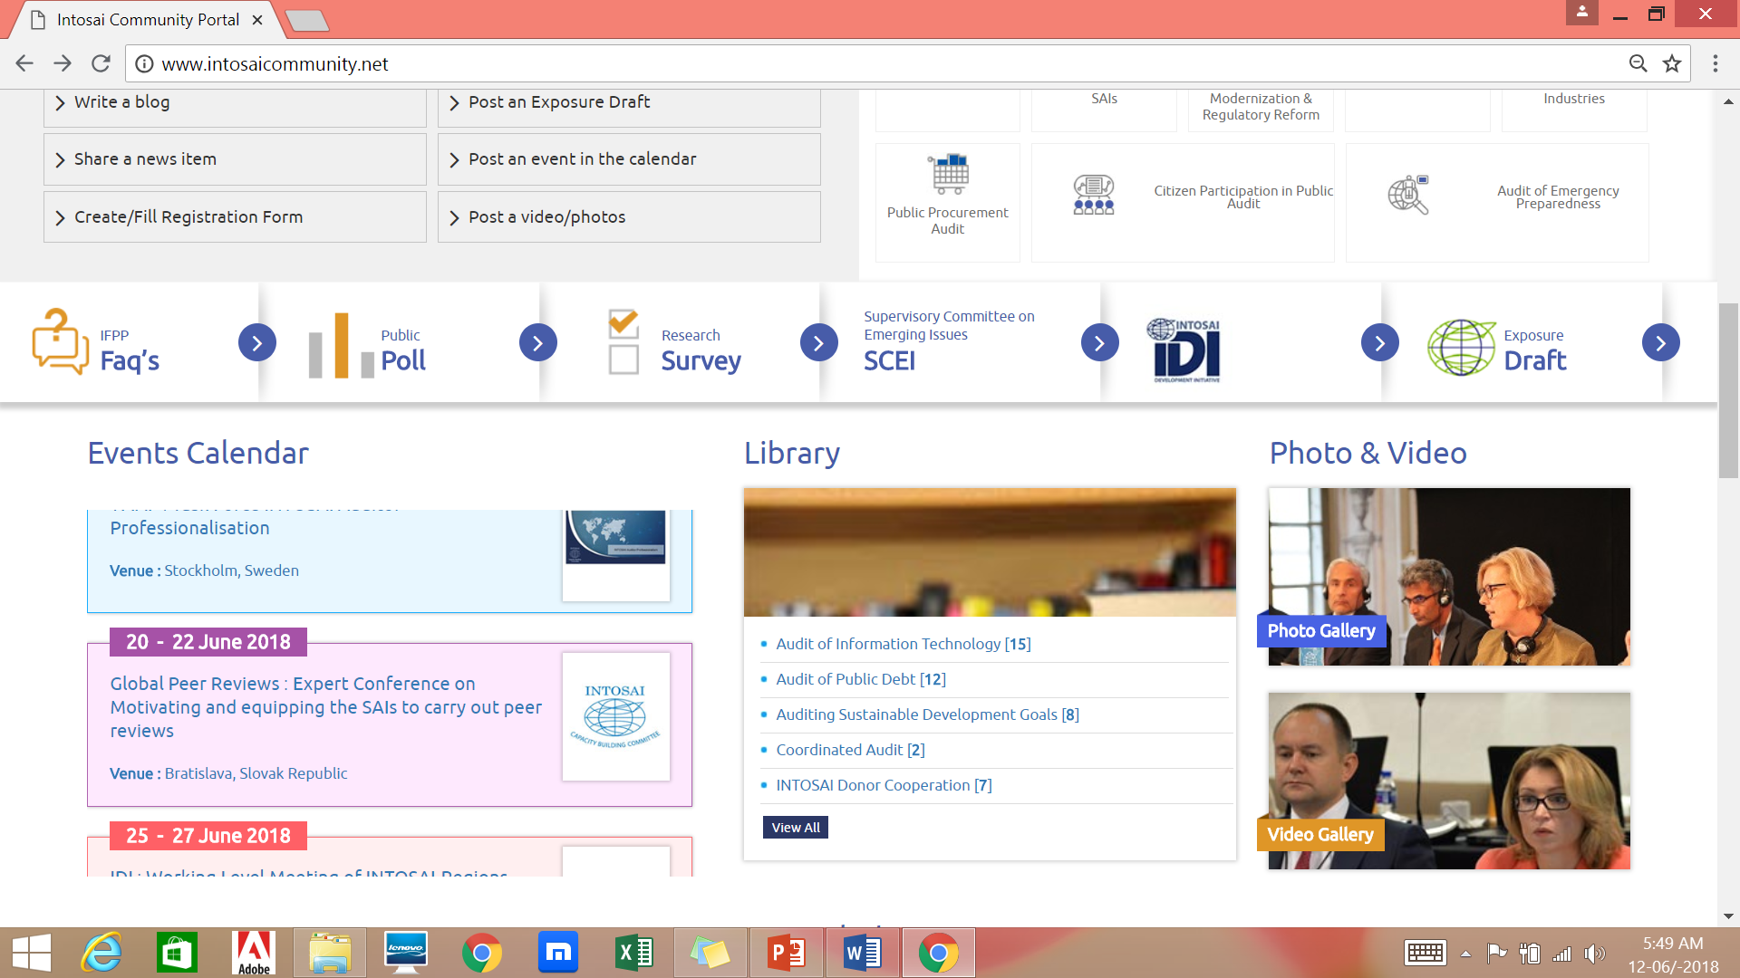
Additional features
Multilingual support– all INTOSAI languages
In-built video conference facility and recording of virtual meetings
Webinars
Multiple Chat forums
Page for Head of SAI

Slide 6
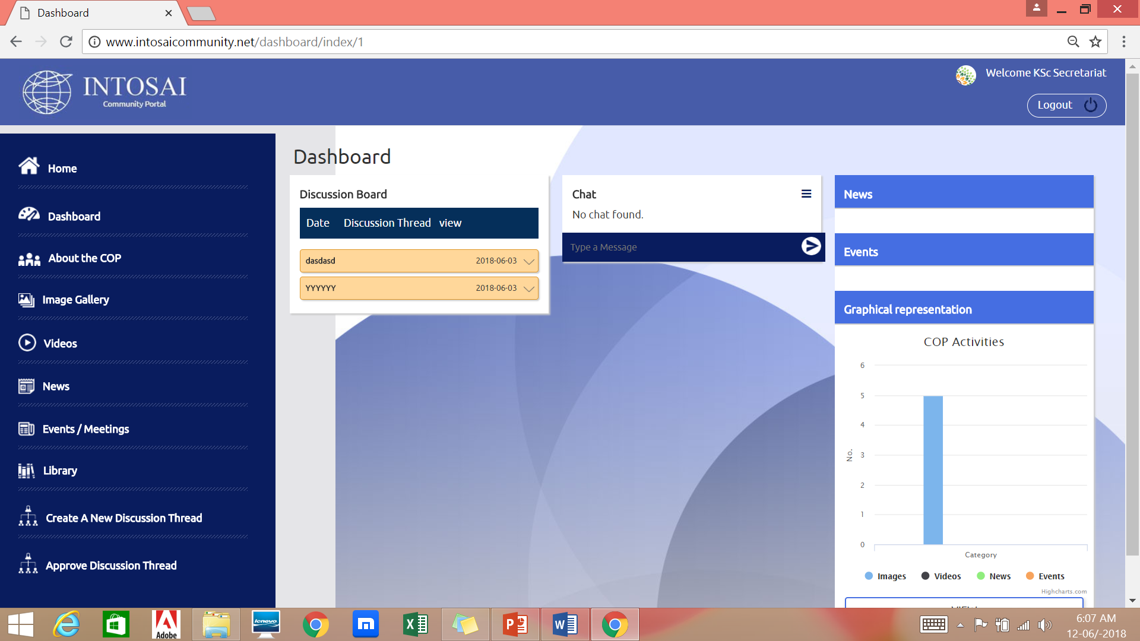
Communities of Practice (CoP)
Closed group
Enable members to communicate among themselves and share documents, photos, videos within the group
Two categories of users: Manager and members
Library in CoP keeps track of version changes of documents

Slide 7
Communities of Practice
Manager
Add/delete members, documents, videos and photos
Create different discussion threads for members to interact
Monitor level of participation of members of the group
Members
Add documents, post videos, photos
Chat within discussion threads

Slide 8
Administration of Portal
Overall administration/maintenance by KSC secretariat
Working Groups allotted separate pages enabling adding of additional features/menus
IDI responsible for outreach support
Currently in testing phase (beta version)

Slide 9
Way forward
KSC Secretariat to manage the contents in portal in all languages of INTOSAI
KSC Secretariat to handle initial process of migration will be handled by KSC Secretariat
Working groups required to manage the contents of their webpages in English
Translation of all static contents undertaken by KSC
Assistance sought for translation of non-static contents like Guidance, Good Practices, Library, Events etc.
Assistance for quality assurance on Translation
Encourage use of Webinar and VC facility

Slide 10
Discussion points
Increased use of VC facilities
Experience of Caribsai, Afrosai and Arabosai
Forwarding the contents of the webpages as per the templates chosen by the Working group.
Identification of Manager of content management of WG Website in English?
Manager to be focal point for knowledge centric activities in the KSC main page pertaining to working group domain and the (for example, Q & A etc.)
Identification of member/s to manage webinars and audit databases
Use CoP in the INTOSAI Community Portal for WG/PG activities.

Slide 11
THANK YOU

