Slide 1
Progress Report INTOSAI Working Group on Environmental Auditing
INTOSAI WGEA Secretariat
8th KSC Meeting
Mexico City, September 7, 2016

Slide 2
Outline
2014 – 2016 Progress Report
Issue on ISSAI 5130 to Discuss
WGEA 2017-2019 Work Plan
Upcoming Meeting

Slide 3
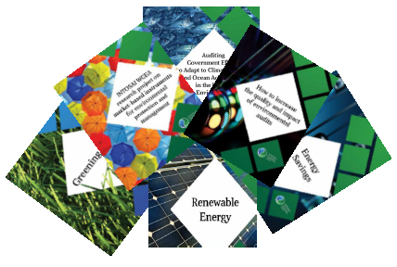
Research Projects
Renewable energy (Leads: Morocco and Indonesia)
Energy saving (Lead: Czech Republic)
Market based instruments for environmental protection and management (Lead: Estonia)
Greening the SAIs (Lead: India)
Auditing government responses to a marine environment impacted by climate change: Creative and innovative strategies used by SAIs (Lead: USA)
How to increase the quality and impact of environmental audits (Leads: Lesotho and Cameroon)
Environmental impact assesment (Leads: Canada and India)

Slide 4
Research Projects
Due Process:
Presentation of project plans by project leaders in 13th SC meeting in Indonesia on April 2-6, 2014.
Conducting mini survey to collect data related to the project from July to September 2014. 60 SAIs responded to the survey.
Drafting of research papers starting from July 2014.
Presentation of first draft in 16th Assembly Meeting in Philippines on September 29 - October 2, 2014.
Distribution of research paper to SC members in July 2015.
Revision of draft after SC members’ comments.
Presentation of the updated draft in 14th SC meeting in Egypt on September 28 - October 1, 2015.
Distribution of research paper to SC members for final comments in February 2016.
Finalization of draft.
Progress:
The final drafts have been approved by SC members in April 2016.
The final research papers will be endorsed by WGEA Assembly in October 2016.

Slide 5
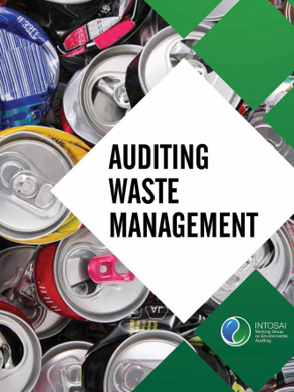
Update of Guidance Material
Update of the WGEA 2004 Guidance Material of “Towards Auditing Waste Management” (Lead: Norway)
Due Process:
Presentation of project plans by project leader in 13th SC meeting in Indonesia in April 2014.
Conducting mini survey to collect data related to the project from July to September 2014. 60 SAIs responded the survey.
Drafting of research papers starting from July 2014.
Presentation of first draft in 16th Assembly Meeting in Philippines on September 29 - October 2, 2014.
Distribution of draft guidance to SC members in July 2015.
Revision of draft after SC members’ comments.
Presentation of the updated draft in 14th SC meeting in Egypt on September 28 - October 1, 2015.
Distribution of revised draft to SC members for final comments in February 2016.
Finalization of draft.
Progress:
The final drafts have been approved by SC members in April 2016.
The final research papers will be endorsed by WGEA Assembly in October 2016.

Slide 6
Trainings
WGEA International Training on Environmental Auditing in Global Training Facility in India
Modules for training developed in conjunction with INTOSAI WGEA GTF project sub committee members
Climate change: Norway
Sustainable development: Estonia
Water: USA
Biodiversity: Brazil
Total number of trainings since 2013 – 2015:
3 trainings
Next training will be held on November 21 – December 5, 2016
Total number of participants:
68 participants from 29 SAIs

Slide 7
Trainings
Total number of trainings since 2014-2015:
2 trainings
Next training will be held on September 19 – 23, 2016 in Jakarta
Total number of participants:
43 participants from 21SAIs
Dissemination of Forestry Auditing Training Module
Module for the training was developed by SAI of Indonesia

Slide 8
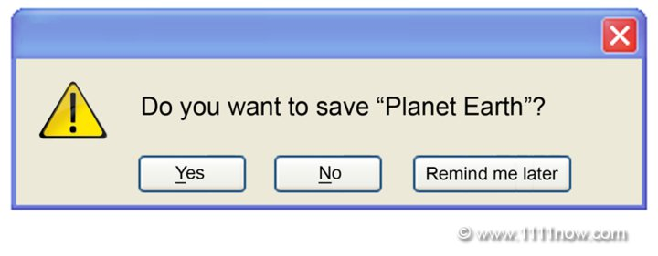
Publications
Greenlines - US GAO
Published twice a year
Progress: Volume 17, Number 3 had been published on August 2016
Audit Collection Worldwide
2014: around 200 audit reports received from 63 SAIs
2015: around 200 audit reports received from 35 SAIs
2016: will be commencing in mid of October 2016
8th Environmental Survey
Survey in English, French & Spanish
Focusing on the auditing work related to environmental matters conducted by SAIs worldwide
58 responses received
Report will be uploaded on WGEA website in September 2016

Slide 9
Review of ISSAI on Environmental Auditing
(Leads: Indonesia and Brazil)
ISSAI
5110
ISSAI 5130
ISSAI 5140
ISSAI
5120
ECA
ECA
SAI of Canada
SAI of Philippines
Project co-lead
Project co-lead
Project co-lead
Project co-lead
Guidance on Conducting Performance Audit with Environmental Perspective
Environmental Audit and Financial and Compliance Audit
Sustainable Development: The Role of Supreme Audit Institutions
How SAIs may co-operate on the on the audit of international environmental accords
Scope of review
Adjustment to INTOSAI fundamental principles and any changes in audit methodology (ISSAI 5110 & 5120)
New understanding of Sustainable Development (ISSAI 5130)
Update audit methodology (ISSAI 5140)
Provide good practices (all ISSAI)
8th INTOSAI KSC Meeting

Slide 10
ISSAI Review Projects – Work Done & Follow Up
3
2
1
PROGRESS AND FOLLOW UP
REVIEW PROCESS
Linking the comments obtained to the draft
5120 is being reviewed by FAAS
5110 and 5140 are being refined
Endorsement by WGEA Assembly in October 2016
PRE REVIEW
Drafting ISSAI reviews
Circulating drafts to SC members
Publishing draft in www.issai.org
Obtaining comments
Circulating comments to project co-leaders
Discussing comments received
Preparing and discussing project plan
Analyzing survey result
Conducting FGD with experts
Reviewing related literature

Slide 11
ISSAI Review Projects – Comments Received
Secretariat had received many valuable comments from SAI of Vietnam, Sweden, UAE, Austria, Philippines, Belgium, Canada, Malta, US, Mexico, South Africa, Thailand, and Pakistan.
Outline Changes
Standardized form of ISSAI documents
Content Changes
Add examples of practices
Definitions harmonised
Alignment with higher level of ISSAIs
Refinement to the text and minor typographical correction

Slide 12
Postponing ISSAI 5130 to accommodate the issue
Issue on ISSAI 5130
Special consideration is given to ISSAI 5130
Establishment of SDGs include three pillars: environment, economic, and social which were not reflected in the draft ISSAI 5130.
Advantages
May better accommodate INTOSAI’s priorities related to SDGs
Give clearer picture on SDGs
Disadvantages
Running projects related to ISSAI 5130 will be delayed
Offer more benefits to users

Slide 13
Next Step
Questions raised
When will be the best time to continue the project?
Will the due process be reiterated from the beginning (i.e. preparing and discussing the project plan)?
May some due process be abbreviated?
How should communication with stakeholders be developed?
Idea to establish a new WG/task force

Slide 14
Work Plan 2017-2019
Undertake Research Project
Visibility on Environmental Auditing (Communication)
Environmental Health (focus on air pollution)
Develop Guidelines
Climate change: Strengthen resilience and adaptive capacity to climate change hazards & natural disasters in all countries
Auditing land organization and soil quality management – combating desertification: Guidance for SAIs
Greening cities (focus on people and environmental health)
Auditing agriculture and food production: Guidance for SAIs
SDGs: How SAIs can enhance the application by governments

Slide 15
Design & carry out parallel/coordinated audit
Multilateral Environmental Agreement (MEAs)
Biodiversity in fisheries – Sustaining Marine Resources
Enhance information dissemination, exchange, & training
Provide training on environmental audit
Climate change
Implement & disseminate training module on forestry
Develop training tool based on research project
Maintain publication of Greenlines
Undertake 9th survey on environmental auditing
Provide annual audit collection
Increase cooperation
Update guidance material on auditing biodiversity

Slide 16
Upcoming Meeting: INTOSAI WGEA Assembly will be held on October 24 – 27, 2016 in Jakarta, Indonesia
8th INTOSAI KSC Meeting

Slide 17
Thank You

