Slide 1
Report from the Professional Standards Committee (item 8)

Slide 2
News from the PSC
PSC Steering Committee Meeting, Copenhagen 29 – 31 May 2016
PSC
INTOSAI Professional Standards Committee

Slide 3
ISSAIs for adoption at INCOSAI 2016
Revised ISSAIs (due for adoption at INCOSAI 2016)
ISSAI 30: Code of Ethics
ISSAI 3000: Performance Audit Standard
ISSAI 3100: Guidelines on Central Concepts for Performance Auditing
ISSAI 3200: Guidelines for the Performance Auditing Process
ISSAI 4000: Compliance Audit Standard
Withdrawal of ISSAI (due for adoption at INCOSAI 2016)
ISSAI 1000: General Introduction to the INTOSAI Financial Audit Guidelines
PSC
INTOSAI Professional Standards Committee

Slide 4
Revised practice notes approved by the PSC SC
Revised practice notes to ISSAIs (Not requiring adoption at INCOSAI 2016)
PN ISSAI 1210: Agreeing the Terms of Audit Engagements
PN ISSAI 1260: Communication with those Charged with Governance
PN ISSAI 1570: Going Concern
PN ISSAI 1610: Using the Work of Internal Auditors
PN ISSAI 1700: Forming an Opinion and Reporting on Financial Statements
PN ISSAI 1701: Communicating Key Audit Matters in the Independent Auditor's Report
PN ISSAI 1705: Modifications to the Opinion in the Independent Auditor's Report
PN ISSAI 1706: Emphasis of Matter Paragraphs and other Matter Paragraphs in the Independent Auditor's Report
PN ISSAI 1720: The Auditor's Responsibilities Relating to Other Information in Documents Containing Audited Financial Statements
PN ISSAI 1800: Special Considerations - Audits of Special Purpose Financial Statements
PN ISSAI 1805: Special Considerations - Audits of Single Financial Statements and Specific Elements, Accounts or Items of a Financial Statement
PN ISSAI 1810: Engagements to Report on Summary Financial Statements
PSC
INTOSAI Professional Standards Committee

Slide 5
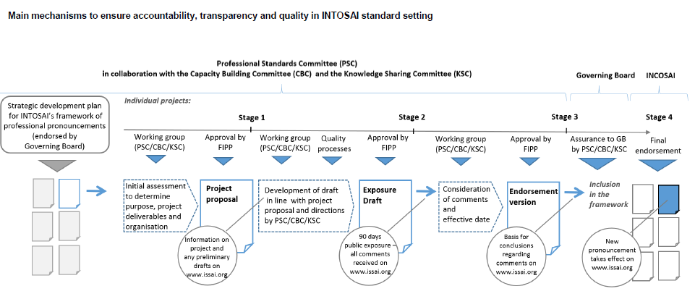
New Due Process
PSC
INTOSAI Professional Standards Committee

Slide 6
Transition of PSC Chair
PSC
INTOSAI Professional Standards Committee

Slide 7
Update on FIPP Forum for INTOSAI’s Professional Pronouncements

Slide 8
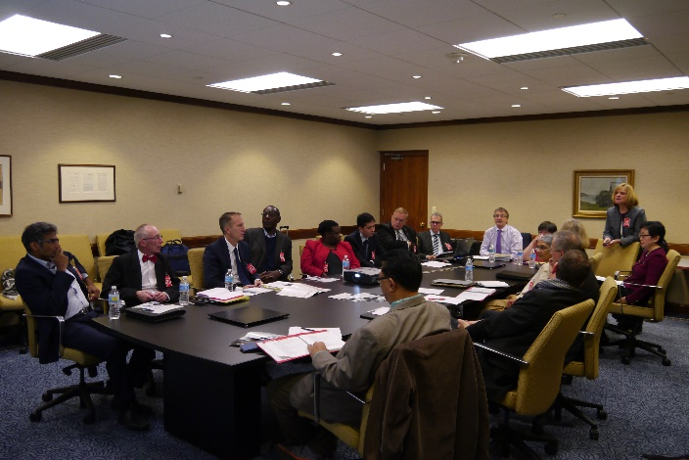
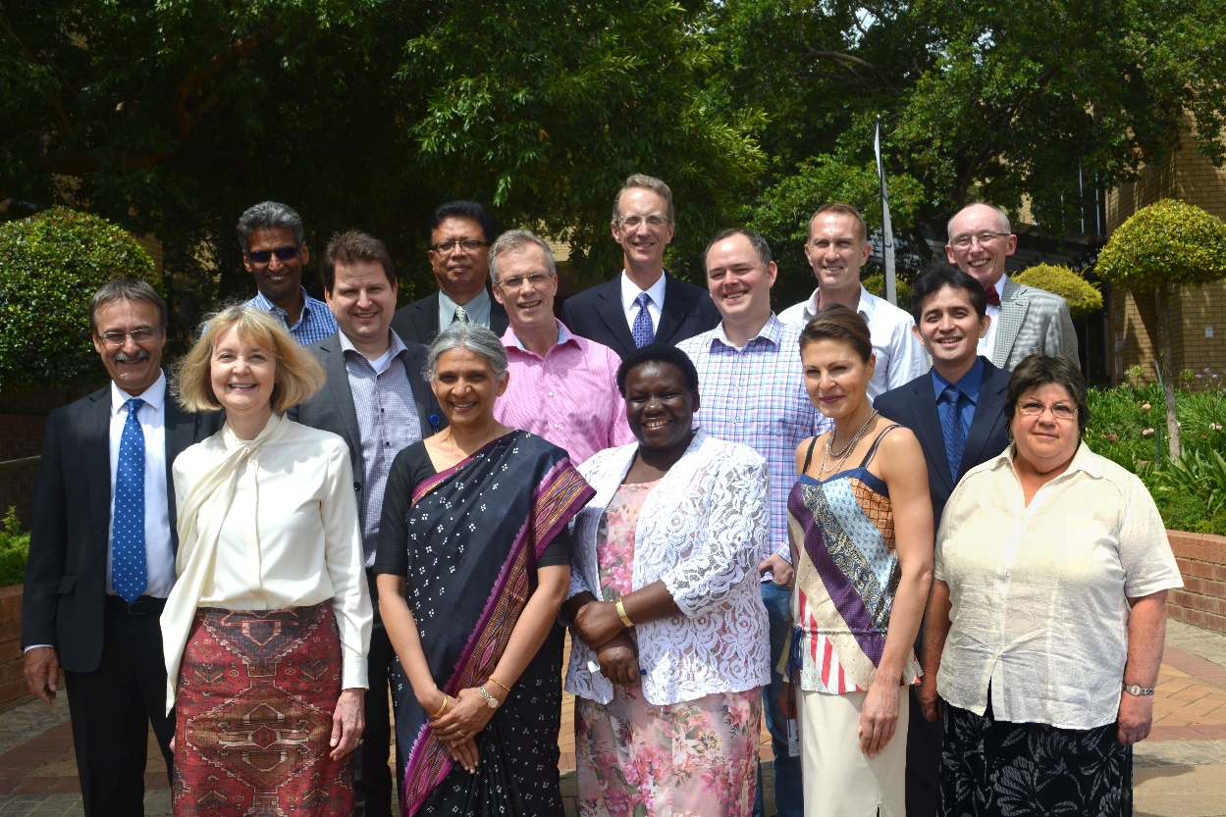

Slide 9
INTOSAI Framework of Professional Pronouncements (IFPP)
INTOSAI principles
INTOSAI Principles (INTOSAI-P)
1
INTOSAI founding principles
2
INTOSAI core principles
International Standards of Supreme Audit Institutions
Auditing Standards
Competency Standards
3
SAI organisational requirements - SAI level
4
Fundamental principles of public sector auditing - Engagement level
(Reserved for future development)
Financial audit:
Performance audit:
Compliance audit:
Other engagements:
5
Financial audit principles
6
Performance audit
principles
7
Compliance audit
principles
11
(Reserved for future development based on ISSAI 100)
18
(Possibly) Competency principles
… and competency standards
8
Financial audit standards
9
Performance audit
standards
10
Compliance audit
standards
INTOSAI Guidance
Auditing Guidance (GUID)
Competency Guidance
12
Supplementary
financial audit
guidance
13
Supplementary
performance audit guidance
14
Supplementary
compliance audit guidance
15
Supplementary guidance on other engagements
19
Supplementary competency guidance
16
Subject matter specific guidance
(Guidance on how the ISSAIs can be applied to specific subject matters such as environment, privatisation, public debt, disaster-related aid, corruption prevention, internal control .. etc. )
Other Guidance
17
Other guidance

Slide 10
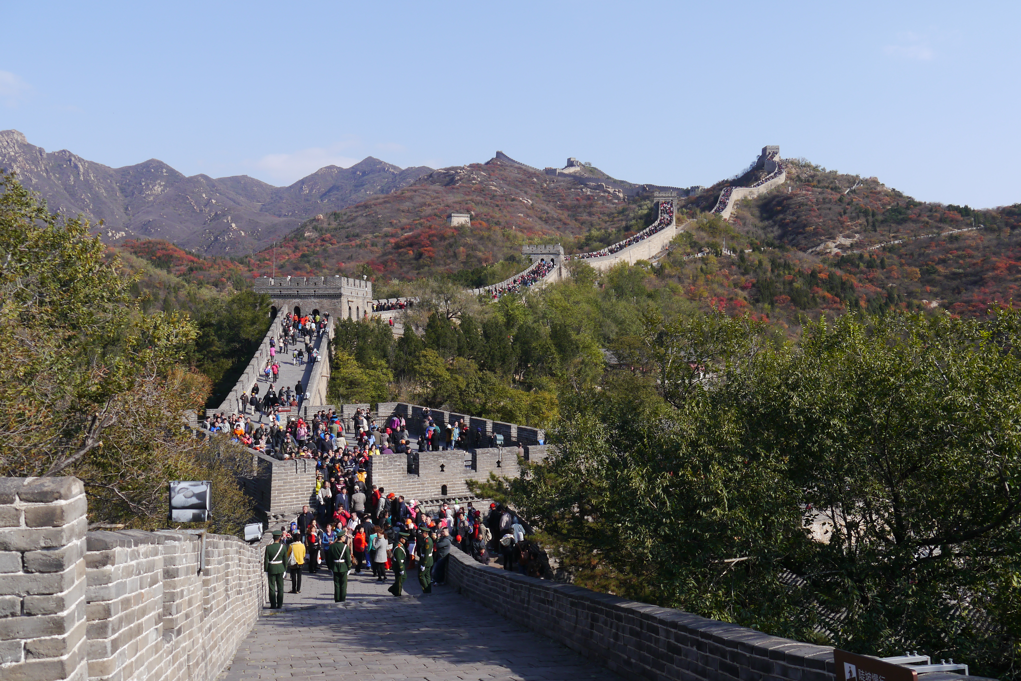
STRATEGIC DEVELOPMENT PLAN FOR INTOSAI’s STANDARD-SETTING

Slide 11
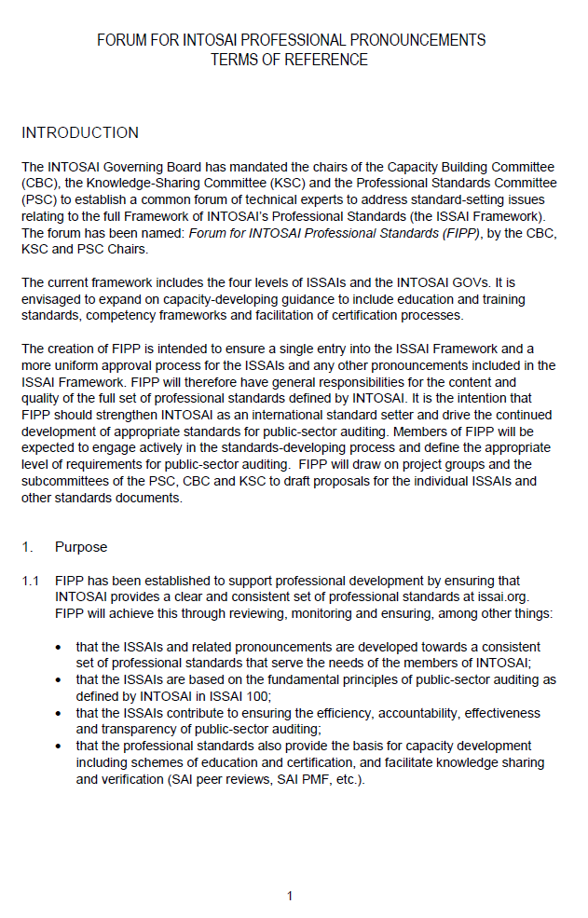
FIPP ToR, Rotation and call for nominations

Slide 12
Inclusion in the due process
FIPP

Slide 13
GOVERNANCE OF FIPP
The executive function of the goal chairs
The governance of FIPP by the PSC Steering Committee
The strategic responsibility for FIPP under goal 1
The PSC Steering Committee’s role in relation to other INTOSAI bodies in relation to the governance function for FIPP

Slide 14
Thank you for your attention

