Slide 1
IDI Report to 8th INTOSAI KSC SC Meeting

Slide 2
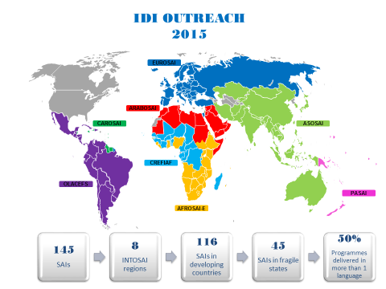
IDI Performance 2015
1106 participants
41% women participation
44% women resource persons
361 in certification programmes
Organisational Development support to 190 SAI Teams
50% in multiple languages

Slide 3
IDI Knowledge Sharing & Use of Global Public Goods
Newsletters, articles, website, social media
3i Community Portal
Draft eLearning handbook
SAI Strategic Management Framework
Draft revised IDI Strategic Management Handbook
Finalised and published 2014 Global survey report
Financial and Compliance Audit Models for Auditing Externally Funded Projects in Agriculture and Food Security Sector
Guidance on Evaluation of Capacity Development Programmes as part of Guidance Note on Strengthening Evaluations of SAI Interventions.
Dissemination of ISSAIs
Draft Strategic Management Framework for INTOSAI Regions

Slide 4
Stronger regional bodies,networks & communities
IDI Workshop for INTOSAI Regions
Regional Strategic Management Framework, Strategic Management, Performance Measurement & Reporting
eLearning platform and communities of practice for INTOSAI regions
IDI- Regional cooperation for every programme
Regional secondees and use of regional resource persons
Creation of regional pools : Training Specialists, ISSAI facilitators, eLearning Specialists, Blended learning specialists
56 IDI-PSC certified ISSAI facilitators and 8 mentors for the OLACEFS; 305 SAI PMF assessors trained in 2015.

Slide 5
Scaled up and more effective support to SAIs
25 (53% ) of 47 Concept Notes received and reviewed under the 2013 Global Call for Proposals have been matched with donor funding.
Enhancement of coordination of SAI capacity development support continued through the hosting of the SAI Capacity Development Database.
Joint focal point with CBC for INTOSAI cooperation with the broader development community, particularly the Effective Institutions Platform.

Slide 6
IDI Programme Portfolio 2016-2018
IDI Capacity Development Programme Portfolio
2016-18
1
Strategy, Performance Measurement & reporting
2
SAI engaging with Stakeholders
3
Auditing SDGs
4
ISSAI implementation – Phase II
5
SAI Fighting Corruption
6
SAI Independence
7
SAI Young Leaders
8
Enhance eLearning capacity

Slide 7
Ongoing Capacity Development Programmes
Bilateral Support
Audit of Agriculture and Food Security
SAI PMF
Donor Training
Train the Trainer
CBC Support Programme
Audit of Public Debt

Slide 8
3i Phase II-Results Framework
Revision & Maintenance of 3i Products
Strengthen IDI Certification Programmes (Competency Based)
Participate in INTOSAI Certification for Auditors
Quality Assurance Programme
3i Cooperative Audits
3i Community of Practice
Support for Implementation at SAI level

Slide 9
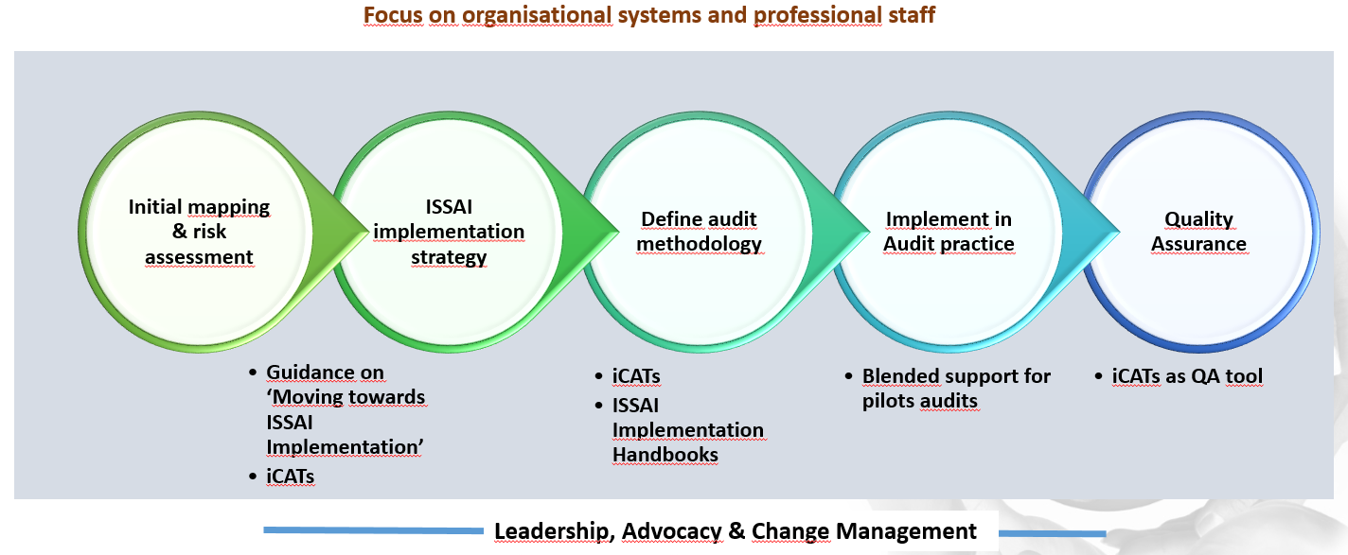
SAI Level support for implementing ISSAIs

Slide 10
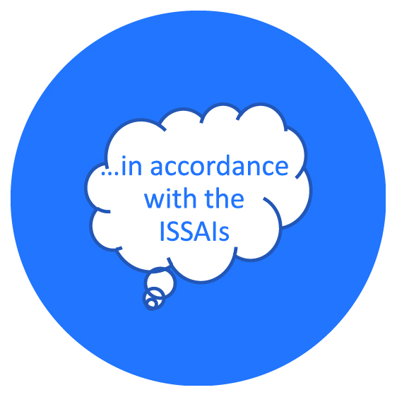
IDI Cooperative Audit Model
Workshop/e-course on subject matter and methodology
Focus on subject matter & methodology
E-facilitation of development of audit plan/Audit Planing Meeting
SAI audit teams
Audit Review Meeting
Support for finalising audit report
Quality Assurance
Independent assurance of audit quality
Global Public goods
Design & Deployment on IDI platform
Expert support for audit planning
SAI Commitment
Agreement with SAI leadership
Roles & responsibilities
Onsite/online support during audit

Slide 11
Auditing Sustainable Development Goals
High quality audit of SDGs by SAIs
2016
Guidance on auditing preparedness
2017-2018
ISSAI based cooperative performance audit on preparedness
2019
Lessons learned and audit results
Policy & enabling environment
Creating ownership
Incorporating in national frameworks
Intergration of social, economic & environmental dimensions
Definition of baselines & indicators
Thematic analysis
Institutional mechanisms
Ensuring that no one is left behind
Advocacy & Awareness Raising
Community of Practice

Slide 12
SAI Fighting Corruption
Global Level
Regional Level
SAI Level
Greater effectiveness of SAIs in fighting corruption
Audit of institutiional frameworks for fighting corruption
SAI- Stakeholder platform for fighting corruption
SAI Leading by example in implementing ISSAI 30
UNDP(GAIN Programme), WGFACML, INTOSaint, other INTOSAI and regional bodies

Slide 13
SAI Engaging with Stakeholders
Internal Stakeholders
Legislature/ Parliament
Executive/ Audited Entities
Citizens/Civil Society
Media
Audit Process
Planning
Conducting
SAI Independence
Before transition
During transition
Reporting
Follow up
After transition

Slide 14
Audit of Lending and Borrowing Frameworks
Global Public Goods
Management Commitment
eLearning
Pilot Audits
Community of practice
Cooperation with WGPD
To support SAIs in strengthening their capacity to audit legal and organisational frameworks of national and sub national governments involved in sovereign lending and borrowing
22 Public Debt Audit Teams

Slide 15
IT Audit Programme
Global Public Goods
Management Commitment
eLearning
Pilot Audits
Cooperation with WGITA
To promote IT Audit Systems and Practices in line with INTOSAI Standards and best pratices and address capacity development needs in the area of IT Audit
38 IT Audits completed

Slide 16
Audit of Disaster Management
Management Commitment
eLearning
Pilot Audits
Online support
Quality Assurance
Cooperation with WGEA
To support SAIs in moving towards ISSAI compliant performance audits, by supporting them in sustainably enhancing their professional staff and organisational capacity and performance, in conducting the ISSAI based cooperative audits of disaster management
57 participants from 19 SAIs

Slide 17
8. Enhancing eLearning Capacity
IDI eLearning platform and LMS
IDI eLearning Handbook
Pool of LMS Administrators
Certified eLearning specialists
Certified blended learning specialists
Support to INTOSAI regions and SAIs
ASOSAI, India
Portfolio of eCourses

Slide 18
SAI Independence
1
Advocacy
3
2
Guidance
SAI level support
Cooperation with INTOSAI GS
Support SAIs in achieving ‘greater SAI independence’
The pilot programme is expected to run from 2016- 2018 to begin with

Slide 19
6.
SAI Young Leaders
I
My Vision
My people
My SAI
My environment
My community
Expanding ‘I’
Design meeting planned for September 2016
SAI Leaders Competency Framework ( Leadership Tree)
Selection criteria and process
Programme design and development

Slide 20
SAI PMF
INTOSAI Congress
Approval
INTOSAI Working Group on the Value and Benefits of SAIs
Oversight and Direction
In Consultation with:
INTOSAI Capacity Building Committee
INTOSAI-Donor Steering Committee
Other Relevant INTOSAI Committees
WGVBS SAI PMF Task Team
Development of SAI Performance Measurement Framework
Coordinator: INTOSAI-Donor Secretariat @ IDI
SAI PMF Reference Group
Technical Advice, Review and Quality Assurance

Slide 21
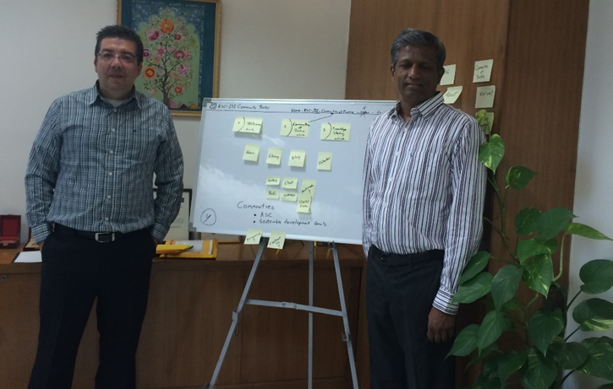
KSC- IDI Community Portal
Communities of Practice : SDGs, INTOSAI Auditor Certification

Slide 22
INTOSAI Development Initiative(IDI)
2015
Total members increased to 10 with no observers
Nomination Committee to recomend appointments to the Board
Better representation to developing countries
Detailed Rules of Procedure for effective performance
Assessment of the Board’s performance

Slide 23
Thank you
www.idi.no
www.idicommunity.org
idi@idi.no or intosai.donor.secretariat@idi.no for newsletters and other information

