Slide 1

Agenda Item 7
Update on INTOSAI Community Portal
www.intosaicommunity.net

Slide 2
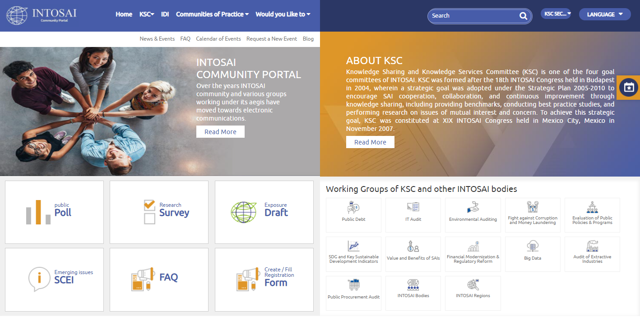
Website Migration
  Consolidation of Working Group websites
  SAI India offers to engage its nominees to Working Groups
  Focal persons to successfully complete migration of all websites

Slide 3
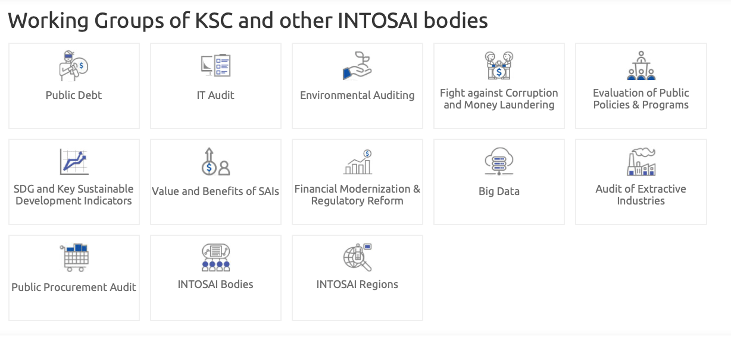

Slide 4
www.intosaicommunity.net
Advantage in Migration
    Enables Portal to serve as central repository of information for the INTOSAI
    Single window for accessing information
    Uniformity in structure aids auditors in SAIs in accessing the required information faster
    Cost savings
    Ease in migration during transitioning of WG secretariat
    Assistance of KSC Secretariat in initial population
    Translation of Webpages in all INTOSAI languages
    Credentials to allow WG secretariats or any member designated by them to maintain their Webpage.

Slide 5
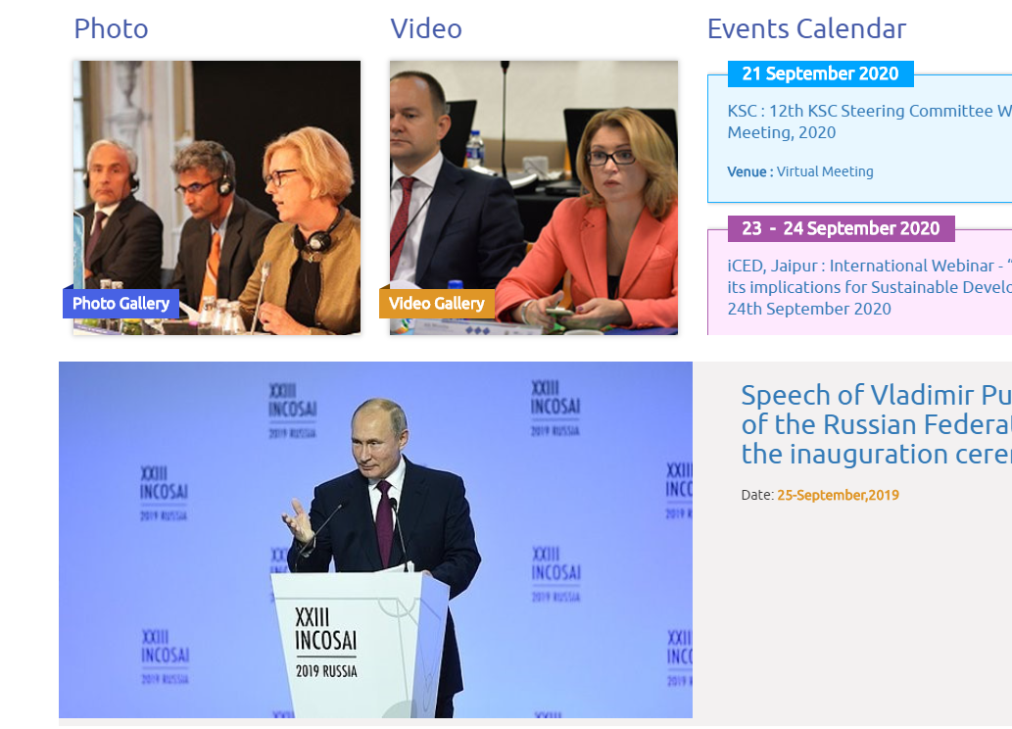
Updates since last meeting
News Items
Calendar

Slide 6
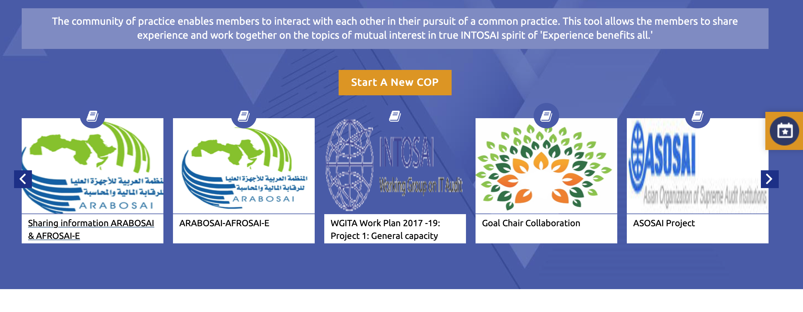
Updates since last meeting
18 active Communities of Practice

Slide 7
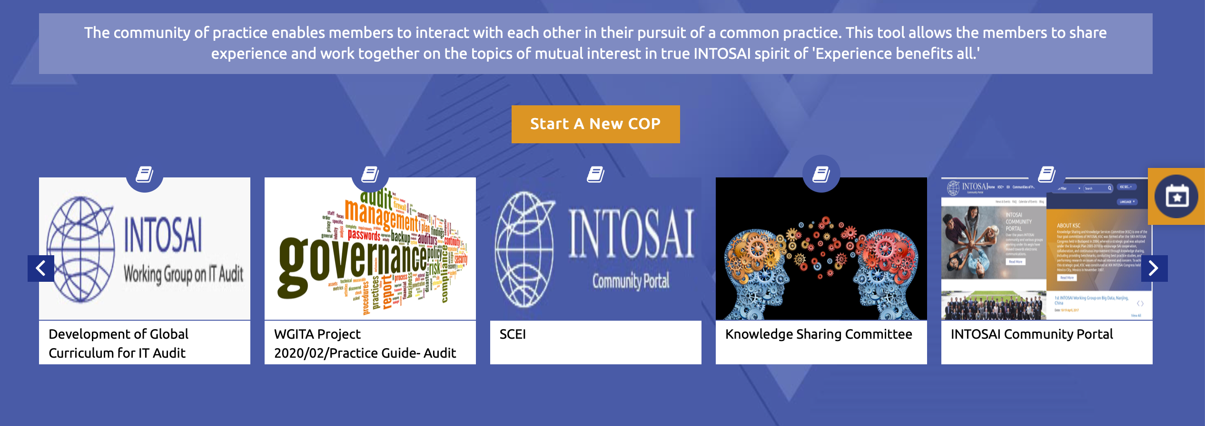
Updates since last meeting
18 active Communities of Practice

Slide 8
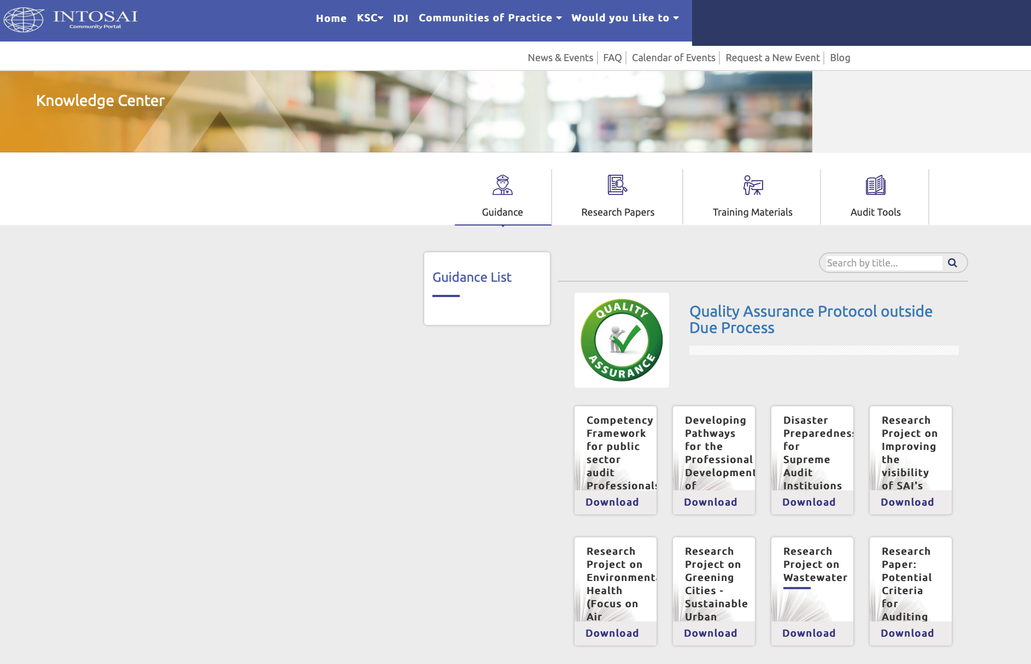
Updates since last meeting
    Non-IFPP Documents developed under QA protocol uploaded.

Slide 9
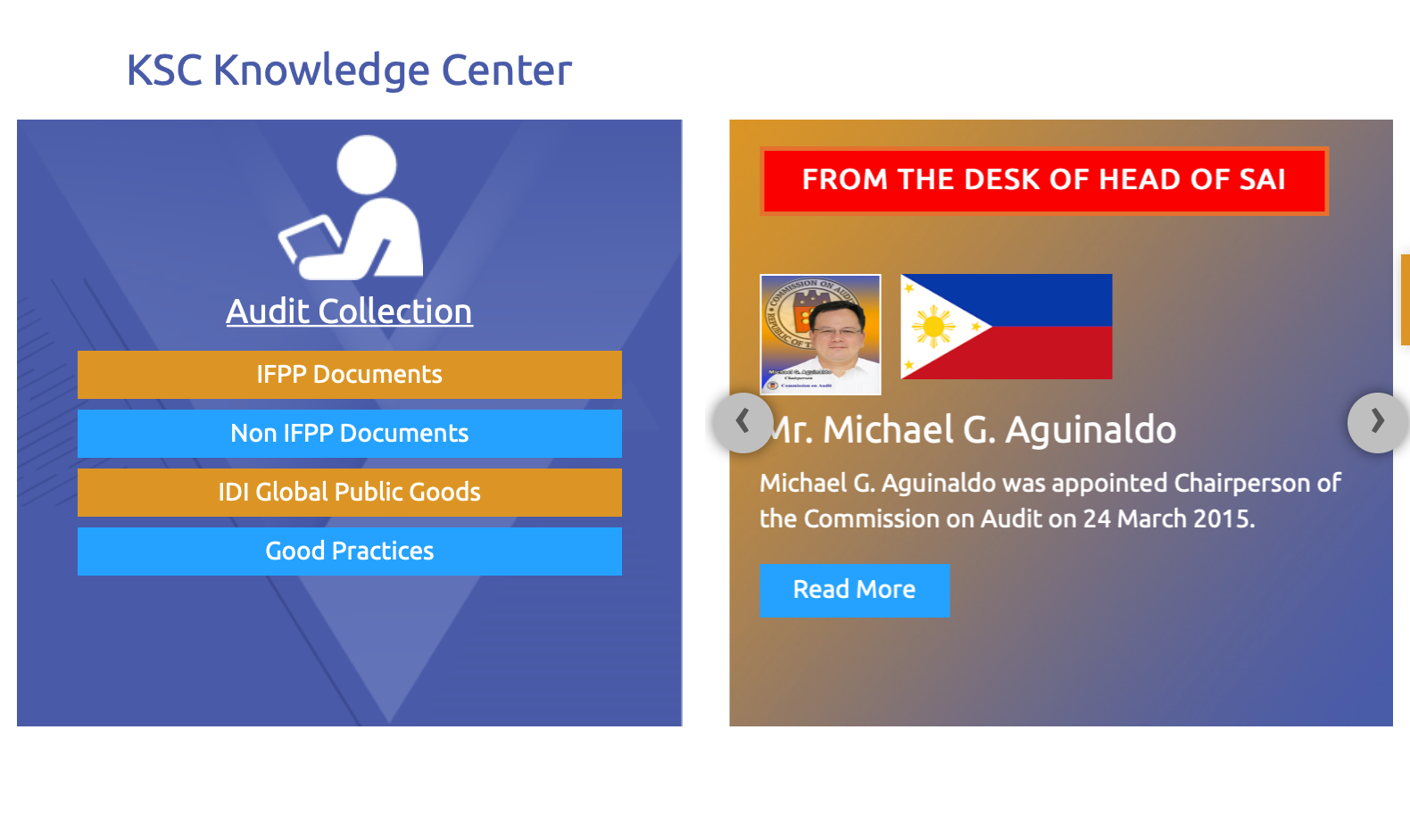
Updates since last meeting
    Links to IFPP products, IDI GPGs, & all other INTOSAI Organs, articles by Heads of SAIs

Slide 10
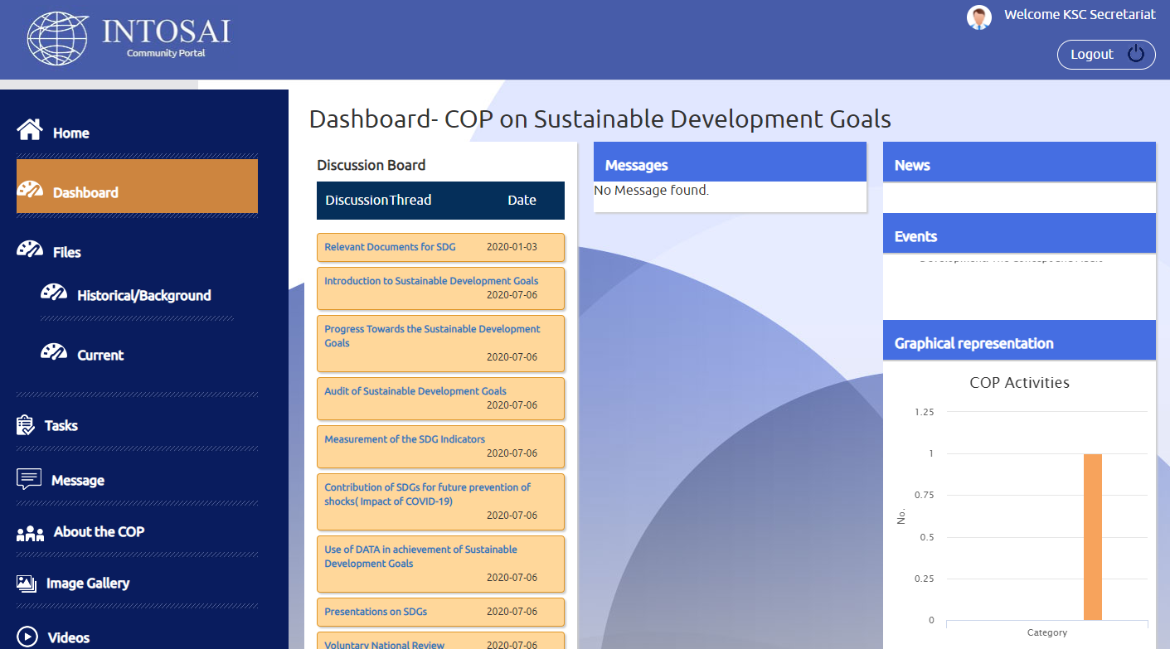
CoP on SDGs

Slide 11
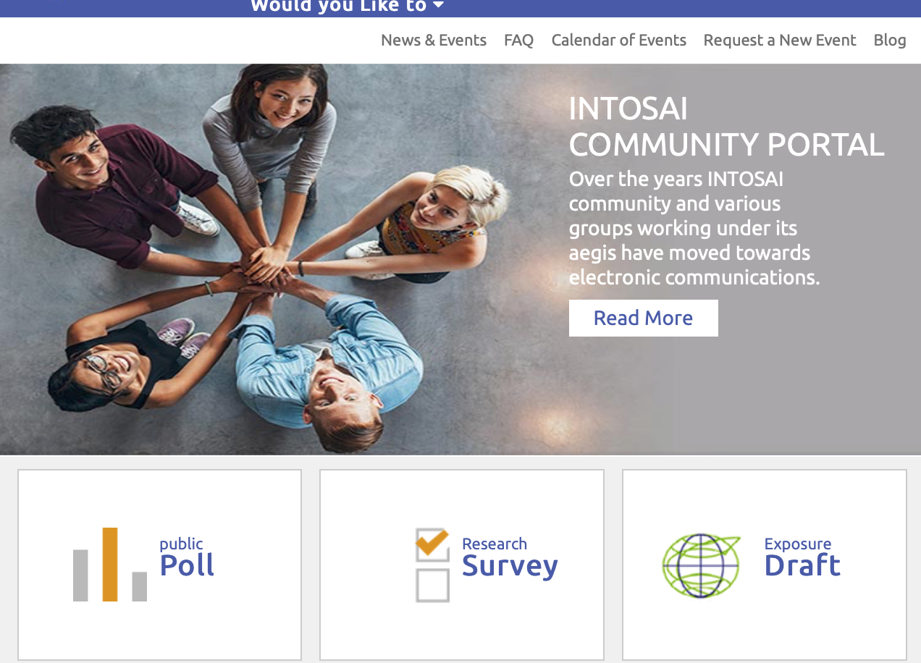
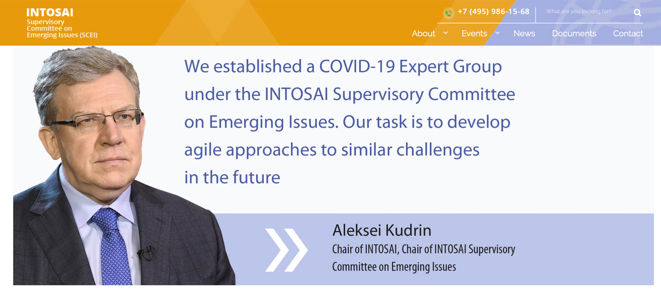
Updates since last meeting
    SCEI Page & Good Practices Section restructured

Slide 12

www.intosaicommunity.net
Spreading the message
    WG project teams to take the lead in usage of features and populate the knowledge resources with audit reports and SAI case studies
    Support of IDI and regional organisations sought to help in popularizing usage
    Request WGs to write to their member SAIs to encourage their staff in using the features of the portal.

Slide 13
www.intosaicommunity.net
Spreading the message
    WGs may encourage the Member SAIs and staff to use the portal and contribute content
    WGs may provide quarterly articles for Blog Section and news items.
    WG Chair may contribute articles on important issues in the Desk of Head of SAIs sections.

Slide 14

www.intosaicommunity.net
Road ahead
    Engage consultant for content management and user interaction
    Develop mobile app for user-specific experience
    Most importantly – we invite your kind suggestions.

Slide 15

www.intosaicommunity.net
Points for discussion
    Challenges in migration and using the facility
    Should WGs (already having independent websites) continue with their individual websites while providing a link in Community Portal.
    Suggestions for improvements

Slide 16
THANK YOU

