Slide 1
INTOSAI
Highlights of the new INTOSAI Strategic Plan 2017-2022
Monika González-Koss
INTOSAI Director Strategic Planning
8th KSC SC Meeting, Mexico City
September 2016

Slide 2
Introduction
• Development
• Drafting
• Key Content
• Chart – organizational changes

Slide 3
Development
Responsible
Release
April 22, 2016 (English version)
Other INTOSAI Languages
Comments due by
July 31, 2016
FAC Task Force on Strategic Planning
July 2016 (ss the translations became available)
(including Director of INTOSAI Strategic Planning)
Positioning on INTOSAI Website for Comments

Slide 4
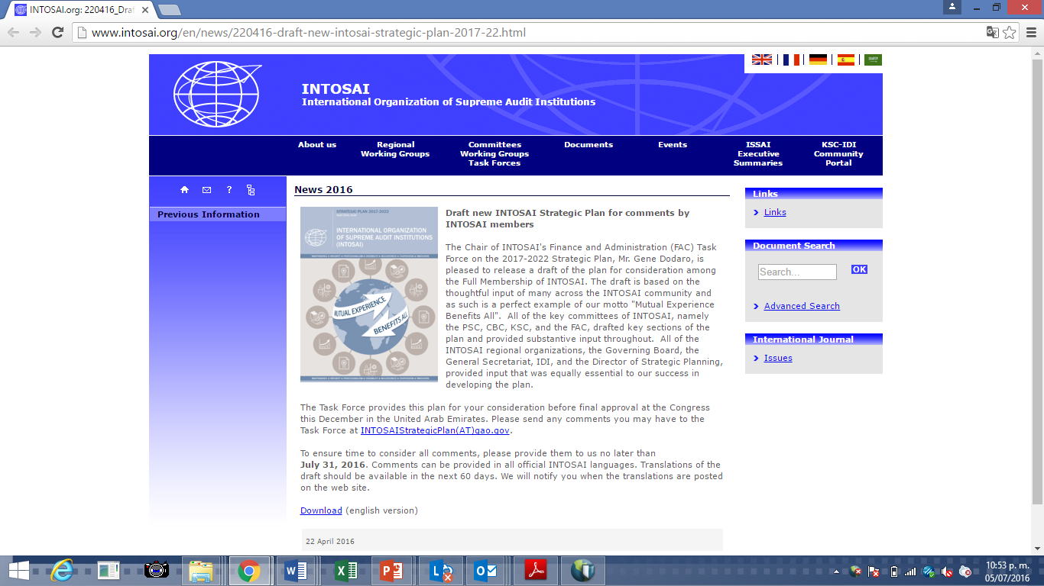
Positioning on INTOSAI Website for Comments
http://www.intosai.org/en/news/220416-draft-new-intosai-strategic-plan-2017-22.html
Overall expectation:
New path for INTOSAI to better position INTOSAI and each of the member SAIs to take advantage of emerging opportunities to provide value and benefits to all stakeholders and fellow citizens.

Slide 5
.
Drafting
Based on the thoughtful input of whole INTOSAI community
Written survey of all SAIs sent in 2014 & numerous discussions since then.
All key committees of INTOSAI (PSC, CBC, KSC & FAC), drafted key sections and provided substantive input throughout.
Regional Organizations, Governing Board, General Secretariat, IDI, and Director of Strategic Planning, provided input equally essential.
Input and experiences of individual SAIs.

Slide 6
Endorsement of the Plan
Release
April 22, 2016
Comments
July 31, 2016
Approval
XXII INCOSAI, UAE
Individual comments
Spetember 2016 final input TFSP
In all INTOSAI language

Slide 7
New Vision and Mission
MISSION
INTOSAI is an autonomous, independent, professional, and nonpolitical organization established to provide mutual support; foster the exchange of ideas, knowledge, and experiences; act as a recognized voice of SAIs within the international community; provide high quality auditing standards for the public sector; promote good governance; and foster SAI capacity development and continuous performance improvement.
VISION
Promote good governance by enabling SAIs to help their respective governments improve performance, enhance transparency, ensure accountability, maintain credibility, fight corruption, promote public trust, and foster the efficient and effective receipt and use of public resources for the benefit of their citizens.

Slide 8
Strategic Goals
Goal 1 - PSC
Professional Standards
Goal 3 - KSC
Knowledge Sharing & Knowledge Services
Goal 4 - PFAC
Maximize the Value of INTOSAI as an International Organization
Goal 2 - CBC
Capacity development

Slide 9
Strategic Goals
Goal 1
ISSAIs and INTOSAI GOVs
Goal 3
Comprehensive Capacity Developmnt Program
Goal 4
Assessment of own performance
Goal 2
SAI PMF
IntoSAINT: Integrity model
IDI-KSC Knowledge Sharing Platform
Enterprise Risk Management
Financing and Resources
Policy Direction of the INTOSAI-Donor Cooperation
Cooperation with other organizations
Communication
New / Revision of INTOSAI products
Research products
Stakeholder engagement
INTOSAI Journal
IDI
Working Groups and TF
Common Forum
Advisory Group
Communities of practice
Peer Reviews
Engagement with international development community platforms.
Cooperation with Regional Organizations
Standards-setting governance structure
ISSAI Website
Implementation of ISSAIs

Slide 10
Crosscutting Strategic Priorities
• Defintion of 5 Crosscutting Strategic Priorities in support of the Strategic Goals
• Crosscutting Strategic Priorities reflect role of independent and capable SAIs in the efficient, effective, transparent, and accountable implementation of the 2030 Agenda for Sustainable Development

Slide 11
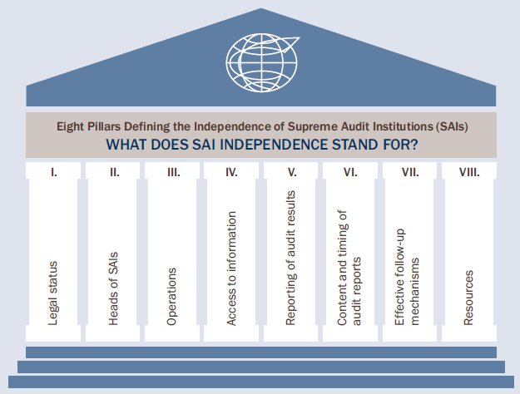
Crosscuttting Strategic Priorities
Crosscutting Priority 1: Advocating for and supporting the independence of SAIs

Slide 12
Crosscuttting Strategic Priorities
Crosscutting Priority 2: Contributing to the follow-up and review for the SDGs within the context of each nation’s specific sustainable development efforts and SAIs’ individual mandates

Slide 13
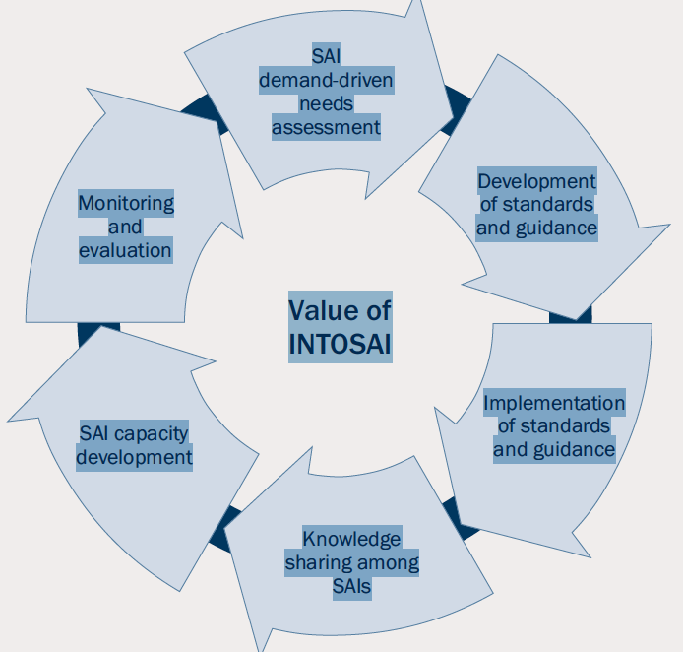
Crosscuttting Strategic Priorities
Crosscutting Priority 3: Ensuring effective development and coordination among standards setting, capacity development, and knowledge sharing to support SAIs and improve their performance and effectiveness

Slide 14
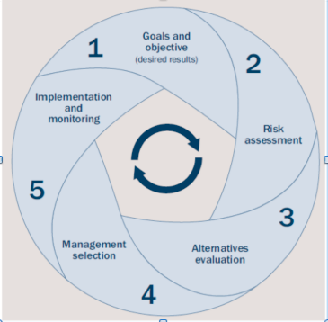
Crosscuttting Strategic Priorities
Crosscutting Priority 4: Creating a strategic and agile INTOSAI that is alert to and capable of responding to emerging international opportunities and risks
INTOSAI
ERM

Slide 15
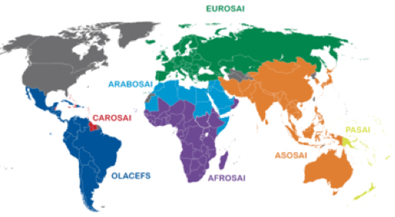
Crosscuttting Strategic Priorities
Crosscutting Priority 5: Building upon, leveraging, and facilitating cooperation and professionalism among the Regional Organizations of INTOSAI

Slide 16
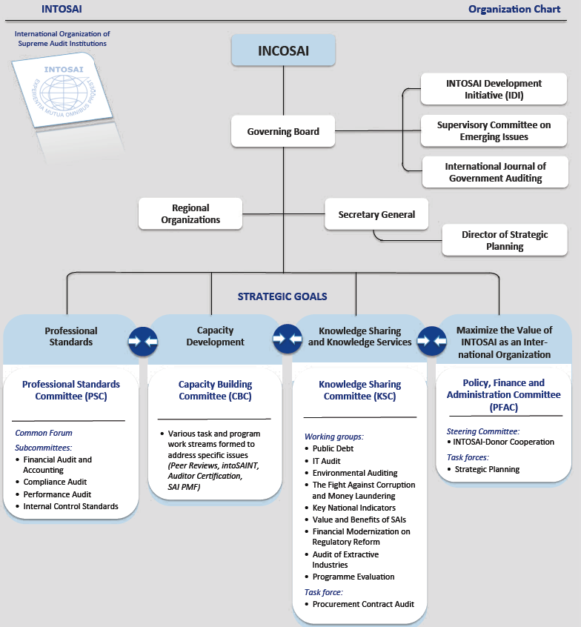
INTOSAI Chart after XXII INCOSAI

Slide 17
INTOSAI
www.intosai.org
THANK YOU for your Attention

