Slide 1
Tanah Lot
9th KSC Steering Committee Meeting
Bali, Indonesia
Source: paketliburanbali.com
Notes:
Tanah Lot

Slide 2
Ulun Danu Bratan Temple, Bedugul
9th KSC Steering Committee Meeting
Bali, Indonesia
Source: www.couleurvoyage.com

Slide 3
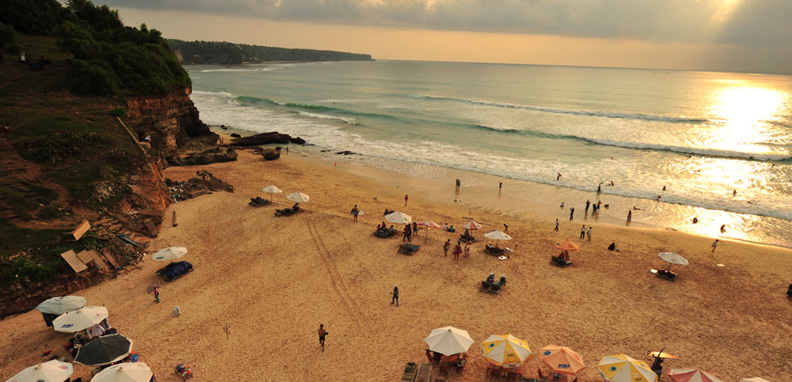
Dreamland Beach, Pecatu
Source: nginepmana.com

Slide 4
Rice Terraces, Ubud
Source: www.topflight.ie
Notes:
Ubud

Slide 5
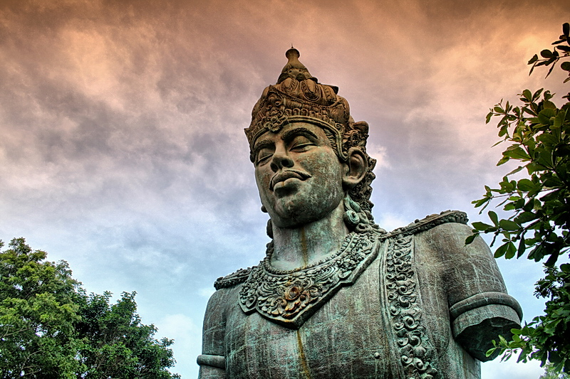
Garuda Wishnu Kencana, Nusa Dua
Source: surgatraveller.com
Notes:
surgatraveller.com
Garuda Wishnu Kencana

Slide 6
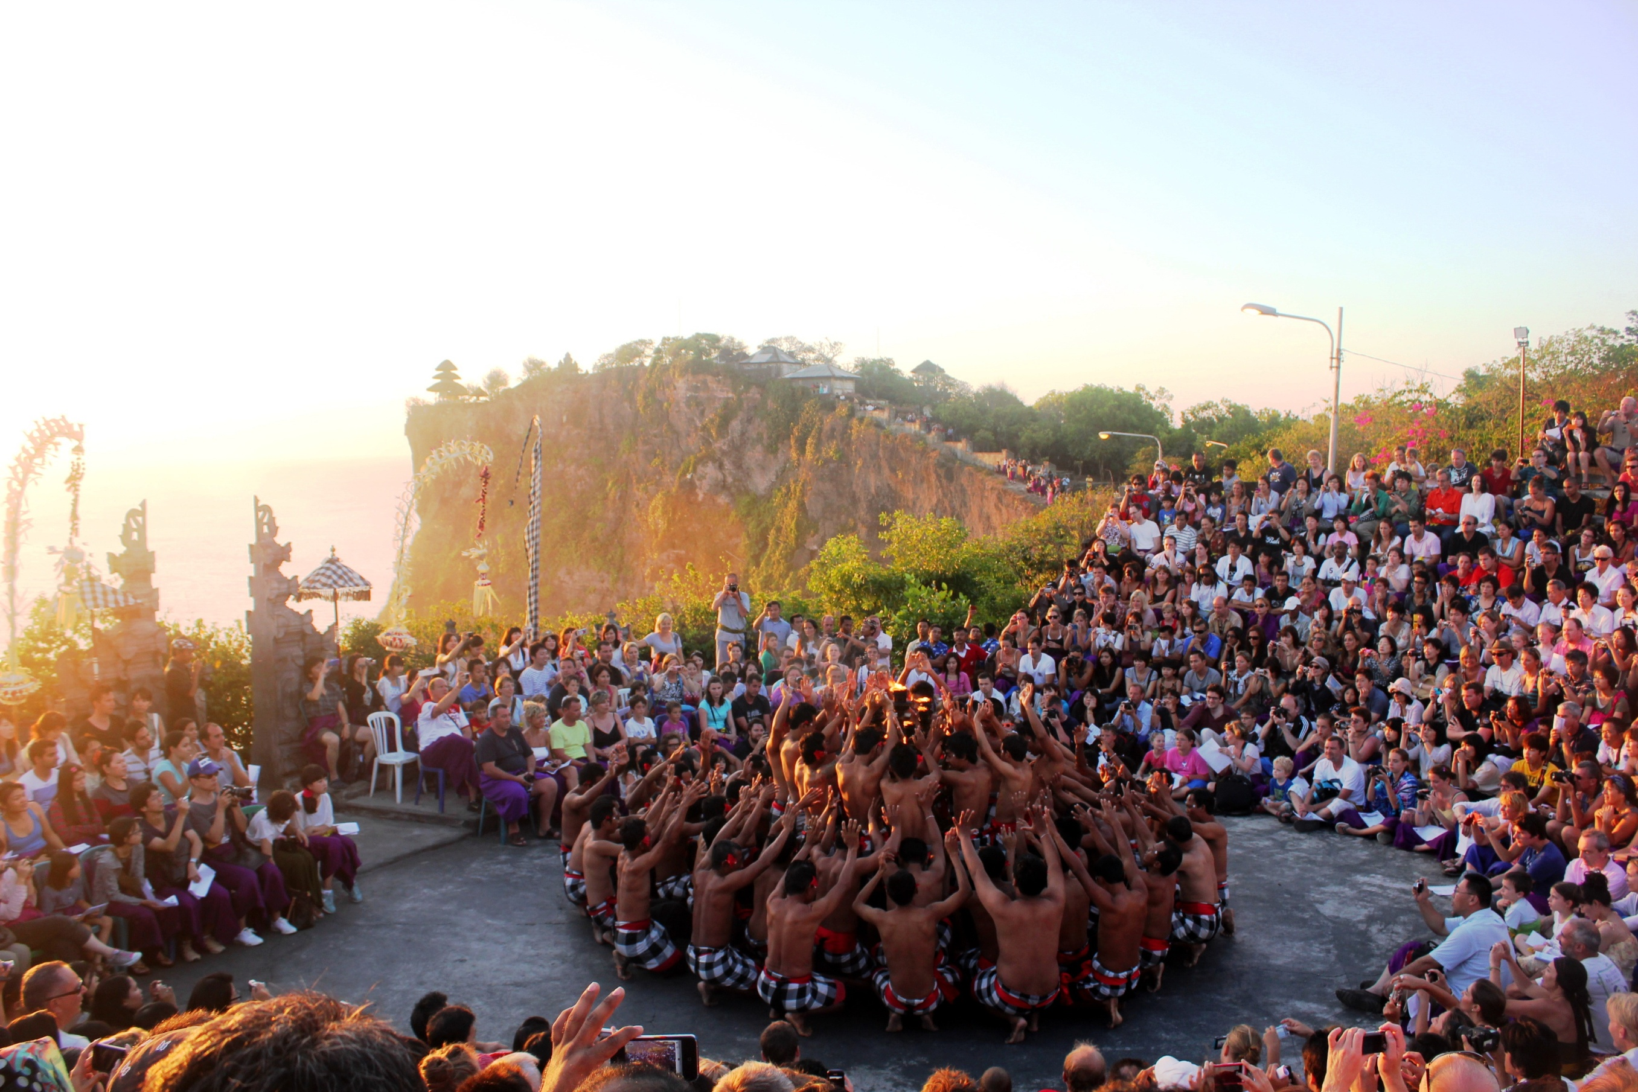
Kecak Dance, Uluwatu
Source: Bernadheta Mia
Notes:
Kecak Dance, Uluwatu
Foto: Bernadheta Mia

Slide 8
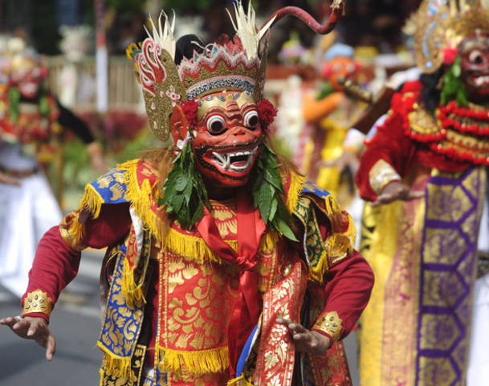
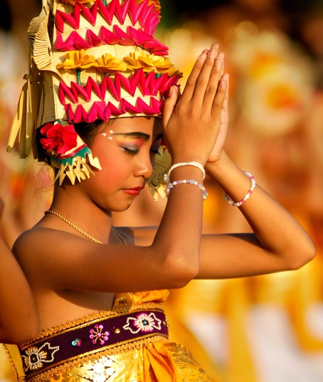
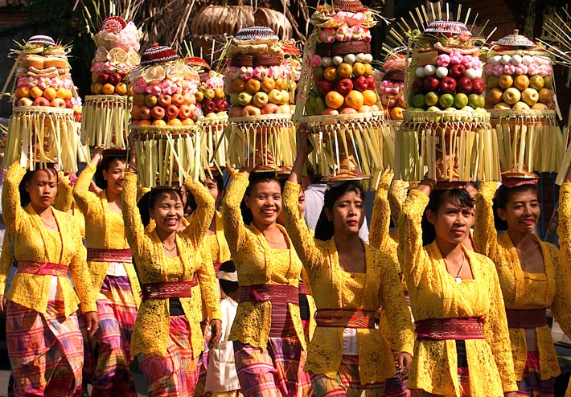
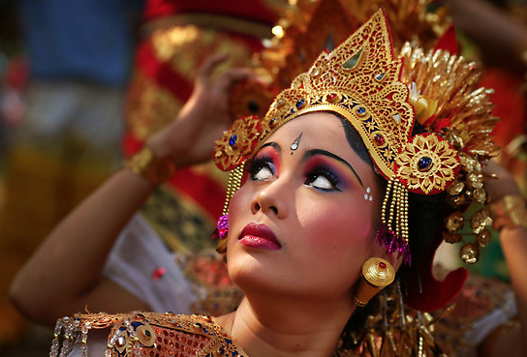
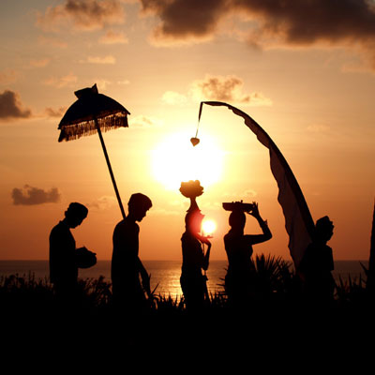
Notes:
Topeng: www.yexplore.travel
Sujud: www.thepulseofbali.com
Para perempuan: fianceinbalii.blogspot.co.id
Siluet: baliculturalheritage.wordpress.com
Menoleh ke atas: psychoculturalcinema.com

