Slide 1
Working Group on IT Audit
9th Meeting of KSC Steering Committee
Bali
(23-25 August 2017)
SAI-India

Slide 2
Projects in SDP which require WGITA
Under Priority 2 (Guidance by 2019 to support ISSAI implementation)
2.5 - Consolidated and improved guidance on understanding internal control in an audit
2.8. - Consolidating and aligning guidance on IT audit with ISSAI 100
ISSAI 5300
ISSAI 5310

Slide 3
Project 2.5 – Internal Control
Led by PSC: Internal Control Subcommittee; WGITA and WGPD desirable to co-opt
Clarity on role awaited from FIPP
Our proposal
WGITA could co-opt as a project member
SAIs willing to participate (3-4 members desired); experience in internal controls in IT environment desirable

Slide 4
Non-IFPP documents
Three Non-IFPP documents being developed:
Guidance on Data analytics
A guideline for establishing IT audit capacity in a SAI environment.
Guideline on documentation process of an IT audit
All the above document fixed at Level 2
Level 2 of Quality assurance for public goods
Level 2: Subjected to more limited but still extensive quality assurance process, such as piloting/testing/comments by/from stakeholders outside body or working group responsible for development
Roadmap for development of future pronouncements under ISSAI 5300 being developed

Slide 5
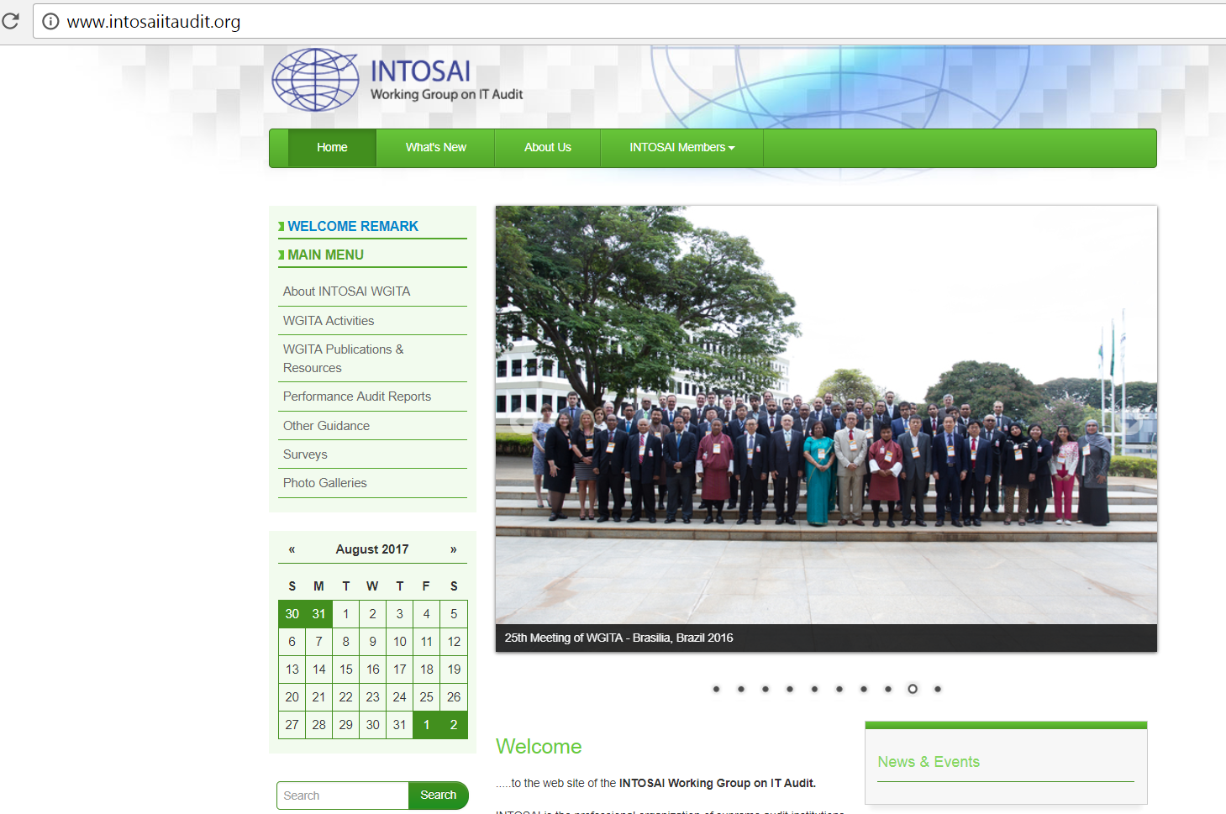
Dissemination and exchange of knowledge
The Working Group uses the website (www.intosaiitaudit.org) as information interchange platform.
Will be part of the revamped KSC-IDI Community Portal
WGITA in coordination with GAO, USA holds triennial Performance Auditing Seminars on topical subjects related to IT Audit.

Slide 6
Stakeholder engagement for greater synergy
WGITA in collaboration with the INTOSAI Development Initiative (IDI) developed an IT Audit Handbook
Handbook a very useful resource for the entire INTOSAI community in conducting IT Audits and in building capacity in this area being updated
AFROSAI-E and ISACA observers of WGITA and involved in various projects of WGITA.
Enables WGITA to get Regional perspective and guidance from a professional organization of International repute.

Slide 7
THANK YOU

