Slide 1
Agenda Item No. 21 Report on IDI-KSC Knowledge Sharing Portal
7th KSC Steering Committee Meeting
Washington D.C.
(15 and 16 October 2015)
SAI-India

Slide 2
IDI-KSC Knowledge Sharing Portal
KSC and IDI have developed an INTOSAI Knowledge Sharing Portal (www.intosaicommunity.org)
Portal to replace INTOSAI Collaboration Tool
Portal to be rolled out before end of 2015

Slide 3
IDI-KSC Knowledge Sharing Portal
Platform includes following features:
Community of Practice
Blogs
Chats
Virtual meeting
Polls/survey
News
Library

Slide 4
IDI-KSC Knowledge Sharing Portal
Technical infrastructure and support by IDI
SAI-India to provide operational support

Slide 5
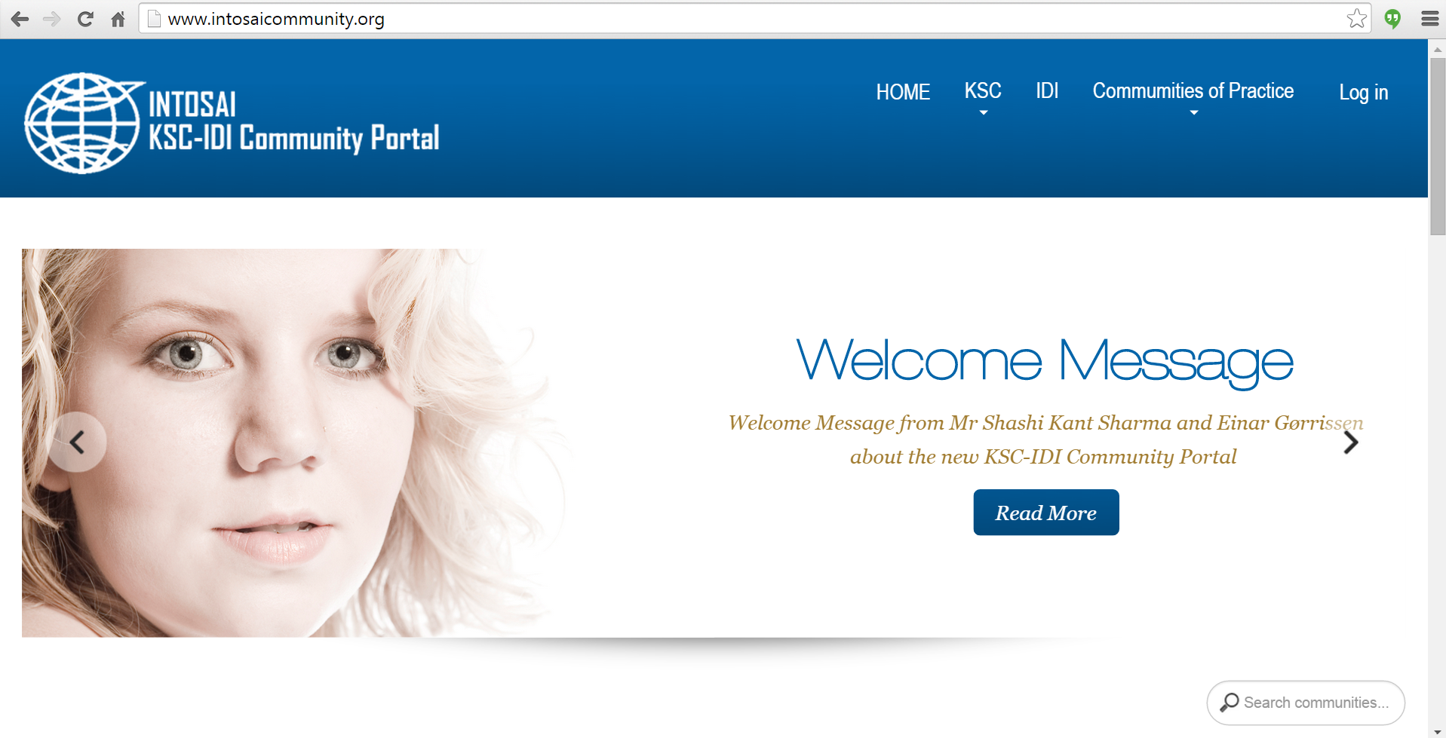
Overview of Portal (Homepage)

Slide 6
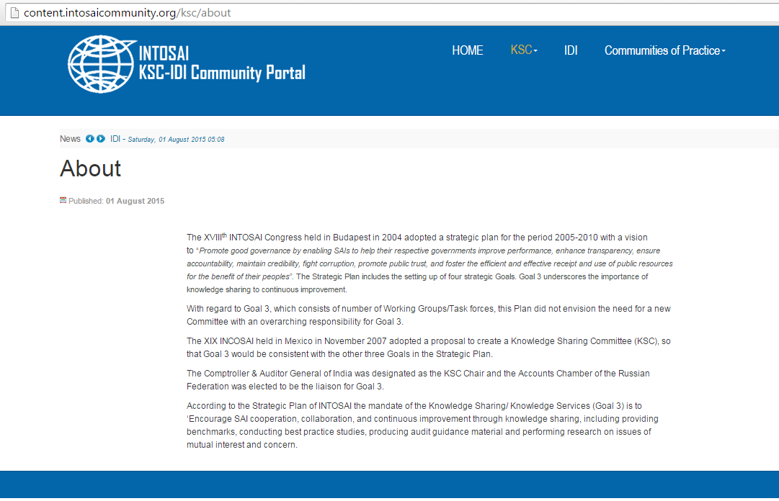
Overview of Portal (KSC Page)

Slide 7
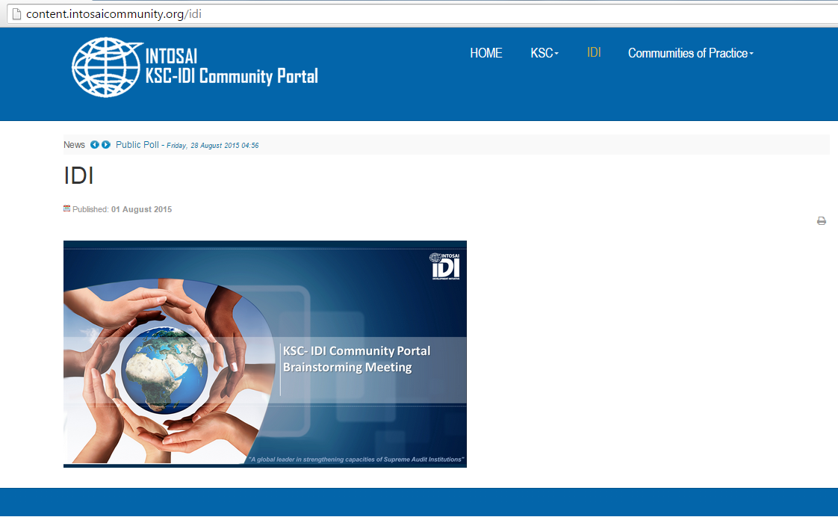
Overview of Portal (IDI Page)

Slide 8
Overview of Portal (CoP)

Slide 9
THANK YOU

