Slide 1
THE INTOSAI WORKING GROUP ON KEY NATIONAL INDICATORS
WORKING GROUP ACTIVITIES REPORT (2015 – 2016)
The Secretariat of the INTOSAI Working Group on Key National Indicators
Mexico, September 8, 2016

Slide 2
THE WORKING GROUP ACTIVITIES REPORT
9th meeting of the Working Group on KNI in Armenia (Tsaghkadzor), April 2016
results of the subproject ‘Analysis of opportunities on the use of KNI for international comparisons in the context of sustainable development and recommendations’
comments on the guidance document ‘Key National Indicators: Guidance for Supreme Audit Institutions’
overhaul of the Knowledge base on KNI
follow-up and review of the 2030 Agenda for sustainable development
results of the Expert group activities

Slide 3
THE WORKING GROUP ACTIVITIES REPORT
Subproject “Analysis of opportunities on the use of KNI for international comparisons in the context of sustainable development and recommendations” (coordinator - SAI of Hungary)
Purpose: to test the applicability of the internationally accepted sustainable development indicators during the audits conducted by SAIs
Pilot audits: Austria, Bulgaria, Hungary, Kazakhstan, Russia
Results: sustainable development indicators can be used in audits and the simultaneous use of the national macroeconomic and sustainable indicators improves the audit quality

Slide 4
THE WORKING GROUP ACTIVITIES REPORT
Key National Indicators: Guidance for Supreme Audit Institutions
accumulates the basic principles and approaches to the development and use of KNI
intends to optimize SAIs activities and to improve the quality of performance management assessment for ensuring the competitiveness, security and sustainability of development processes
aims at the application of recommendations by SAIs.

Slide 5
THE WORKING GROUP ACTIVITIES REPORT
September 2014 | Project proposal and Initial assessment approved by the WG members
October 2014 | Project proposal and Initial assessment approved at the 6th INTOSAI KSC Steering Committee Meeting in Cairo
October 2015 | draft Guidance presented at the 7th INTOSAI KSC Steering Committee Meeting in Washington
November 2015 | draft Guidance presented at the 67th INTOSAI Governing Board Meeting in Abu-Dhabi
January -April 2016 | draft Guidance was open for INTOSAI community to comment on
September 2016 | Guidance presented at the 8th INTOSAI KSC Steering Committee Meeting in Mexico
December 2016 | Guidance presented at the INCOSAI XXII
2017-2019 | development of the ISSAI

Slide 6
THE WORKING GROUP ACTIVITIES REPORT
Knowledge base on KNI – kniknowledgebase.org
Knowledge base contains:
About us
Glossary
Group members
Discussion
Analytical materials and other sources
Videoconference
Surveys

Slide 7
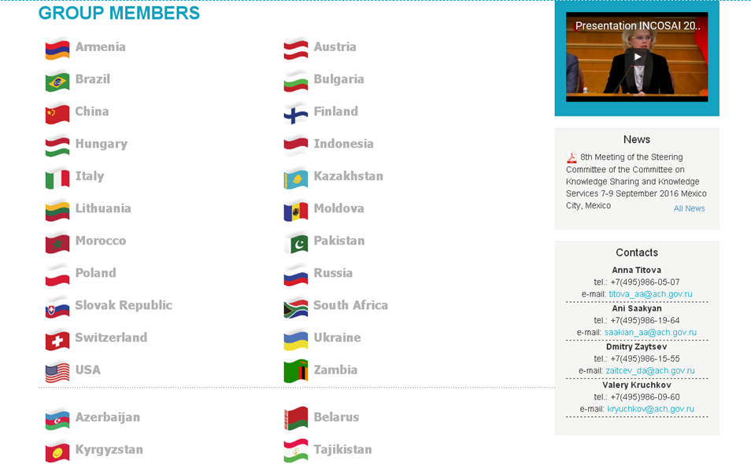
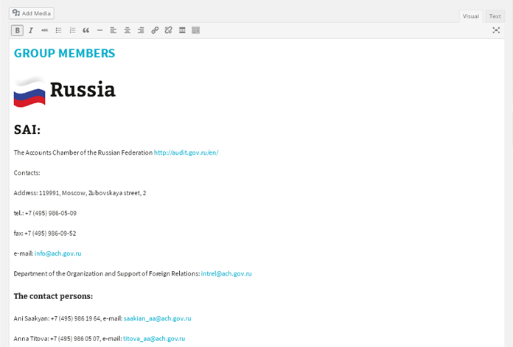
THE WORKING GROUP ACTIVITIES REPORT
Knowledge base on KNI – kniknowledgebase.org

Slide 8
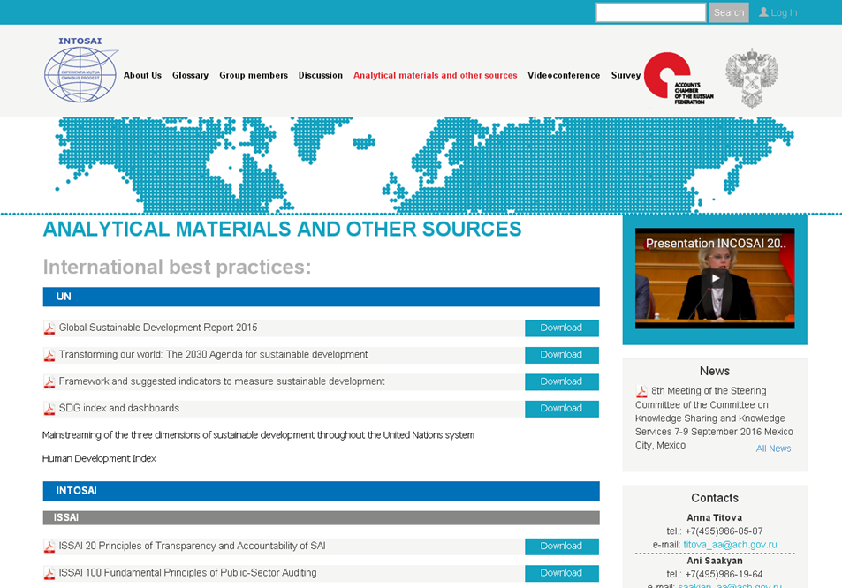
THE WORKING GROUP ACTIVITIES REPORT
Knowledge base on KNI – kniknowledgebase.org

Slide 9
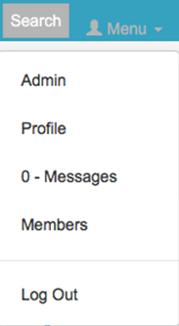
THE WORKING GROUP ACTIVITIES REPORT
Knowledge base on KNI – kniknowledgebase.org

Slide 10
THE WORKING GROUP ACTIVITIES REPORT
Knowledge base on KNI – kniknowledgebase.org

Slide 11
THE WORKING GROUP ACTIVITIES REPORT
9th meeting of the Expert group on KNI in Kyrgyzstan, May 2016
Knowledge base improvement
presentation of the guidance document ‘Key National Indicators: Guidance for Supreme Audit Institutions’
subproject on studying the issues of sustainable development in CIS member-states

Slide 12
THE WORKING GROUP ACTIVITIES REPORT
working plan for 2016 adopted
new Working group member – SAI of Brazil
10th Meeting of the Working Group on KNI to be held in Brazil in spring 2017

Slide 13
THE WORKING GROUP ACTIVITIES REPORT
Main directions of the Group’s activities in 2016-2017
presenting draft document “Key National Indicators: Guidance for Supreme Audit Institutions” at the 8th INTOSAI KSC Steering Committee Meeting and at XXII INCOSAI
Knowledge base development
new framework agreement between INTOSAI and OECD
starting a new subproject “ Key national indicator systems and public governance” (coordinator - SAI of Brazil)
starting the ISSAI development

Slide 14
THE WORKING GROUP ACTIVITIES REPORT
THANK YOU!

