Slide 1
Agenda item 22 Working Group on IT Audit
11th Meeting of KSC Steering Committee
Pampanga, Philippines
(12-14 June 2019)
SAI-India

Slide 2
WGITA –contribution to implementation of strategic objectives
WGITA Projects 2017-19
Projects in SDP which involve WGITA
Development of non-IFPP Documents
Work Plan 2020-22
Knowledge Dissemination Activities
Stakeholder Engagement
Collaboration

Slide 3
WGITA projects
WGITA Work Plan 2017-19 includes five projects:
General Capacity Requirements for SAIs for conducting IT Audit
Development of roadmap for future GUIDs in the 5100 series
Data Analytics (Area: IT Audit Techniques)
Updating the ISSAI 5300 on Information Systems audit and 5310 on Information Systems’ Security Audit including Cyber Security as GUIDs under IFPP
Documentation Requirements of an IT Audit including Audit Management System (Area: Audit process)
Project 5 has been re-scoped with Audit Management System Projects.
All Projects would be completed before the next INCOSAI in 2019
Project on updating ISSAIs 5300 and 5310 taken up under the SDP 2017-19 of IFPP will result in two GUIDS in 5100 series in new IFPP framework

Slide 4
Projects in SDP which involve WGITA
Priority 2 –
Guidance by 2019 to support ISSAI implementation
2.5 - Consolidated and improved guidance on understanding internal control in an audit
The project has now been shelved by PSC
2.8. - Consolidating and aligning guidance on IT audit with ISSAI 100
ISSAI 5300 as GUID 5100
ISSAI 5310 as GUID 5101

Slide 5
Non-IFPP documents
Two Non-IFPP documents being developed:
Guidance on Data analytics
Guideline for establishing IT audit capacity in a SAI environment.
Both these documents assigned QA Level 2.
Guidance on Data Analytics exposed in the INTOSAI Community Portal for Comments.
Guideline on IT capacity building is under consultation among the WGITA members and is likely to be exposed before June end.
Level 2 of Quality assurance for public goods
Subjected to extensive quality assurance process, such as piloting/testing/comments by/from stakeholders outside the working group responsible for development
Roadmap for development of future pronouncements/Guidance under GUID 5100 is already approved and posted in INTOSAI Community Portal.

Slide 6
Work Plan 2020-22
Name of project | QA Level
1. Cyber security/data protection challenges | 2
2. Audit of IT Management functions including IT Governance, Contract Management and Sustainability | 2
3. Performance Evaluation of IT systems | 2
4. Review of previous work done
5. Quarterly Webinars on IT Audit Topic
6. Maintenance of IT Audit Database in the WGITA Webpage
7. Development of Global Curriculum for IT Audit

Slide 7
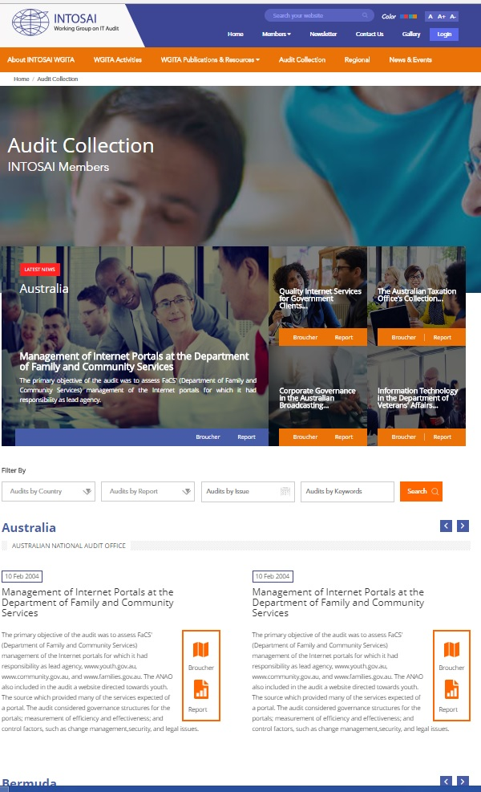
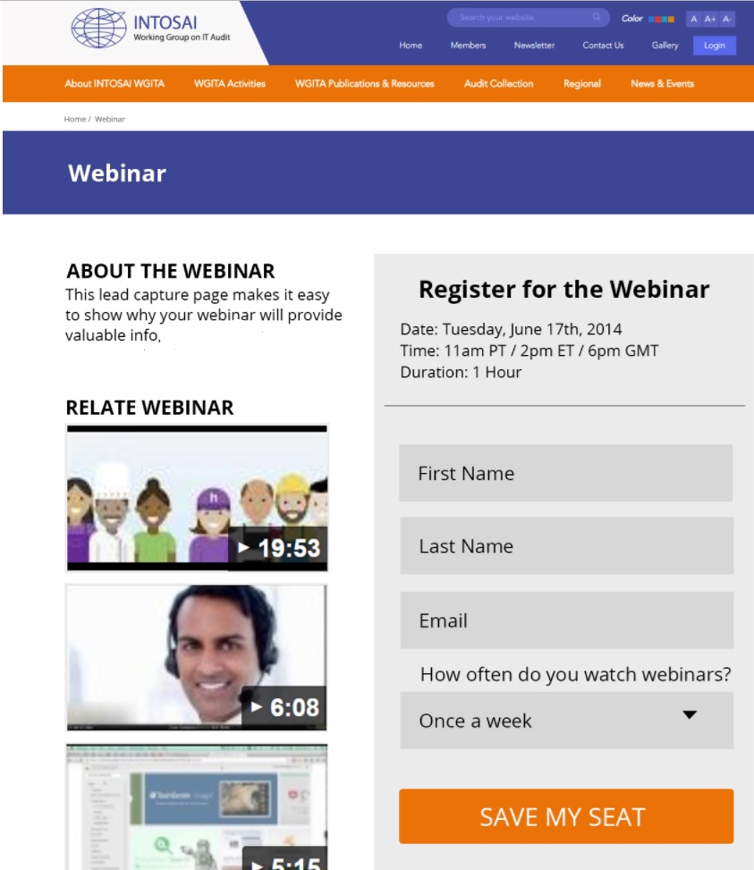
Dissemination and exchange of knowledge
Working Group webpage in the INTOSAI Community Portal is used as information interchange platform
(http://www.intosaicommunity.net/wgita/)
Project teams formed for maintenance of Audit Database and for Webinars
Intend to hold one Webinar every six months
WGITA in the 28th Annual meeting held in Fiji saw 3 country paper presentations.
26th and 27th meetings - 6 and 8 country papers respectively.
Triennial Performance Audit Seminar on “IT Security Audit” was held in conjunction with WGITA Seminar.
Two international Seminars on “Audit Management System” and ‘’Embedding data assurance to drive audit efficiency and quality” was held in 2017 and 2018.

Slide 8
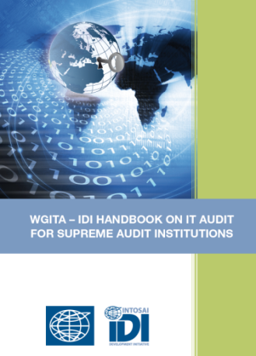
Stakeholder engagement for greater synergy
WGITA in collaboration with the INTOSAI Development Initiative (IDI) developed an IT Audit Handbook
Useful resource for entire INTOSAI community in conducting IT Audits and in building capacity
This handbook will undergo QA evaluation as per the IDI QA protocol and the contents are being updated
ISACA and AFROSAI-E observers of WGITA and involved in various projects of WGITA.
Guidance from a professional organization of International repute.
Enables WGITA to get Regional perspective
AFROSAI-E will be involved in five projects of WGITA in the next Work Plan.

Slide 9
Collaboration
WGITA member SAIs have shown active interest in using the real-time interaction features like video conferencing and webinars in the INTOSAI Community portal
Papers on topics of emerging interest like Cyber resilience, data protection and emerging risks presented during the Performance Audit Seminar triggered knowledge sharing between member SAIs
The WG is trying involve a broad set of member SAIs at different levels of maturity in IT implementation to be part of project groups

