Slide 1
THE INTOSAI WORKING GROUP ON KEY NATIONAL INDICATORS
THE WORKING GROUP ACTIVITIES REPORT (2014 – 2015)
The Secretariat of the INTOSAI Working Group on Key National Indicators
Washington, October 16, 2015

Slide 2
THE WORKING GROUP ACTIVITIES REPORT
The 8th meeting of the Working Group on KNI in Bulgaria (Sofia) in March 2015
the results of the subproject ‘Analysis of opportunities on the use of KNI for international comparisons in the context of sustainable development and recommendations’
a survey on the countries’ preparedness to use KNI systems in the SAIs' activities
preparation of the guidance document ‘Key National Indicators: Guidance for Supreme Audit Institutions’
the overhaul of the Knowledge base on KNI

Slide 3
THE WORKING GROUP ACTIVITIES REPORT
Countries’ preparedness to use KNI systems in the SAIs' activities
Countries participated in the survey (total - 17)

Slide 4
THE WORKING GROUP ACTIVITIES REPORT
Key National Indicators: Guidance for the Supreme Audit Institutions
Objectives:
to explain what KNI and the KNI system are;
to provide a framework for self-assessment of the countries preparedness to use KNI systems in the SAI`s activities and
to describe the role of SAIs in the development and use of KNI.
Content:
Part 1. Basic information
Part 2. Important aspects of the KNI system development and improvement
Part 3. Possible ways of the KNI use in SAI’s activity

Slide 5
THE WORKING GROUP ACTIVITIES REPORT
Knowledge base on KNI – kniknowledgebase.org
The new Knowledge base structure:
Glossary
Countries
Analytical materials and other sources
Videoconference
Discussions
Surveys

Slide 6
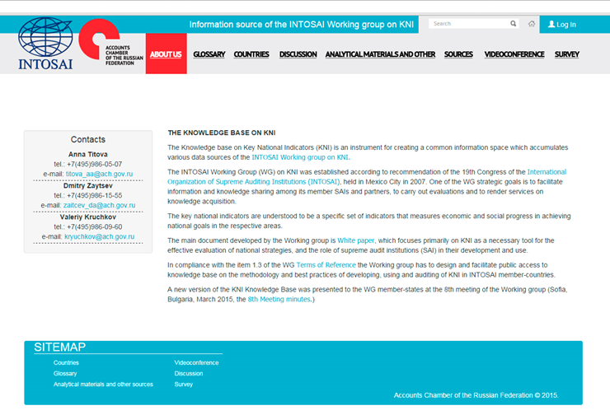
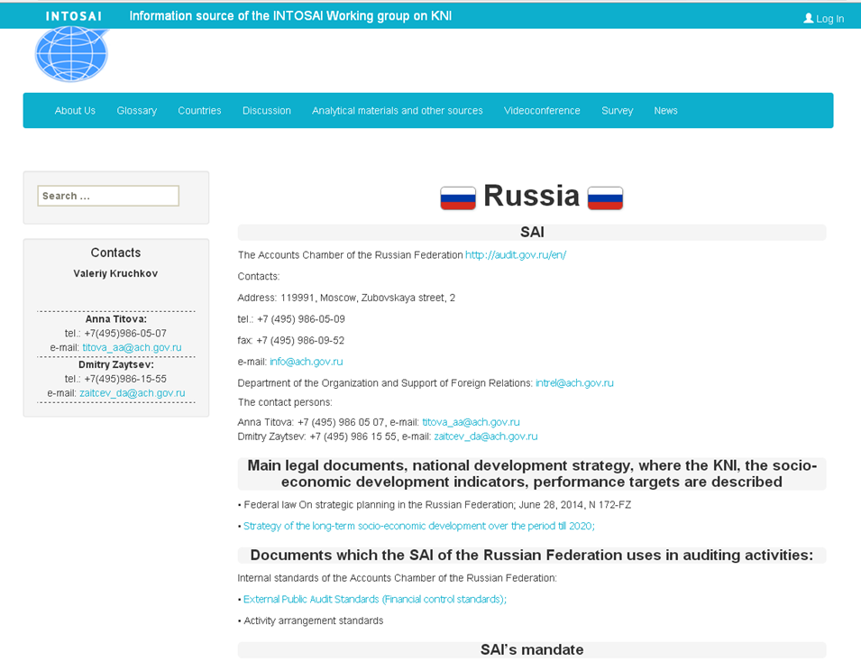
THE WORKING GROUP ACTIVITIES REPORT
Knowledge base on KNI – kniknowledgebase.org

Slide 7
THE WORKING GROUP ACTIVITIES REPORT
Cooperation with INTOSAI committees and departments
2nd EUROSAI-ASOSAI joined conference (Moscow, September 2014)
47th ASOSAI Governing Board Meeting (Moscow, September 2014)

Slide 8
THE WORKING GROUP ACTIVITIES REPORT
Working Plan for 2015 adopted
New Working Group member – SAI of Brazil
the 9th Meeting of the Working Group on KNI to be held in Armenia in spring 2016

Slide 9
THE WORKING GROUP ACTIVITIES REPORT
THANK YOU!

