Slide 1
INTOSAI Strategic Plan 2017-22 & Role of KSC
9th Meeting of KSC Steering Committee
Bali
(23-25 August 2017)
SAI-India

Slide 2
Strategic Objectives for Goal 3
Develop and maintain expertise in various fields of public-sector auditing and help to provide content to INTOSAI Framework for Professional Pronouncements
Enable wide exchange of knowledge and experience among INTOSAI members
Working with CBC, IDI, and other INTOSAI entities, facilitate continuous improvement of SAIs through knowledge sharing on crosscutting lessons learned from results of peer reviews and SAI PMF

Slide 3
Content for IFPP - Revision of ISSAI products
Four projects included in SDP of IFPP:
2.7: Consolidating and aligning guidance for audit of Privatization
2.8: Consolidating and aligning guidance on IT audit
2.9: Consolidating and aligning audit of public debt
2.10: Consolidating and aligning audit of disaster related aid
May result in revision of 18 ISSAIs/INTOSAI GOV

Slide 4
Content for IFPP - Preparation of new IFPP documents
Three Projects on development of IFPP documents now proposed for inclusion in SDP:
Jurisdictional SAIs (SAI Mexico)
Key National indicators (SAI Russia)
Public Procurement (SAI Russia)
KNI & Public Procurement Project proposal yet to approve by FIPP
May co-opt in Project on Guidance of Internal Controls led by PSC

Slide 5
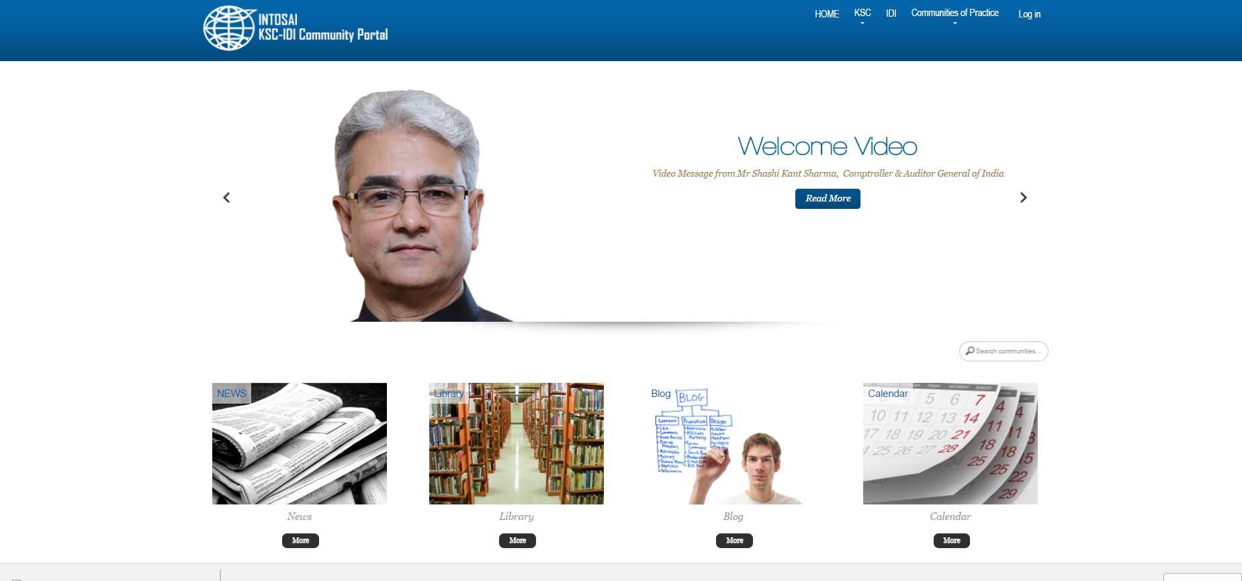
Exchange of Knowledge - INTOSAI Community Portal
Launched in November 2015
Technical support by IDI and operational support by SAI India
Most features accessible without registration
To be revamped to include features like multi-language support, portability across all mobile devices

Slide 6
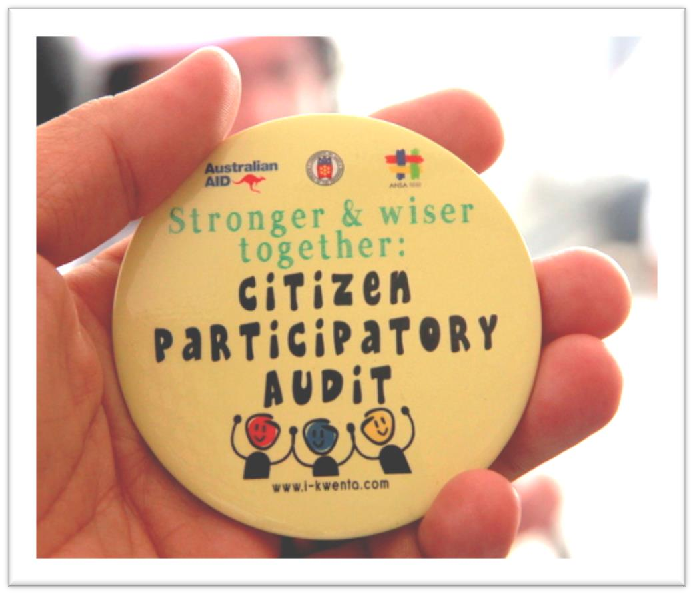
Exchange of Knowledge - Research projects on crosscutting issues
Topics chosen out of survey conducted in December 2015
Out of 30 SAIs responded, 21 in favour of conducting research projects
Big Data, Auditing Emergency Preparedness and Citizen Participation in Public Audit emerged as popular topics
‘Auditing emergency preparedness’ led by SAI Indonesia
‘Citizen participation in Public Audit’ led by SAI Guatemala with SAI Philippines as Vice Chair
Project Initiation underway
Big Data handled by Working Group on Big Data

Slide 7
Exchange of Knowledge - Collaboration with Academic Institutions and others
Proposal for collaboration with Nanjing Audit University, China
Proposal from Financial University, Moscow for collaboration being pursued
Engagement with stakeholders like IDI, PSC, CBC, FAC, Supervisory Committee on Emerging Issues and INTOSAI Secretariat
Suggestions – for cooperation

Slide 8
Facilitate continuous improvement
Crosscutting lessons learned from results of peer reviews and of SAI PMF assessment in collaboration with CBC and IDI
Talks with CBC to evolve a mechanism; three way consultation between chairs of Peer review and SAI PMF works streams, IDI SAI PMF unit being explored
Interaction of Goal chairs with all Regions a day before GB being explored

Slide 9
Comprehensive Capacity Development Program
Recognized as hub for INTOSAI’s efforts on Sustainable Development goals
IDI and KSC started a comprehensive capacity development program on auditing implementation of SDGs
Draft Guidance for Auditing Preparedness for Implementation of SDGs published
Next stage is a cooperative performance audit of preparedness for implementation of SDGs
Programme commenced in July 2017 and to end in 2019 with lessons learnt and Exit meeting

Slide 10
THANK YOU

Slide 11
Revision of ISSAIs
Project name | Existing material reviewed or included as sources | Number of docs.
2.7. Consolidating and aligning guidance for audits of Privatization with ISSAI 100 | ISSAI 5210, 5220, 5230, 5240 | 4
2.8. Consolidating and aligning guidance on IT-audit with ISSAI 100 | ISSAI 5300, 5310 | 2
2.9. Consolidating and aligning the audit of public debt with ISSAI 100. | ISSAI 5410, 5420, 5421, 5422, 5430, 5440 | 6
2.10. Consolidating and aligning the audit of disaster related aid with ISSAI 100. | ISSAI 5500, 5510, 5520, 5530, 5540 & INTOSAI GOV 9250 | 6

