Slide 1
Working Group on the Value and Benefits Chair´s Report
7th Meeting of the Steering Committee of the INTOSAI Committee on the Knowledge Sharing and Knowledge Services (Goal 3)
Washington, DC, United Sates of America
October 15 and 16, 2014

Slide 2
Membership
Working Group´s Membership
23 SAIs
Canada and India concluded their valuable participation

Slide 3
Collaboration
Collaborators | Stakeholders
UNDESA | OECD
IBP | GIZ
IADB | ACIJ
GIFT

Slide 4
SAI PMF Process – Where Are We?
Mandate from INCOSAI (2010)
1st round of consultations and pilots - SAI PMF v 2.0 (2012)
2nd pilot phase (2013-2015)
Development and approval of Endorsement Version (2015-2016)
SAI PMF Pilot Version endorsed by WGVBS (2013)
Endorsement at INCOSAI 2016
WGVBS endorsement of Concept Note, project plan (2012)
Consultations on Pilot Version (Dec 2014-March 2015)

Slide 5
SAI PMF Projects
SAI-PMF has been subject to pilot tests in diverse INTOSAI regions
To learn from the relevant SAIs’ experience
To calibrate the tool

Slide 6
Progress on SAI PMF Pilot phase 2
Target in Roll-out strategy: test SAI PMF Pilot version in about 20 SAIs with different characteristics
Target reached!

Slide 7
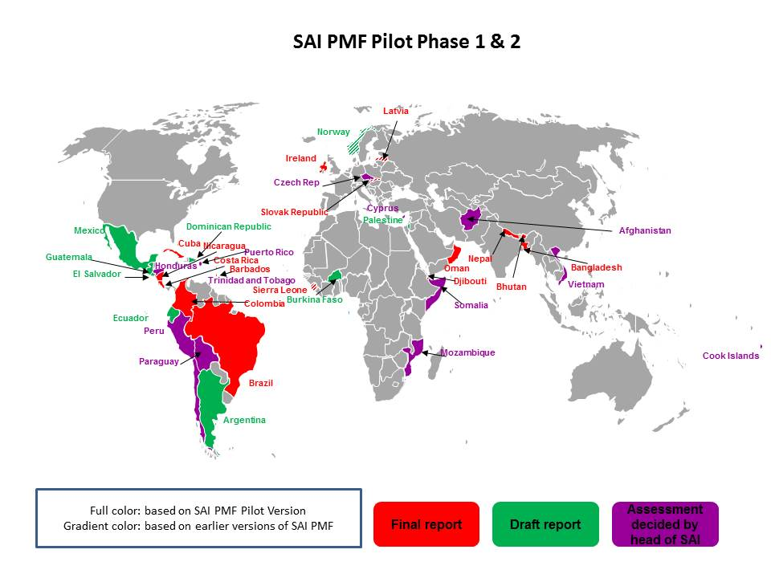
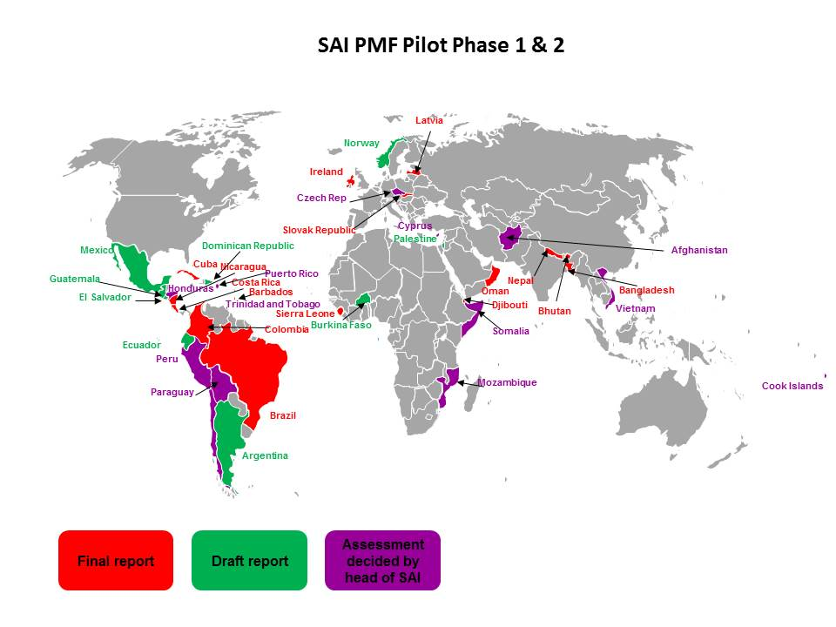
Map over regional distribution – thre different colors – finished, draft, decided

Slide 8
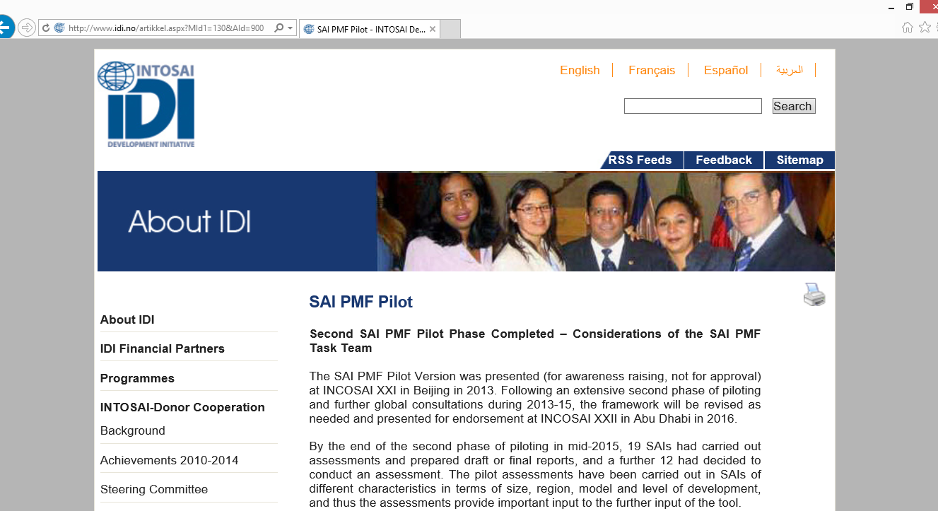
Extensive testing in a number of diverse environments
Analysis of the resulting indicator scores
To ensure the scoring system is properly calibrated
90-day consultation: December 19, 2014, until March 31, 2015

Slide 9
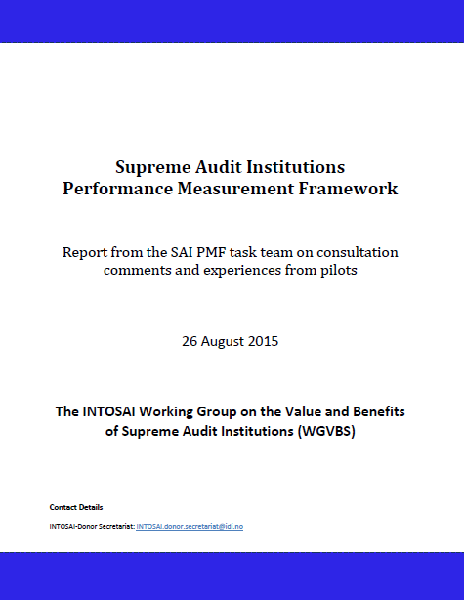
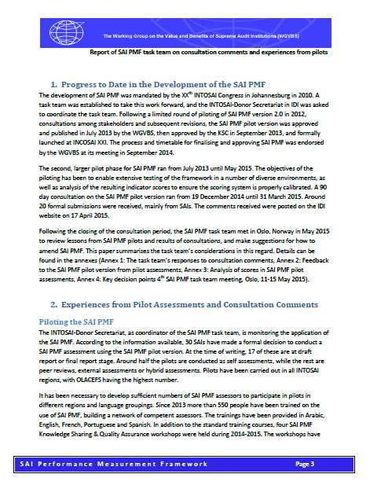
http://www.idi.no/

Slide 10
SAI PMF NEXT STEPS
Progress in line with the timetable
Suggested amendments to the timetable:
Test v 3.2 / changes in a limited no. of SAIs in Q1, 2016 – about 2 full pilots plus desk testing
Share v 3.2 with the WGVBS for comments in February 2016

Slide 11
SAI PMF Maintenance of SAI PMF post-2016
Ownership by INTOSAI committee important
Dedicated resources essential for
Training, Knowledge Sharing
Guidance and advice, Virtual Community
Quality Assurance
Maintenance of tool as circumstances change
INTOSAI-Donor Secretariat willing to continue providing such a support function – with less direct involvement in assessments

Slide 12
Guideline on Effective Practices of Cooperation Between SAIs, the Legislature, the Judiciary, and the Executive
Drafting of Guideline on Effective Practices of Cooperation between SAIs, the Legislature, the Judiciary, and the Executive
Second Draft should be available at the end of October,2015
2013
To be completed by the XXI INCOSAI in 2016

Slide 13
Forum on Jurisdictional SAIs Network of General Prosecutors
Proposal made in 2014 by the SAI of Chile and France
Space for reflection, collaboration and exchange of good practices particularly for jurisdictional SAIs
Approved in 2014 by the KSC SC & INTOSAI Governing Board (66th meeting)
To demonstrate the value and benefits of SAIs with this institutional model

Slide 14
Forum on Jurisdictional SAIs Network of General Prosecutors
“Forum of Jurisdictional SAIs Network of General Prosecutors”
Development of a tool to assess the performance and value of jurisdictional SAIs.
Entities Participating:
- Brazil
- Chile
-France
-Italy
-Morocco
-Peru
-Portugal
-Spain
-Tunisia
-Turkey

Slide 15
Task Team focused on ISSAI 12 implementation
Exchange knowledge and experiences
Contribute to make a difference to the lives of citizens
1) Identify the main principles which are most challenging to apply in SAIs
2) Detect good practices and lessons learned

Slide 16
Task Team focused on ISSAI 12 implementation
KSC Steering Committee
WGVBS members (INTOSAI sample)
Reliable analysis

Slide 17
WGVBS Mandate
Established
To develop
Value and Benefits of SAIs
framework & measurement tools for defining:
Working Group on the Value and Benefits of SAIs

Slide 18
WGVBS Mandate
Instruments and tools for communicating and promoting the value and benefits of SAIs
Impact of auditing services
A difference in the lives of citizens
STAKEHOLDERS
2010

Slide 19
WGVBS Recent Topics
The importance for SAIs to identify and manage their own risks and those of the public sector
(2) its own internal functioning risks
(1) key national risks
Mexico
US GAO
Mexico
China

Slide 20
Value and Benefits of INTOSAI Tools
Promotion and Communication of the value and benefits of INTOSAI tools
SAIs’ Information Database
Self-Assessment of Integrity (IntoSAINT)
Collaboration Tool
INTOSAI Online Glossary
Experts Database
SAI Capacity Development Database
Extended mandate

Slide 21
WGVBS 2015 meeting
27 delegates representing
12 SAIs
Austria | Germany | Peru
Cameroon | Iraq | South Africa
China | Mexico | Tanzania
France | Namibia | USA
Nanjing, People’s Republic of China
September 14 to 16, 2015

Slide 22
2016
Activities to be conducted in 2016
Presentation of relevant deliverables before the XXII INCOSAI
Communication with the KSC Chair
Updating of the INTOSAI Strategic Plan for the period 2017-2022
To effectively promote and communicate the value and benefit of SAIs

Slide 23
WGVBS Chair’s Report
Request presented before the members of the KSC Steering Committee:
1. To take note of the Working Group’s annual report
2. To endorse the SAI PMF Task Team’s recommendations, including suggested amendments to the timetable for finalizing and approving. To take note on the considerations shared by the Task Team for the maintenance of SAI PMF after 2016.

Slide 24
WGVBS Chair’s Report
Request presented before the members of the KSC Steering Committee:
3. To draw the attention of INTOSAI to the issue of citizen participation, acknowledging the relevance that it has gained and the challenges and risks that it entails
4. INTOSAI should be aware on the need to assess the quality of information of its different databases and tools, as well as the usability of them

Slide 25
WGVBS Chair’s Report
7th Meeting of the Steering Committee of the INTOSAI Committee on the Knowledge Sharing and Knowledge Services (Goal 3)
Washington, DC, United Sates of America
October 15 and 16, 2014
Thank you!

