Slide 1
WORKING GROUP ON AUDIT OF EXTRACTIVE INDUSTRIES
THREE YEAR PROGRESS REPORT: 2013-2016
Presentation at the 8th Meeting of the Steering Committee of KSC 7th-9th September, 2016 Mexico City, Mexico
By
John F.S. Muwanga
Auditor General, Uganda
Chair WGEI
Presented by Keto Nyapendi Kayemba
Assistant Auditor General

Slide 2
Presentation outline
Background of WGEI
Outcomes of Annual meetings
Progress in the three years
Future Opportunities
Conclusion & recommendation to Goal 3 Chair

Slide 3
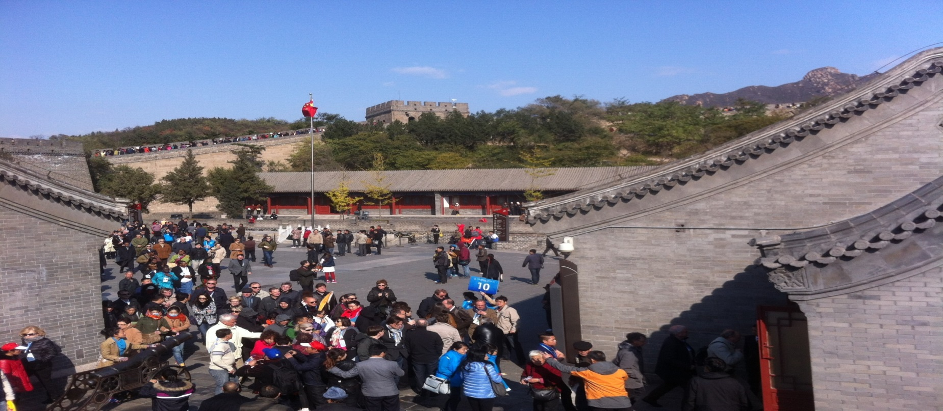
INCEPTION
Objective of WGEI by Beijing, China, 2013, XXI INCOSAI
Under KSC

Slide 4
Inception cont.
Scope: defined as Oil, gas and solid minerals.
Objective: Promote audit of EI
With an intention of promoting good governance and sustainable development

Slide 5
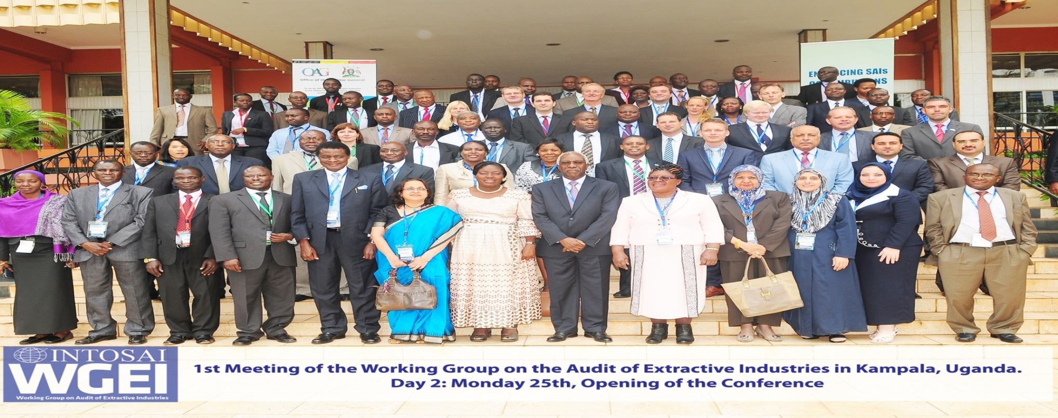
2014: 1ST YEAR
Inaugural annual meeting held in Kampala.
Set up and anchoring working group,
Key operational documents,
Set up operations in SAI Uganda

Slide 6
2015: 2nd Year
Exposed WGEI members to priority areas of EI
Developed new networks with non SAI EI stakeholders.
Annual meeting held in Oslo, Norway
Notes:
The 1st meeting of WGEI:
The 1st WGEI members meeting was hosted by SAI Uganda in Kampala during the period 25-27 August 2014 under the theme: “Enhancing Supreme Audit Institutions (SAI) contribution in the Governance of Extractive Industries”.
The key deliverables registered in the 1st Meeting were:
Approval of the created secretariat within SAI Uganda to support the WGEI chair.
Approved group’s Terms of Reference (TOR).
Approved group’s Activity plan for a three year period spanning 2014-2016.
Approved WGEI steering committee comprising five SAIs (Brazil, Norway, Iraq, South Africa and Uganda).
Approved working group website: www.wgei.org.
Approved WGEI Logo
Agreed to hold the next meeting of WGEI in August/September 2015 at a venue yet to be volunteered by a willing SAI.
Twelve (12) SAIs from the following SAI regional groupings had opportunity to share their experiences and initiatives: EUROSAI, AFROSAI, OLACEFS, ASOSAI, and ARABOSAI.

Slide 7
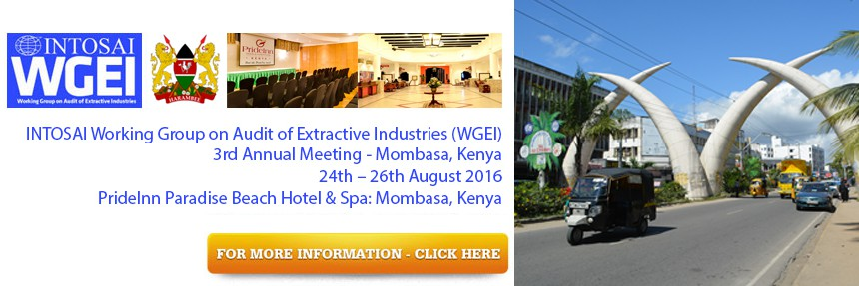
2016: 3rd year
Consolidating and expanding networks
Consolidating the understanding of the key role of SAI’s and stakeholders in EI
Developing guidance material in the industry

Slide 8
Target for 1st three years:
A functioning EI working group
Operational Community of Practice
Creation of forum for peer interchange and knowledge sharing
Improved understanding of the extractive industries among SAIs
Access to resources
Improved audit coverage
Increased awareness
Most have been met

Slide 9
Three year progress of WGEI
Steady increase in membership 36 now which is half of the biggest INTOSAI Working group i.e. 76
Fully operational Secretariat
Operational steering committee comprising five SAIs: Uganda, Norway, South Africa, Iraq and USA
Established a platform for sharing knowledge, best practices and guidance – Website.
More quality audits are now being undertaken - 56

Slide 10
Three year progress cont
Increased awareness and recognition of the role of SAIs in the Industry
Willingness to support SAI initiative in extractives area by various stakeholders.
Better understanding and knowledge of EI by SAIs
Improved ability of SAIs to undertake audits in the Industry
SAIs supporting themselves
Benchmarking between SAIs

Slide 11
FUTURE OPPORTUNITIES
The working group members in their 3rd Annual meeting 2016 unanimously endorsed its continued operation
WGEI designated and will initiate extractive industry trainings in iCED and similar institutions
Increasing interest by the INTOSAI regional groupings to use materials developed by WGEI
Willingness of other stakeholders to partner with SAIs in EI
Growing interest in collaborative audits

Slide 12
On going initiatives
Development of guidelines under leadership of GAO:
SAI USA - General EI audit guideline;
CCAF - EI performance audit guideline,
SAI Uganda and Norway - guidelines in Production Sharing Agreements audit.

Slide 13
SAIs need a continuation of WGEI to enable them build on in-rods made in:
understanding audits of EI
acquiring knowledge and skills in audits of EI
Continuing collaborative audits.
WGEI recommend the continuation of the WG to KSC and ultimately to INCOSAI.
Conclusion

