Slide 1
KSC Revised ToR
9th Meeting of KSC Steering Committee
Bali
(23-25 August 2017)
SAI-India

Slide 2
Background
KSC current ToR formulated in line with
INTOSAI Strategic Plan 2005-10
Handbook of committees
Old Due Process

Slide 3
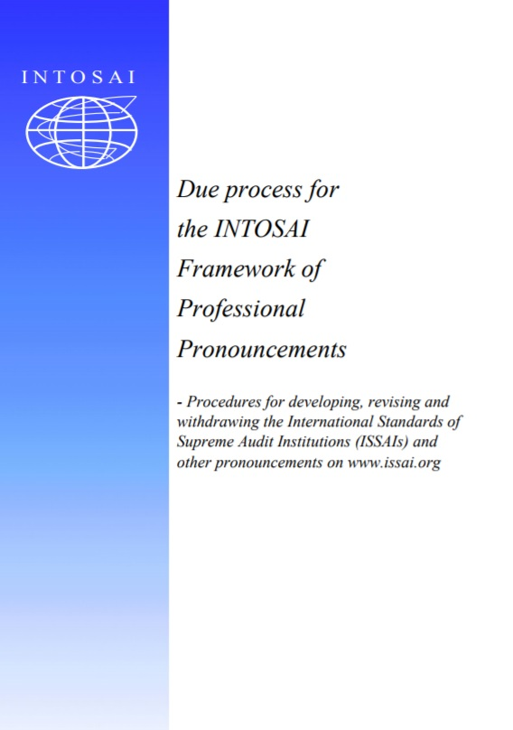
Necessity for Revision
New priorities in INTOSAI Strategic Plan 2017-22
Formation of FIPP and approval powers to FIPP
Added responsibilities of Chair, Steering Committee and Chairs of WG in new due Process of IFPP
Focus on performance reporting in new Strategic Plan

Slide 4
Salient Features Role of Steering Committee
Monitors progress made by WG/PG
Provides Strategic Directions
Defines Performance Measurement Framework/ Reporting template
Decides about use of INTOSAI Funds
Approves cooperation arrangements with academic/research institutions

Slide 5
Salient Features – Role of Chair
Coordinates activities of KSC, WG/PG
Monitor implementation of work plan of WG/PG and projects under SDP
Carry out Performance assessment of WG
Certify Quality assurance of INTOSAI goods produced outside Due Process
Maintains INTOSAI Community Portal
Refer drafts to FIPP at all three stages of development
Maintains pronouncements developed by dissolved working groups
INDIAN AUDIT AND ACCOUNTS DEPARTMENT
भारतीय लेखा एव लेखा परीक्षा विभाग

Slide 6
Salient Features Role of Chair of WG/TF/PG
Responsible for development of guidance and best practice studies
Provide assurance on quality of Non-IFPP Documents
Responsible for WG/TF/PG and their work
Initiate proposals for development/ revisions of pronouncements
Ensure quality processes for approved project proposal (IFPP Documents)

Slide 7
Additional Provisions
New category called “Partners” and “Adhoc groups” added to accommodate academic and research institutions, Regions and Project Teams
References to Goal Liaison removed
Explicit mention that only members have a right to vote in Steering Committee Meetings
Provision to ensure regular presence at Steering Committee meetings

Slide 8
THANK YOU

