Slide 1
KSC-IDI Community Portal
9th Meeting of KSC Steering Committee
Bali
(23-25 August 2017)
SAI-India

Slide 2
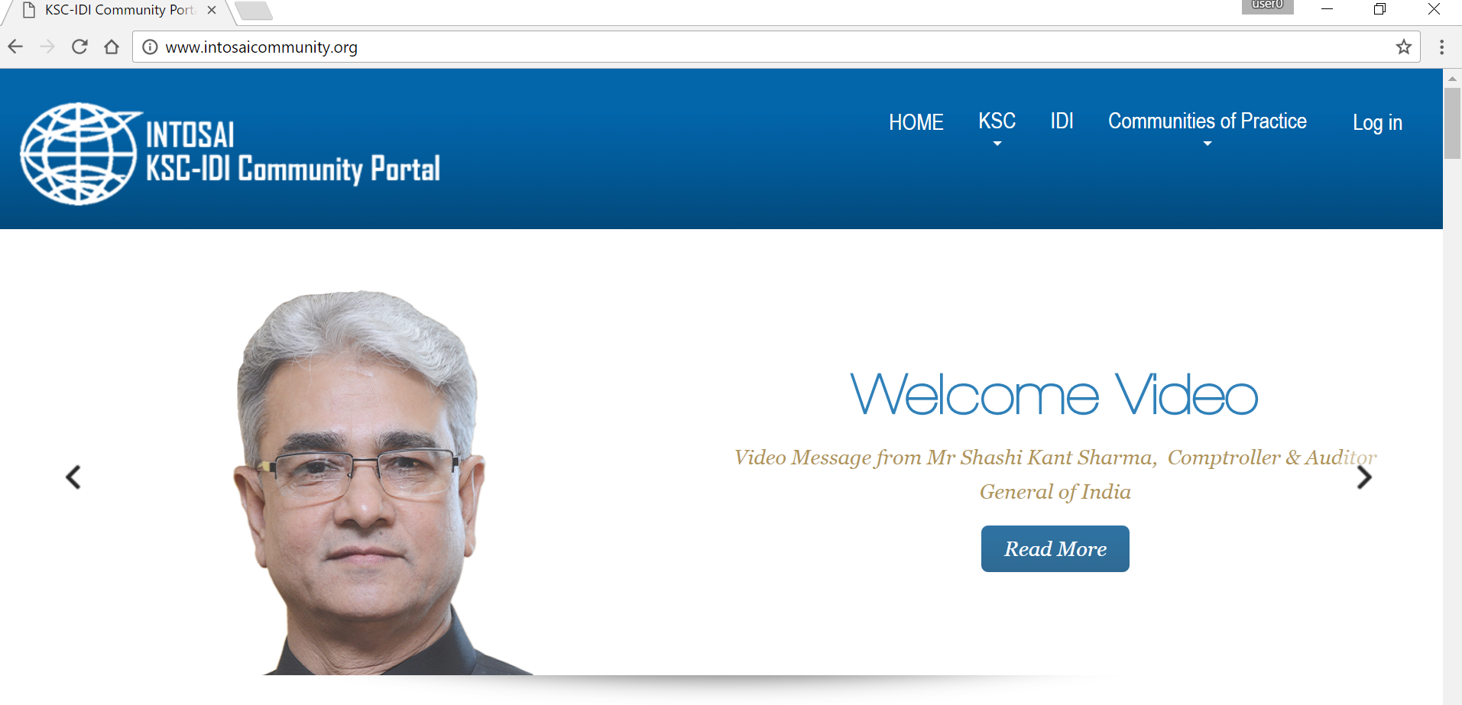
Background
KSC and IDI jointly developed INTOSAI Community Portal (www.intosaicommunity.org)
Launched in November 2015
Technical infrastructure and support by IDI
SAI-India to provide operational support
Replaced INTOSAI Collaboration Tool

Slide 3
IDI-KSC Knowledge Sharing Portal
Has interactive features and facilities to enable better communication and sharing of ideas
Hosting several Communities of Practice (seven) and facilitating Virtual meetings of various groups
Features like Library, blogs, Chats, virtual meeting, Polls/Survey, News

Slide 4
Revamping of Knowledge Sharing Portal
One common platform for resources - KSC Website and Community Portal merged
Single window access for information
Individual pages to all working groups-Distributed credentials
More auditor centric, interactive, ease of access and use
More sophisticated, professional looking website to enhance visitors experience

Slide 5
Additional features
Multilingual support – All INTOSAI languages
Portability across all devices
In built video conference facility and recording of such virtual meetings
Conduct or answer polls and surveys
Availability of Forms – Registration forms etc.
Multiple Chat forums
Advanced search

Slide 6
Administration of Portal
Overall Administration/maintenance by KSC secretariat
Working Groups allotted separate pages with 3-4 templates enabling adding of additional features/menus
Working Groups provided autonomy for maintaining pages assigned to them
All static pages translated in all five languages
IDI responsible for outreach support
Expected to be ready by this year end

Slide 7
Advantages
Single window access for information pertaining to KSC and all working groups
Providing independent websites to all WGs. (4 WGs yet to have Websites)
Saves cost to WGs for hosting websites
Added features
Access to many features without registration

Slide 8
Discussion issues
Suggestions for new features in the Web portal
Problems faced in current KSC-IDI Portal
Migration from existing websites to new portal
How to make website more Auditor Centric?
Assigning personnel for content management
Mechanism of cooperation for translation of pages

Slide 9
THANK YOU

